Slide 1
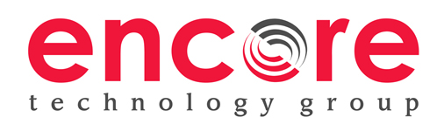
Microsoft Hybrid Cloud Solutions Overview
Michael J. Knight – CTO
Notes:
This is the introduction slide.
Welcome to overview presentation on System Center 2012 R2. We’re excited about continuing to deliver against our Cloud OS vision with some of the cool capabilities that I will walk you through over the next hour.

Slide 2


Agenda
Review Microsoft Hybrid Solutions
Virtualization and Data
  Windows Server / System Center 2012 R2
  Azure / InTune
  SQL 2014
Communications and Collaboration
  Exchange / Lync 2013
  Sharepoint / Yammer 2013
  Office 365

Slide 3
Encore Technology Group - Company Details
Originally founded in 1989 (25 Year History) / ~100 Employees
Focus on providing solutions and services for Public Sector
  Current customer size ranges from 25 to 2,000,000 Users
Technology Solutions:
Borderless Networks
Datacenter and Enterprise Systems
Unified Communications
Physical Security / Digital Signage / Interactive Technologies
Cloud and Consultancy:
Cloud Services (as a Service)
Consulting Services / Assessments
Managed/Support Services
Software Solutions: Identity Lifecycle Management and
Federated Security Suite (ILM/FSS)

Slide 4
Encore Professional Services
VAR Business:
Borderless Networks
Datacenter and Enterprise Systems
Unified Communications
Physical Security / Digital Signage
Interactive Technologies
Cloud and Consultancy:
Cloud Services (as a Service)
Consulting Services
Assessments
Managed/Support Services

Slide 5
ENCORE TECHNOLOGY GROUP
Rethink Technology!
What is Cloud?
A methodology to access resources that are distributed but accessible both singularly and/or in a dispersed methodology from multiple, geographically diverse locations using a common connectivity medium (LAN, WAN, Internet).
2015 - Encore Technology Group, LLC. - All rights reserved.
http://www.encoretg.com

Slide 6




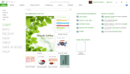
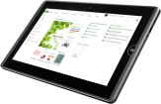
Trends impacting the way we work
Devices
People
Cloud
1 billion
For the first time in modern history, workplace demographics now span
50%
smartphones, 4 years ahead of predictions
3 generations
of enterprise customers
are “on the road” to cloud in some form
Notes:
1.2 Billion Smartphones, Tablets To Be Bought Worldwide In 2013; 821 Million This Year: 70% Of Total Device Sales
http://techcrunch.com/2012/11/06/gartner-1-2-billion-smartphones-tablets-to-be-bought-worldwide-in-2013-821-million-this-year-70-of-total-device-sales/

Slide 7
ENCORE TECHNOLOGY GROUP
Rethink Technology!
What do these trends cause?
Hyper-connectivity: All resources should be, always-on, always-accessible, secure and fast.
2015 - Encore Technology Group, LLC. - All rights reserved.
http://www.encoretg.com

Slide 8
Microsoft – Public Clouds built on Microsoft Technologies
Windows Server
Windows Azure
Notes:
These consistent capabilities make the Cloud OS unique. So does the fact that the Cloud OS is deeply informed by our first-hand experience running 200+ cloud services for 1+billion customers and 20+ million businesses around the world.
Ultimately a firm can only truly deliver this type of innovation if it has the track record and direct experience in building and running large datacenters and online services. Of course at Microsoft, we have an unrivaled experience in doing just that, across services such as Office 365, Xbox Live, Bing and a host of other major online services including our cloud platform, Windows Azure. We have learned and proven how to drive down cost through a combination of software, hardware innovation and extreme automation. We also learned how to maintain efficient, high availability services on industry standard hardware.
And this innovation and know-how from running these online services provides us a unique perspective on the challenges our customers face. This learning makes its way into the software we sell such as Windows Server and System Center, creating a virtuous cycle that enables us to provide market-leading capabilities for our customers. Our breadth of experience across private, public and hybrid cloud is unmatched, whereas other vendors tend to specialize in one or another area.
We run over 200 online services to hundreds of millions of people globally 24/7 such as MSN, Bing, Outlook.com, and Office 365. We consume data from those datacenters to drive rich analytics to improve customer experience. And of course our work with Windows Azure creates a virtuous cycle that brings even more of this feedback into our Windows Server development process.
Bing had already deployed Windows Server 2012 even before RTM. It has been powering all of the Bing searches since the RC release earlier this year, handling over 5.5 billion search queries each month. Windows Server 2012 is battle tested. And this is extended with Office 365 and its use of Active Directory and Xbox Live with its use of the virtual GPU in Windows Server. These services and more are consuming services from Windows Server and in turn providing a unique feedback loop that makes Windows Server more capable.
Only Microsoft can say this.
Optional factoids:
Windows Azure is available in 89 countries around the world.
5.5 billion+ Bing queries monthly
350 million active Hotmail accounts
40 million XBOX Live users
200+ global, 24x7, online services
135k Dynamics CRM users

Slide 9
Bringing Massively Scalable Cloud Features to Customer Environments
Windows Server
High performance
storage on industry-
standard hardware.
Highly available, file-based storage.
Storage spaces with automatic tiering.
Shared VHDX guest clustering.
Multi-tenant environments
with isolation.
Resource metering.
High-density web sites and VMs.
Software-defined networking.
Hyper-V network virtualization with
multi-tenant, site-to-site gateway network QoS.
Policy based automation.
Cluster aware updates
Dynamic optimization.
Application
and web.
NUMA-aware scalability.
Support for open standards and
multiple languages.
Windows Azure
And many others….
Notes:
These are but illustrative examples (there’s a lot more) of how we’ve implemented our core learnings from operating large scale cloud services as capabilities/features within Windows Server so you can also benefit from the resulting agility and cost benefits. We’re committed to this approach as we continue the journey towards realizing our Cloud OS vision.
1. High performance storage on industry-standard hardware
File & storage services – Microsoft’s large scale cloud services implement hot-hot nodes in many cases so the application services can seamlessly failover in case of node failures. Analogously, Active-On technologies in Windows Server 2012 are those capabilities than can survive the failure of a key component without disrupting the service provided - for example, the File and Storage Services server role can be deployed in an active-active cluster which can endure the failure of a server while maintaining connectivity for clients. Even open file handles are maintained.
Offloaded data transfer – This feature came about by applying a key design principle that Windows Azure uses to Windows Server 2012, which is to push work to hardware as much as possible so CPU cycles can be optimally leveraged for the hosted application.
Storage spaces - We routinely provision commodity hardware in our pods thereby making hardware failure a non-event; we wanted to provide enterprise customers with the ability to easily and flexibly provision inexpensive storage. Windows Server 2012 enables you to use file servers for even critical workloads like Hyper-V server and SQL with arguably similar reliability and performance characteristics as more expensive storage (e.g. SAN).
2. Multi-tenant environments with isolation
Server core - Small footprint with server core so you do not have to worry about updating or fixing unnecessary code, meaning less churning or required reboots for the host. This is similar to how we designed the Windows Azure hypervisor where we’ve only retained (and optimized) critical code paths that are applicable to large scale cloud scenarios.
Hyper-V Network Virtualization - Windows Azure was designed from the ground up to be multi-tenant environment with isolation given that it hosts apps and infrastructure that belongs to different customers. Over time, it became increasingly evident that this same requirement would be pertinent to enterprises implementing cloud infrastructure (albeit at smaller scale) given the need to distinguish between infrastructure allocated to different departments, integrating infrastructure from acquisitions, assigning costs etc. We then built the ability to isolate networks logically in multi-tenant enterprise environments with Hyper-V using similar architectural considerations.
Web-sites & virtual machines - These are great examples of how we’ve bought consistent experiences and cloud-optimized services from Windows Azure to Windows Server and System Center environments.
3. Software-defined Networking
Hyper-V Network Virtualization - The network virtualization features within Windows Azure and Windows Server enable customers to easily extend their on-premises datacenters into third party datacenters (e.g. Windows Azure or service providers) by allowing for flexible placement of VMs along with the ability to continue using the same IP address.
Cross-premises connectivity- The cross-site connectivity capabilities offered by Windows Server 2012 and Windows Azure (Windows Azure Virtual Network) complement each other well for VPN-like scenarios.
Network QoS – Windows Server 2012 provides the ability to programmatically adhere to a given SLA by guaranteeing minimum bandwidth available to a VM or a port. We’re assessing how to implement this in Windows Azure (albeit at a much larger scale) to shift from “best effort” to quality of service guarantees, thus providing an example of this bi-directional virtuous learning between our platforms.
4. Policy based Automation
Cluster aware updates (CAU) – Windows Server 2012 lowers downtime by coordinating software updates on all servers in a failover cluster while maintaining continuous availability as appropriate. For example, in case of applications with continuous availability features such as Hyper-V with live migration, or an SMB 3.0 file server with SMB Transparent Failover, CAU can coordinate automated cluster updating with no impact on service availability. This is very similar to Windows Azure which offers the ability to maintain high availability for its cloud services (e.g. web role/worker role) and virtual machines through Upgrade Domains (UD) and Availability sets.
Dynamic optimization – System Center 2012 - Virtual Machine Manager provides the ability to load balances the resources within a host cluster automatically using a policy based approach (e.g. move workloads VMs between hosts based on defined CPU, memory, or I/O thresholds). Such policy based automation is implemented by the Windows Azure Fabric Controller too using various load balancing approaches.
5. Application elasticity
Service templates – Similar to how an application owner (or developer) can specify application instance counts and scale thresholds in Windows Azure, service templates in System Center enable application owners to specify similar parameters that enable scaling the application once relevant thresholds are reached.

Slide 10
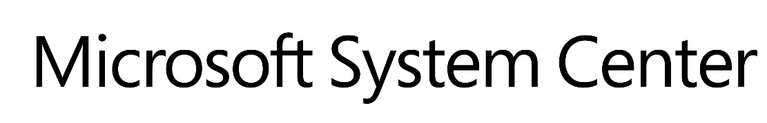
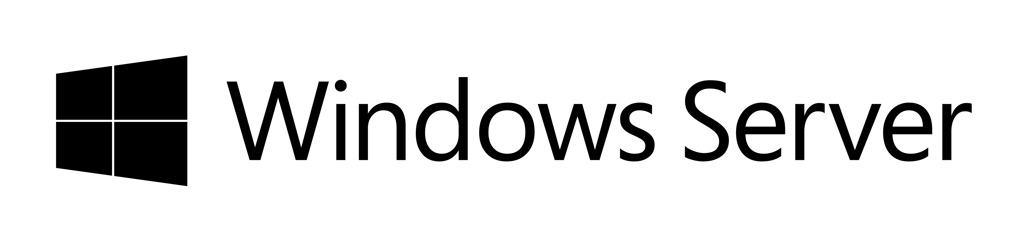
Customer challenges and opportunities
Opportunities:
Lower infrastructure costs and OPEX savings from increased operational efficiencies
Support for modern,
self-service applications
and automation of repeatable tasks
High level of cross-platform interoperability
Customer
challenges:
Flat or shrinking IT budgets even as
business expectations increase
“Keeping the lights on” mandate reduces agility
to address app owners’ needs
Complexities due to diverse
datacenter infrastructure
Efficient datacenter operations
across entire customer base
Need to offer differentiated services to customers
Notes:
One of the key things that all of us have got to do and some of our core responsibilities, most of you in this room are responsible for infrastructure in your organizations and you have a service level, you've got budgets, and the demands that are being asked of you are continually escalating, they're going up. Your budgets usually are staying about the same. But you're being asked to deliver this elastic, always-available, highly scalable fabric across all your customers' needs.
If you are an ITPro in an enterprise, you are really trying to get ahead of some of the mundane tasks that are simply keeping the lights on in your datacenter, and instead focus on impactful projects that can help your organization achieve a substantial competitive advantage in the market, while being a great partner to your applications owners.
If you are an ITPro in a service provider organization, you are likely mostly concerned about how to differentiate your offerings so you can better compete with the Googles and Amazons of the world. Being able to quickly offer new, value-add application services while keeping laser focus on your costs will make your business more successful.
Whether you are a professional services provider company or providing professional IT services within your company, there are a few things that you will want to expect from a modern datacenter and cloud solution; you want to be able to:
- Lower infrastructure cost and increase operational efficiencies
- Automate repeatable tasks to focus on strategic projects
- Benefit from a high level of cross-platform interoperability
- Build and deploy modern, self-service and highly available applications that can span datacenters
10

Slide 11
Hybrid cloud solutions with Windows Server 2012 R2 and System Center 2012 R2
Windows Server and System Center overview
Cloud and datacenter infrastructure
Enterprise-class multitenant infrastructure for hybrid environments
Business continuity
Protection and recovery of assets across datacenters
Service delivery
Standardized services and reliable SLAs on top of shared infrastructure
Application management
Build, scale, and run apps with deep insight on-premises and in the cloud
Flexible service delivery
Notes:
Consistent with the notion of the Cloud OS, Microsoft’s vision for a cloud, application and data platform that spans on-premises, service provider clouds and the Windows Azure public cloud, Windows Server 2012 R2 and System Center 2012 R2 in concert offer four solutions that enable a hybrid cloud environment:
Cloud and datacenter infrastructure
Business continuity
Service delivery
Application management
Let’s take a closer look at all four hybrid cloud solutions offered by Windows Server 2012 R2 and System Center 2012 R2:
Cloud and datacenter infrastructure:
Let’s start with the foundation for any modern datacenter: infrastructure. With Windows Server 2012 R2 and System Center 2012 R2, Microsoft has engineered an infrastructure and management platform that’s designed for the cloud from the ground up. We’ve gone far beyond basic server virtualization. With the Cloud OS, datacenter virtualization is pervasive. Networks are no longer managed with separate and cumbersome hardware management tools. Now they exist primarily at the software-layer and can be fully managed using the same unified tool kit with which IT professionals manage the rest of your datacenter services.
We’ve integrated features from Windows Server and System Center that manage every aspect of your datacenter beginning with hardware configuration, monitoring, and performance management, extending across our virtual server and networking layers, and also reaching into the cloud. These tools deliver broad automation and workflows and provide a flexible and agile datacenter management experience.
Finally, we can’t stress enough the seamless integration with Windows Azure that presents a whole new landscape of hybrid cloud possibilities. That’s the end-goal of the Cloud OS: an end-to-end datacenter and service delivery model that seamlessly spans any cloud architecture to build the right hybrid architecture that suits your particular business needs. Use the cloud as a direct extension of your datacenter, with unlimited resources and uptime for your IT staff, and a completely transparent experience for your users.
Business continuity:
Using the Cloud OS as the vision, you now have a roadmap for transforming the way your infrastructure is architected, the way your datacenter is managed, and the way your enterprise users or service provider customers do their work. But these new abilities must be carefully managed to ensure service reliability and data protection. You need to be able to deliver reliable SLAs to your application owners. Windows Server 2012 R2 and System Center 2012 R2 contain a series of features that work in conjunction to give you rock solid, enterprise class business continuity.
At the virtual infrastructure level Hyper-V now has more ways to respond immediately to new business needs as well as sudden application problems or outages. These span cloud boundaries but still respect tenant-level separation. We’ve added the ability to provide increased, application-level uptime and to manage storage quota online, to a running VM. We have made Hyper-V Replica multi-node aware and easier to configure with variable replication frequencies. And we’ve implemented a backup and recovery stack that secures everything from your data to your infrastructure, and does it on-premises, at datacenters in other locations, and in the cloud.
Service delivery:
Windows Server 2012 R2 and System Center 2012 R2 deliver resources and applications as services. Microsoft has included new capabilities in these releases that span this entire process from application development through service provisioning and delivery; resources can be included in services that are easier than ever for your IT staff to build and maintain. Provisioning and service requests are more sophisticated in functionality but with a simplified experience. You can now define application and resource usage as policy-based services that are easily created using custom templates, and can be easily requested by users via a template-based self-service portal. Flexible tenant offer administration provides service plan authoring capabilities that allow service providers to easily create and customize service capabilities and quota for their tenant subscriptions. And the monitoring and consumption of resources can be controlled via usage metering and chargeback at the tenant level.
Application management:
But as always, the end result of service delivery is delivering that crucial application your users need to do their work and move your business forward. To let you achieve the best user experience possible, we’ve again enhanced our unified application platform and management stack that offers not only development tools for hybrid applications, but also application-level health and performance tools from Windows Server and System Center. Infrastructure management as well as service and application management can be used as a single tool suite not a disparate set of processes, platforms, and skills.
Your infrastructure IT professionals, your DevOps personnel, and your application developers can work together leveraging a single development and management model. That means they can build application services that will automatically respond to performance requirements, scalability needs, and problem resolution from the code level on up. These releases of Windows Server and System Center provide you with complete control over your application services from creation to endpoint delivery, and they do so with a single set of unified platform and management tools.

Slide 12







Unified management for the Cloud OS
Microsoft
App Controller
Orchestrator
(incl. SPF)
Infrastructure Provisioning
Self-service
IT Service Management
Service model
Automation
Virtual Machine Manager
Operations Manager
On-premises
Multiple tenants / customers
Windows Azure Pack
Configuration Manager
Service
admin
Data Protection Manager
Service
Manager
Service
Manager
Service
Provider
Infrastructure monitoring
Application perf. Monitoring
Notes:
Goal: Frame how System Center 2012 (and SP1) deliver unified management for the Cloud OS.
Talking Points
Let’s discuss the capabilities required to deliver on our promise of unified management:
<click> First, you need a “simple” self-service experience to enable your App Owners to specify their requirements. For example, let’s suppose they want to provision a SharePoint service with the following specs:
3 tier .NET architecture
Has a set of configuration and deployment parameters to conform with (e.g. perf thresholds, scale out rules, update domains)
Needs 99.95% availability SLA
Adheres to compliance/security controls around SOX/HIPAA
Need on-demand reporting on key availability metrics that track against SLA
<click> Next, you need a way to understand the topology and architecture of the application service in question. An application deployed in on an abstracted, or cloud computing model is called a “service”. This would necessitate a “service model” that accurately binds the application’s architecture to the underlying resources where it will be hosted. The “service model” would be comprised of:
Service definition information, deployed as “roles”. Roles are like DLLs, i.e. a collection of code with an entry point that runs in its own virtual machine
Front end: e.g. load-balanced stateless web servers
Middle worker tier: e.g. order processing, encoding
Backend storage: e.g. SQL tables or files
Service Configuration information
Update domains
Availability domains
Scale out rules
<click> You will need a set of process automation capabilities to break down this application provisioning request into the enterprise change requests that need to be implemented. This could include setting up the underlying infra and then a set of app configuration/release requests that need to be tracked (and ideally implemented with orchestrated automation)
<click> Next you need a set of provisioning tools that actually configure and deploy the infra and application layers.
<click> the underlying datacenter resources could be physical, virtual, private or public cloud as per the requirements dictated by the application’s service model
<click> once the underlying infrastructure and application service are deployed, they would immediately need to be “discovered” and monitored for reporting and health tracking
<click> There you see how the System Center 2012 components offer these life cycle management capabilities in combination to help you deliver on the Microsoft promise of unified Cloud OS management:
App Controller would offer that self-service experience that allows your application owners manage their apps across on-premises, service provider and Windows Azure environments.
Service Manager offers the standardized self-service catalog that defines “templates” for your applications and infrastructure.
App Controller, Virtual Machine Manager, Service Manager and Operations Manager work together to maintain the service model through the application service life cycle
Orchestrator and Service Manager offer orchestrated automation for the process workflows required to drive your provisioning and monitoring tools
Virtual Machine Manager and Configuration manager can provision physical, virtual and cloud environments
Operations Manager (AVIcode capabilities will be built into Operations Manager) monitors your application services end to end and offers deep app insight to help you deliver predictable SLA
Your datacenter resources could be deployed anywhere from on-premises, service provider and Windows Azure
However, to get to this agile self-service end-state, you will have to start with abstracting your infrastructure and allocating it appropriately so that your business units can deploy and manage their applications on top.
Transition: So, how does System Center 2012 get you to this point where you can deliver unified management across cloud? These can really be categorized into three buckets:
Application Management: Deploying and operating your business applications
Service Delivery & Automation: Standardizing and automating service and resource provisioning, managing change and access controls, etc.
Infrastructure management: Deploying and operating all the underlying infrastructure on which your business applications and services run.
12

Slide 13
Cloud and datacenter infrastructure
Windows Server 2012 R2 and
System Center 2012 R2 together deliver
IT demands
Less expensive, enterprise-class virtualization, storage and networking capabilities
Reduced complexity of cloud infrastructure deployments
Insight into physical, virtual and cloud infrastructure health, capacity and usage
Enterprise-class, multi-tenant infrastructure
for hybrid environments
Best-in-class performance
for Microsoft workloads
High-performance, highly available storage on industry-standard hardware
Software-defined network infrastructure for multi-tenant hybrid clouds
Management of Windows Server storage and SDN
Service templates & runbooks to deploy System Center components
Migration of workloads
to Windows Azure
Virtual Machines
Windows/cross-platform infrastructure and network monitoring
Best practice workload configuration with System Center Advisor
Capacity planning and usage analytics
New levels of performance on industry-standard hardware
Simplified management and migration at scale and across premises
Comprehensive monitoring of physical, virtual and cloud infrastructure
Notes:
Windows Server 2012 R2 and System Center 2012 R2 allow enterprises and service providers to provision and manage hybrid cloud infrastructure that meets their key requirements with respect to scale and performance of their workloads, heterogeneity of datacenter resources, as well as the sharing and consumption-based chargeback of these resources in a multi-tenant environment. Windows Server 2012 R2 and System Center 2012 R2 deliver enterprise-class hybrid cloud solutions where workloads, networks and storage become highly programmable, policy-based resources, increasing business agility.
New levels of performance on industry-standard hardware
Virtualization:
First of all, System Center 2012 R2 fully supports the extensive improvements in scale and performance in Windows Server 2012 R2, such as support for 320 logical processors and 64-node clusters, that allow a fixed number of resources to run more workloads faster with Hyper-V. System Center 2012 R2 can perform bare-metal provisioning of up to 1,000 hosts or 25,000 virtual machines (per Virtual Machine Manager server). System Center Virtual Machine Manager also supports live migrations of VMs between hosts, including live migration from Windows Server 2012 hosts to Windows Server 2012 R2 hosts.
Enabling uniform IaaS services including consistent VM life cycle management, System Center offers a standardized gallery of single- and multi-VM tier templates for Windows Server and Windows Azure environments for consistent workload deployment and hosting.
System Center 2012 R2 is also the ideal solution to support a heterogeneous datacenter, with VMM support for multiple hypervisors (Hyper-V, ESX, Xen) and cross-platform configuration management for Linux & Unix servers with SC Configuration Manager. SC Operations Manager allows for cross-platform monitoring of Windows, Linux and Unix guests.
Last not least, for physical workloads running Windows Server (or Linux or Unix), SC Configuration Manager supports both the provisioning and patching of the workloads.
Storage:
Out-of-the-box, Windows Server 2012 R2 enables high-performance, highly available file-based storage capabilities on low-cost, industry-standard hardware. Using System Center 2012 R2, you can now perform bare-metal provisioning of file-based, scale-out storage and create affordable storage and increased uptime for all your workloads, not just your mission-critical ones. System Center Virtual Machine Manager takes care of the file server clustering, the virtualization and automatic tiering of your physical storage resources provided by Windows Server Storage Spaces, and the assignment of virtualized, tiered storage resources to your workloads.
To let you take advantage of your existing SAN investments and support tier 1 applications that you rely on the SAN environment for, System Center offers managed fiber channel connectivity directly between your guest workloads and your SAN.
Network:
To understand networking in a hybrid cloud environment, customers need to think about networking in the same way that they think about compute – i.e. as a shared, automated pool of capacity. They also need to think about a solution that can seamlessly bridge on-premises and off-premises networks, and how to reduce operational complexity in hybrid networking. With Windows Server 2012 R2 and System Center 2012 R2, Microsoft is committed to delivering on an open, extensible & standards-based solution that has its origin in how we deliver networking for global hi-scale online services like Windows Azure or Bing.
Hyper-V Network Virtualization in Windows Server 2012 R2 is a key feature that helps abstract the physical network intricacies from apps/workloads and allows isolated virtual networks running to run on shared, physical network infrastructure. This is key to meeting the multi-tenancy and isolation requirements that exist in service provider or large enterprise IT organizations (that serve multiple LOB constituents or dev/test/production environments). Hyper-V Network Virtualization together with the Hyper-V Extensible Switch in Windows Server 2012 R2 provide the foundation of our software-defined networking promise, and VMM in System Center 2012 R2 makes it easy for you to provision and manage multiple isolated virtual networks in your environment.
VMM in System Center 2012 R2 offers in-box provisioning and configuration of Hyper-V Network Virtualization, remote access and of a multitenant edge gateway for seamless connectivity between physical & virtual networks. This software-based gateway will help customers easily extend their datacenter into a service provider environment by providing a termination point for site to site connectivity and enabling end-users access company resources that might be hosted at the service provider. Simultaneously, the gateway will be multitenant aware and hence enables the service provider to drive operational efficiency by enabling multiple customer connections terminate on it. More importantly, the gateway enables seamless bridging between the customers’ physical and virtual networks (NV-GRE based) by offering the necessary translation, thereby enabling broader adoption of hybrid networking with bring-your-own-IP (BYOIP) enablement.
Transforming the datacenter involves abstracting storage, compute and network resources from their underlying physical hardware and manage them in a standardized manner. To this end, Windows Server 2012 R2 and System Center support standards-based and automated configuration of network switches: A plugin for VMM in System Center 2012 R2 allows you to manage top-of-rack network switches that support OMI.
Simplified management and migration at scale and across premises
Management of Windows Server storage and SDN: see above notes on storage and networking
Service templates & runbooks to deploy System Center components:
With System Center 2012 R2, you can use VMM service templates to quickly deploy System Center components faster, with less expertise, and less chance for configuration error. Service templates for Service Manager, Data Protection Manager, Operations Manager and Service Provider Foundation (SPF) are available, and we will also offer post-install component configuration runbooks in Orchestrator.
Migration of workloads to Windows Azure Virtual Machines:
System Center 2012 R2 continues to provide the unified tool to manage on-premises and Azure deployments, including migrating workloads between the two.
Comprehensive monitoring of physical, virtual and cloud infrastructure
Windows/cross-platform infrastructure and network monitoring:
System Center is best of breed for Windows environment given our rich history with Operations Manager. System Center also provides cross-platform configuration support, including Linux and Unix systems, and 1 in 4 Operations Manager deployments already monitors Linux today. - Network monitoring is one the most requested System Center features and really rounds out our ability to monitor health across the whole stack. Network monitoring enables you to discover and monitor health of physical devices along with associated “vicinity” views that shows that device is interconnected with the rest of the network (incl. display of virtual switches). From a cloud fabric health perspective, we’re enabling a dashboard view that brings together availability and performance metrics across storage, network and compute fabric for the datacenter administrator to take remediation measures as necessary.
Best practice workload configuration with System Center Advisor:
With System Center Advisor, an online service, you can consume best-practice configuration guidance for your Microsoft workloads (SQL, Exchange, Lync, SharePoint) in your familiar Operations Manager console.
Capacity planning and usage analytics:
System Center 2012 R2 combined with the Windows Azure Pack for Windows Server enables showback/chargeback in the context of multitenant deployments by offering the following features:
Granular metering of resource usage by tenant, including CPU, memory & storage - Windows Server 2012 R2 and System Center 2012 R2 enable granular metering (every 15 minutes) across a range of infrastructure resources thereby offering a rich base of data for chargeback as well as business/ operational analysis.
Enable business/ operational insight with tenant-level analytics - Service providers can perform upsell analysis (e.g. sell “premium” infrastructure offerings, identify value added services) by looking at the infrastructure usage patterns for each customer.
Data warehousing & reporting, incl. allocation, utilization & license compliance views – In box data warehousing and reporting for critical reports that facilitate customer management while ensuring transaction accuracy.

Slide 14
Enterprise Cloud Operating Environment – Windows 2012 R2
System | Resource | Maximum number |  | Improvement factor
 |  | Windows 2008 R2 | Windows Server 2012 R2
Host | Logical processors on hardware | 64 | 320 | 5×
 | Physical memory | 1 TB | 4 TB | 4×
 | Virtual processors per host | 512 | 2,048 | 4×
Virtual machine | Virtual processors per virtual machine | 4 | 64 | 16×
 | Memory per virtual machine | 64 GB | 1 TB | 16×
 | Virtual disk capacity | 2 TB | 64 TB | 32x
 | Active virtual machines | 384 | 1,024 | 2.7×
Cluster | Nodes | 16 | 64 | 4×
 | Virtual machines | 1,000 | 8,000 | 8×
Manage Windows Server 2012 R2 virtualization scale with System Center 2012 R2 Virtual Machine Manager (VMM). Each VMM server manages upto 1000 hosts and 25000 VMs.
Notes:
System Center 2012 R2 supports the enterprise-class scale and performance for Windows Server based environments.
The Virtual Machine Manager (VMM) component of System Center 2012 R2 is key to enable this virtualization-management scale, with each VMM server supporting upto 1000 hosts and 25000 VMs.

Slide 15
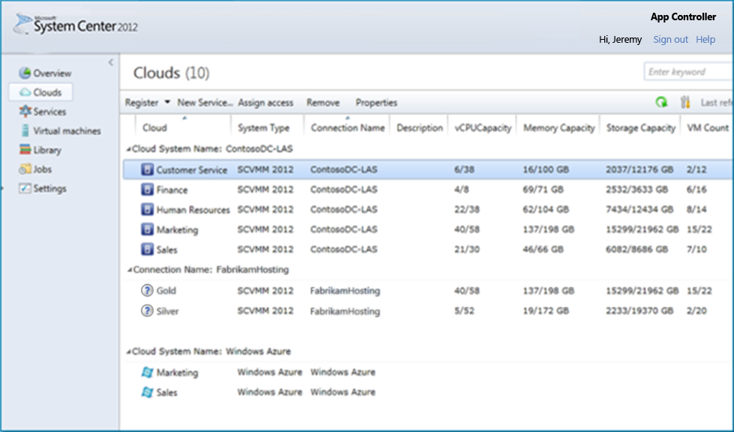
System Center 2012 R2:
Unified Management Interface Across Clouds
Flexible delegation with single sign-on
“Microsoft is doing a great job providing packaged solutions for companies looking for a private cloud solution that may migrate to the public cloud. Because you can manage both public and private cloud environments from the same System Center console, it’s easier for companies to not think of public versus private cloud but to move applications back and forth between the two as the business demands. Microsoft makes the public
and private cloud transition seamless.”
- Alan Bourassa, Chief Information Officer, EmpireCLS Worldwide Chauffeured Services
Self-service visibility for application services across on-premises, service provider, and Windows Azure
Easy VM and workload portability from
on-premises to Windows Azure
(including SharePoint and SQL)
Notes:
<This capability was also delivered in System Center 2012 and SP1>
Goal of the slide
Key proof point to support our common management story across on-premises, service provider and Microsoft (Windows Azure).
Talking points
<click>
System Center 2012 R2 App Controller offers a unified management view across clouds:
Empowers application owners with a self-service application management experience across on-premises, service provider and Windows Azure clouds
Puts your IT pros firmly in control with visibility and control across on-premises, service provider and Windows Azure resources and applications
Enables you to easily manage services through a highly intuitive “service-centric” interface
Additionally, organizations that need application portability—to free up on-premises datacenter capacity, for example—can use App Controller to move virtual machines to the Windows Azure Virtual Machine service (aka.ms/WA_VM ). They can migrate core applications such as Microsoft SQL Server, Active Directory, and Microsoft SharePoint Server from on-premises environments to Windows Azure with just a few mouse clicks.
Case study - EmpireCLS
http://www.microsoft.com/casestudies/Windows-Server-2008-R2/EmpireCLS-Worldwide-Chauffeured-Services/Chauffeur-Firm-Uses-Cloud-Computing-to-Trim-Operating-Costs-30-Percent-Grow-Business/710000000424
While a couple of capabilities are highlighted in the slide with successive clicks, you can refer the below list for more details:
Empowers application owners with self-service application management across private and public clouds:
Self-service delegation and single sign-on across clouds
Web-based console that offers comprehensive view of all services
Enables application owners to register and consume capacity from multiple Windows Azure subscriptions
Enable multiple users to authenticate using Active Directory to access a single Windows Azure subscription
Enables application owners to easily customize all components of the service, including virtual machines, network resources, and load balancing
Copy Windows Azure configuration, package files, and VHDs among Windows Azure subscriptions, and copy service templates and resources from one Virtual Machine Manager server to another
Easily configure, deploy, and manage services through a highly intuitive service-centric interface:
Application owners can design, build, configure, and deploy a service using a library of delegated templates with predefined configuration values
Enables datacenter administrators to delegate authority to application owners, confident that the predefined templates ensure compliance with company IT standards and policies
Puts your IT pros firmly in control with visibility and control across on-premises, service provider and Windows Azure resources and applications:
Consolidated views of on-premises, service provider and Windows Azure cloud services, including virtual machines that represent those services
Granular control of application components, along with the ability to track on-going jobs and maintain a detailed history of changes
15

Slide 16
Windows 2012 R2 / System Center 2012 R2 Enterprise Cloud Features
Live Migration
Storage Tiering
SDN
Central Management
Multi-cloud

Slide 17


High-performance live migration
Accelerate live migration performance with compression or RDMA-capable network adapters
For <10GBit network connectivity, live migration compression delivers superior performance – 2x acceleration for most workloads
For >10GBit networks, Remote direct memory access (RDMA) offload delivers the highest performance with low CPU utilization and transfer speeds of up to 56Gb/s
Windows Server 2012 R2 supports RoCE, iWARP and Infiniband RDMA solutions
Compute
Network
RDMA delivers low latency CPU
and network utilization.
Virtual
machine
Virtual
machine
Fast network connection
Network
adapter
20GB Connection
Network
adapter
GbE (Gigabit Ethernet) network connectivity
Server running
Hyper-V
Server running
Hyper-V
Live migration with RDMA
Notes:
Lets consider a simplistic scenario:
You have a client and server. You want to request data of say 500k from the client – this typically goes through the TCP/IP stack, you place a request for getting the data to the server, the data gets read, gets broken down into smaller packets, transferred back to you. You assimilate all these packets into the 500k data that you asked for and send it back up. All this takes CPU resources. You cant send the entire 500k at once no matter how fast your NIC is. You still have to chop it down into small packets and send it up and down the stack. Now think about having multiple NICs doing a lot of IO intensive operations. Your CPU is just busy doing this over and over again. You don’t want your CPU to be used for this – you want it to work on servicing database requests, indexing and so on.
We worked with a lot of network adapter vendors to bring a class of specialized NICs to support high speed data transfers with SMB Direct into Windows Server 2012. These NICs have a better CPU in them and support Remote Direct Memory Access or RDMA so that they can transfer data between them without involving the host CPU.
How does it work – I need to read 500k of data. First I find out a place in memory where that data should reside, then I register that with the NIC and get a token back. I send this token back to the other side through SMB direct and say I need to read 500k of data. Now the host uses this token, identifies the memory that needs to be copied, passes the memory location and the token to the NIC and says this is the data that needs to be transferred, why don’t you guys just talk with each other and transfer the data over. So the two NICs actually do the transfer. The two CPUs are now busy doing something else. RDMA can be incredibly fast – 1-2 ms latency when doing transfers. We support Infiniband, RoCE and iWARP network interfaces.
New in Windows Server 2012 R2, we are taking advantage of RDMA technology and are introducing it to Hyper-V live migrations taking advantage of the SMB protocol. As in the case with regular SMB file transfers, RDMA enables the offloading of CPU resources to NICs during live migration. This means that live migrations can now take advantage of high-speed networking, and they can also stream over multiple networks for improved bandwidth. Live migration with RDMA delivers the highest performance for live migrations, supporting transfer speeds of up to 56 GB/s.

Slide 18
Storage tiering
  Inbox storage virtualization solution with automatic tiering
  Improved storage cost-performance with
  industry-standard hardware
  Use solid-state drives (SSD) and hard-disk drives (HDD) in tiered storage space
  Can “pin” high priority files
  to the SSD tier
Storage Spaces
Solid State Drives
Hot data
Storage tiering
Cold data
Hard Disk Drives
Notes:
This slide talks about the variety of storage innovation that Microsoft is driving forward with Windows Server 2012 R2 for on-premises as well as cloud-integrated contexts. As their storage needs keep growing, customers have a great opportunity to drive up storage reliability while driving down costs/ complexity.
Storage tiering
Storage tiering is an exciting example of how we’re driving storage cost-performance with industry standard hardware. The key principle here is to use low cost-high capacity spinning disks to store less frequently used data and reserve the high-speed solid state disks to store frequently used data. Storage tiering builds on storage virtualization offered by Storage Spaces by assigning solid state drives (SSD) and hard disk drives (HDD) to the same storage pool and using them as different tiers in the same tiered space. Windows Server recognizes the tiers and optimizes them by moving often used “hot” data to the SSD tier. Windows tracks data temperature and moves data at the sub-file level; only “hot” regions of a file (VHD, database, etc.) need to move to SSDs, the “cold” regions can reside on HDDs.
Additional talking points:
Performance improvements in file-based application storage – This will build on the innovation Microsoft delivered in Windows Server 2012 to deliver greater performance in file-based storage for workloads, including SQL Server. As an example, we expect significant IOPS improvements for a few IO classes, including SQL OLTP workloads.
StorSimple cloud-integrated storage and Windows Azure – We will continue to integrate StorSimple from an engineering, marketing and business model standpoint.
Flexible data protection with Windows Azure Backup – Windows Azure Backup integrates with the familiar backup tools in Windows Server 2012, Windows Server 2012 Essentials, and System Center 2012 Data Protection Manager so customers protect important server data offsite with automated backups to Azure, where it is available for easy data restoration. Windows Azure Backup is in public paid preview as of April 2013. As per current POR, we expect this service to be commercially available later this year.

Slide 19
Software-defined networking
  Features
  In-box multi-tenant edge gateway for seamless connectivity between physical & virtual networks
  Isolated virtual networks running on
  shared network infrastructure
Standards-based automated network
switch configuration
Partner ecosystem support
  Benefits
  Open, extensible and standards-based solution
  Delivers flexibility, automation and control
  Seamlessly bridges on-premises and off-premises networks, physical and virtual
  Simplifies BYOIP scenarios and customer onboarding to service provider clouds
192.168.0.0/24
192.168.0.0/24
Blue company
Red company
Site-to-site connectivity
Site-to-site connectivity
Multi-tenant VPN gateway
http://contosoweb.red.com
14.1.1.100
http://contosoweb.blue.com
14.1.1.100
NVGRE
Service provider cloud
Notes:
Networking is fundamental to the datacenter and customers are generally familiar with how it’s done – so networking is just taken as a “given”. We believe there’s lot of upside in helping customers rethink how they approach networking (through a combination of software and hardware) in a private or hybrid cloud computing environment.
To transform networking, customers need to think about networking in the same way that they think about compute – i.e. as a shared, automated pool of capacity. They also need to think about how to reduce operational complexity in networking. Finally, they need a solution that can seamlessly bridge on-premises and off-premises networks.
To address the above, Microsoft is committed to delivering on an open, extensible & standards-based solution that has its origin in how we deliver networking for global hi-scale online services like Windows Azure or Bing. It turns out that our key learning is centered around the promises of flexibility, automation and control.
Specific bullets
Isolated virtual networks running on shared network infrastructure – Hyper-V Network Virtualization in Windows Server 2012 is key to abstracting the physical network intricacies from apps/workloads. This is key to meeting the multitenancy and isolation requirements that exist in service provider or large enterprise IT organizations (that serve multiple LOB constituents or dev/test/production environments). This needs to be reiterated as it is the foundation of our software-defined promise and solves a key customer need today. Many customers have asked us for the ability to deeply integrate Hyper-V networking into their existing network infrastructure, their existing monitoring and security tools, or with other types of specialized functionality – to meet that need, Windows Server 2012 also introduced the Hyper-V Extensible Switch that enables easy extensions of our hypervisor platform.
In-box multitenant edge gateway for seamless connectivity between physical & virtual networks – This software-based gateway will help customers easily extend their datacenter into a service provider environment by providing a termination point for site to site connectivity and enabling end-users access company resources that might be hosted at the service provider. Simultaneously, the gateway will be multitenant aware and hence enables the service provider to drive operational efficiency by enabling multiple customer connections terminate on it. More importantly, the gateway enables seamless bridging between the customers’ physical and virtual networks (NV-GRE based) by offering the necessary translation, thereby enabling broader adoption of hybrid networking with bring-your-own-IP (BYOIP) enablement. It should be noted that System Center Virtual Machine Manager is needed to provision and configure remote access and Hyper-V Network Virtualization in this context.
Self-service virtual network provisioning and management – Enterprises can easily connect their on-premises infrastructure to service providers by using a self-service experience to provision and manage connectivity and access. This self-service experience will be delivered through Windows Azure Services for Windows Server technologies that we’re now introducing to enterprises too.
Standards-based automated network switch configuration - Transforming the datacenter involves abstracting storage, compute and network resources from their underlying physical hardware and manage them in a standardized manner. To support this thinking, Microsoft will enable a plugin for System Center Virtual Machine Manager to manage top-of-rack network switches that support OMI. We’re working with our networking OEM partners to assure availability of hardware that meet this requirement.
Partner ecosystem support – A variety of partners have extended their support to offer solutions like merchant silicon, Hyper-V Switch extensions and NVGRE gateways. We will continue to work with these partners to offer customers the choice of networking solutions to best meet their needs.

Slide 20
Multi-tenant cloud infrastructure deployment
Service provider portal
Tenant admin/users
Simplified cloud infrastructure deployment with inbox service templates and runbooks for System Center components
Integrate existing investments using web-based interfaces to System Center capabilities
Scale management across multiple System Center instances (or “stamps”)
Tenant-level resource metering for capacity planning and usage analytics
APIs
Service Provider Foundation (SPF)
System Center
REST web service APIs, incl. usage metering
Tenants
User roles Stamps
Service mgmt. automation (PowerShell based)
Service provider systems (e.g., Billing).
Virtual machine manager
Virtual machine manager
Orchestrator
Operations manager
Virtual machine manager
System Center (Management stamps)
Notes:
This is about making it easy for service providers to easily and efficiently deliver infrastructure-as-a-service (IaaS), so they can focus on delivering additional value-added services to their customers (external or internal). This will also be compelling to mature enterprises with multitenancy needs so they can act like a service provider to their internal LOB constituents . Microsoft will offer a set of capabilities in System Center to deliver on this promise. It should be noted that we will be delivering a service provider portal with the Windows Azure Pack but the thrust of this particular slide is on System Center capabilities that enable multitenant cloud infrastructure, in particular the Service Provider Foundation (SPF) APIs. A lot of the features described below are delivered by the SPF and its tight integration with System Center components such as Virtual Machine Manager, Orchestrator and Operations Manager.
Specific bullets
In-box service templates and runbooks for System Center components - With the upcoming release of System Center, customers can use VMM service templates to quickly deploy other System Center components faster, with less expertise, and less chance for configuration error. Service templates for Service Manager, Data Protection Manager, Operations Manager and Service Provider Foundation (SPF) will be offered. We will also offer post-install component configuration runbooks in Orchestrator.
Integrate existing investments using web-based interfaces to System Center capabilities – You can easily integrate your existing infrastructure investments (e.g. customer panels or portals) with System Center infrastructure at the back end. This is enabled by the Service Provider Foundation (SPF), which is a set of web services APIs that expose System Center capabilities.
Built-in multitenant isolation and scale across multiple System Center instances – Tenants (or customers) demand the ability to host their workloads across geographically separated boundaries for protection against a significant failure or other incident that may have broad reaching impact on a datacenter or facility. Service providers desire to distribute workloads across resources that are most efficient and/or manageable at any given moment of the life-cycle of each service. Both of these requirements require the platform to seamlessly support service management across multiple instances of System Center components. This requirement is also enabled by SPF.
Extensible service management automation – Through this capability, service providers and enterprise IT will be able to respond to tenant (and business) needs faster with higher efficiency and accuracy through automation of system tasks. These workflows and APIs will be built into the Orchestrator component (and surfaced through the service administration portal) and will enable automation of various IaaS and service administration tasks. This includes REST API coverage for VMM, orchestration, and monitoring tasks that will also allow rich integration into external management systems as well as existing service provider systems. See following slide for additional details.
Tenant-level usage metering for capacity planning and chargeback – This will enable service providers to provision the right amount of capacity and incent tenants to use the capacity in a responsible manner. Microsoft will enable usage level metering and the ability to chargeback, supported by various reports, including allocation/ utilization based views and price-sheets. See following slide for additional details.

Slide 21
Deep infrastructure and workload insight
Availability and performance monitoring for Windows Azure Virtual Machines & Windows Azure Storage
Windows Azure
Compute
Storage
Cloud-integrated monitoring
Integrated System Center Advisor views with Operations Manager connector
VMware vSphere monitoring with VEEAM Management Pack
Comprehensive
System Center Monitoring
VMware vSphere
Windows Server 2012
Expanded cloud infrastructure health visualization with integration between VMM and Operations Manager components
Native SNMP-based network monitoring
Compute
Storage
Network
Notes:
This slide is meant to talk to Microsoft’s monitoring investments that delivers deep insight into your infrastructure and workloads.
<this is a build slide>
Specific bullets
Expanded cloud infrastructure health visualization with VMM/ Operations Manager integration – This is about a set of investments in enabling a dashboard view that brings together availability and performance metrics across storage, network and compute fabric for the datacenter administrator to take remediation measures as necessary. This includes metrics for load balancers, IIS pools, storage LUNs, host, storage pools, file servers, VM health, VMM server health, host health, host cluster health etc.
Native SNMP-based network monitoring – This is about enabling generic SNMP based monitoring of network devices within the Operations Manager component without the dependency on third-party licensing. Network monitoring is one the most requested System Center features and really rounds out our ability to monitor health across the whole stack. Network monitoring enables you to discover and monitor health of physical devices along with associated “vicinity” views that shows that device is interconnected with the rest of the network (incl. display of virtual switches).
VMware monitoring – You can get detailed metrics on VMware infrastructure health through the management packs offered by VEEAM. Again, one single place to monitor and manage health across all your investments.
Availability and performance monitoring for Windows Azure Infrastructure Services - Microsoft announced preview availability of the System Center Management Pack for Windows Azure in April 2013 (at MMS 2013). This Management Pack enables customers to monitor availability and performance of their Windows Azure resources and services using their existing System Center 2012 SP1 monitoring environment. Additionally, this management pack enables hybrid application monitoring by combining on-premises components with Windows Azure components into a unified view. Timing of general availability is yet to be determined.
Cloud-integrated monitoring – This is expected to be a key element of our monitoring strategy going forward. Our goal is to leverage intelligence and scale from the public cloud (Windows Azure) while enabling customers to use their familiar Operations Manager monitoring experience. For the upcoming release, we will use Windows Azure to enhance monitoring and configuration of on-premises resources and key server workloads (like Exchange, SharePoint and Lync):
End user experience monitoring, including unified dev-ops diagnostics between System Center and Visual Studio – This is enabled through Global Service Monitor (GSM), for which we announced general availability as of March 28th 2013.
Integrated System Center Advisor views with Operations Manager connector - System Center Advisor Connector for Operations Manager allows System Center Advisor configuration data to be displayed on the Operations Manager Console. We announced preview of this connector in April 2013 (at MMS 2013). We expect this to be generally available in Q3 CY13.

Slide 22


Business continuity
Windows Server 2012 R2 and
System Center 2012 R2 together deliver
IT demands
Flexibility in managing application uptime and resources
Simple, flexible and affordable disaster recovery
Lower recovery costs and protection of more workloads
Protection and recovery
of assets across datacenters
Online VHDX resize
Shared VHDX files
Storage QoS
Integrated offsite data protection with Windows Azure Backup
Hyper-V Replica with
variable replication frequency and
multi-node replication support
Windows Azure Hyper-V Recovery Manager for
automated replication of VMs
customizable recovery plans
orchestrated VM recovery
Continuous services and cloud backup
Out-of-the-box, application-and storage-agnostic VM replication
Automated protection and at-scale recovery orchestration
Notes:
Business continuity is the ability to quickly recover business functions from a downtime event with minimal or no data loss. There are number of reasons why businesses experience outage including power failure, IT hardware failure, network outage, human errors, IT software failures, and natural disasters. Depending on the type of outage, customers need a high availability solution that simply restores the service. However, some outages that impact the entire data center such as natural disaster or an extended power outage require a disaster recovery solution that restores data at a remote site in addition to bringing up the services and connectivity. Organizations need an affordable and reliable business continuity solution that helps them recover from a failure. Also, many workloads that could benefit from protection go without. Windows Server 2012 R2, System Center 2012 R2 and Windows Azure help simplify business continuity by providing well-managed application uptime, simplified VM replication and orchestrated recovery.
Continuous services and cloud backup
Online VHDX resize:
Online VHDX resize allows for greater storage flexibility by allowing a virtual SCSI disk to either grow or shrink the VHDX file whilst attached to a running virtual machine. Thus the volume within the guest can be dynamically either expanded or reduced.
Shared VHDX files:
Windows Server 2012 R2 offers the most flexible guest clustering options that give you complete flexibility for deploying application-level high availability, without sacrificing agility and density. In addition to Fiber Channel, iSCSI and SMB, Windows Server 2012 R2 now also offers shared VHDX files. Unlike competing guest clustering that does not support file-based storage, shared VHDX files can be stored on a scale-out file server cluster or on Cluster-shared Volumes (CSV) on block storage. Unlike competing guest clustering options, shared VHDX clustering preserves dynamic memory, live migration and storage live migration for a VM that is part of the guest cluster.
Storage QoS:
Storage QoS allows you to restrict disk throughput for overactive/disruptive virtual machines and can be configured dynamically while the virtual machine is running. For maximum bandwidth applications, it provides strict policies to throttle IO to a given VHD/VHDX to a maximum IO threshold. For minimum bandwidth applications, it provides policies for threshold warnings that alert of an IO starved VHD/VHDX when the bandwidth does not meet the minimum threshold.
Integrated offsite data protection with Windows Azure Backup:
Windows Azure is suitable for any workload (file servers, SharePoint, SQL, Exchange, and others). Consider any of these situations:
If you have a small number of serves to protect and you currently have no backup solution or you are using the in box Windows Server back up tool on these servers, Windows Azure Backup is an option. Downloading and installing the Agent onto the servers will enable the in box Windows Server tool to communicate with Windows Azure. If you are already using System Center 2012 and are using DPM for protection and you want to keep replicas offsite, Windows Azure backup can integrate with DPM once System Center is installed. As with scenario 1, once the Windows Azure Agent is downloaded and installed on the DPM server, it can communicate with Windows Azure Backup service.
If you’re already using System Center, you can start using Windows Azure Backup today – it integrates with Data Protection Manager.
If you’re a small business or branch office…: If you have a small number of servers to protect, Windows Azure Backup integrates with the in-box Windows Server backup tools you may already be using.
Out-of-the-box, application- and storage agnostic VM replication
Hyper‑V Replica provides a storage-agnostic and workload-agnostic solution that replicates efficiently, periodically, and asynchronously over IP-based networks, typically to a remote site. It also allows an administrator to easily test the replica virtual machine without disrupting the ongoing replication. If a disaster occurs at the primary site, administrators can quickly restore their business operations by bringing up the replicated virtual machine at the Replica site. New in Windows Server 2012 R2, Hyper-V Replica now allows for variable (configurable) replication frequencies (30 sec., 5 min., 15 min.) and also supports multiple nodes; this means that tertiary replica sites are supported, for example in the case of a service provider who wants to replicate a customer’s workload to another (tertiary) data center.
Automated protection and at-scale recovery orchestration
Windows Azure Hyper-V Recovery Manager helps simplify the task of delivering service availability. For organizations with two or more datacenters looking to protect vital workloads running in their private cloud, Windows Azure Hyper-V Recovery Manager enables them to combine Windows Azure, System Center and Hyper-V Replica to deliver business continuity of workloads. Note Currently, the Hyper-V Recovery Manager feature is being offered as a limited customer preview to customers selected via an application process. Windows Azure Hyper-V Recovery Manager provides:
Automated Protection: Private clouds can be protected by automating the replication of the virtual machines that compose them at a secondary location. The ongoing asynchronous replication of each VM is provided by Windows Server Hyper-V Replica. All communications with Windows Azure is encrypted and limited to the System Center Virtual Machine Manager server in each datacenter.
Continuous Health Monitoring: Service availability at the primary datacenter is monitored by Windows Azure Hyper-V Recovery Manager on an ongoing basis. Workload data is not transferred to Windows Azure.
Orchestrated Recovery: The service helps automate the orderly recovery of services in the event of a site outage at the primary datacenter. Virtual machines are started in an orchestrated fashion to help restore service quickly. This process can also be used for testing recovery without disruption to services, or temporarily transferring services to the secondary location.

Slide 23
Online VHDX resize
Virtual Machine
Grow or shrink virtual SCSI with no downtime
Resize of the VHDX file occurs whilst attached to a running virtual machine
Dynamically expands or reduces the volume within the guest
Managed from within System Center
Workload
Storage Capacity
Windows Server and
System Center
VHDX
Notes:
Online VHDX resize allows for greater storage flexibility by allowing a virtual SCSI disk to either grow or shrink the VHDX file whilst attached to a running virtual machine. Thus the volume within the guest can be dynamically either expanded or reduced.

Slide 24




Inbox VM replication with Hyper-V Replica
  Affordable inbox business continuity and disaster recovery solution
  Replicate Hyper-V virtual machines from a primary site to a single or multiple replica sites
  Variable, configurable replication frequencies
  More secure replication across the network
  No need for storage arrays or other software replication technologies
  Simple configuration and management
Primary site
Replica site
CRM virtual machine
Exchange virtual machine
IIS virtual machine
Exchange
replica
virtual
machine
SQL virtual machine
SharePoint virtual
machine
CRM
replica
virtual
machine
R2
P1
P2
Replicate over
WAN link
R1
R3
SMB file share
SAN
Hyper‑V role and tools
Hyper‑V role and tools
Hyper‑V cmdlets
Hyper‑V PS integrated UI
Hyper‑V cmdlets
Hyper‑V PS integrated UI
Send/receive
replica traffic
Hyper‑V Management Module tracks and replicates changes for each virtual machine
Hyper‑V Management Module receives and applies the changes to the replica virtual machine
Notes:
Before Windows Server 2012
Beginning with Windows Server 2008 R2, Hyper‑V and Failover Clustering can be used together to make a virtual machine highly available and minimize disruptions. Administrators can seamlessly migrate their virtual machines to a different host in the cluster in the event of outage or to load balance their virtual machines without impacting virtualized applications. While this can protect virtualized workloads from a local host failure or scheduled maintenance of a host in a cluster, this does not protect businesses from outage of an entire data center. While Failover Clustering can be used with hardware-based SAN replication across data centers, these are typically expensive. Hyper‑V Replica fills an important gap in the Windows Server Hyper‑V offering by providing an affordable in-box disaster recovery solution.
Windows Server 2012 Hyper‑V Replica
Windows Server 2012 introduces Hyper‑V Replica, a built-in feature that provides asynchronous replication of virtual machines for the purposes of business continuity and disaster recovery. In the event of failures (such as power failure, fire, or natural disaster) at the primary site, the administrator can manually fail over the production virtual machines to the Hyper‑V server at the recovery site. During failover, the virtual machines are brought back to a consistent point in time, and within minutes they can be accessed by the rest of the network with minimal impact to the business. Once the primary site comes back, the administrators can manually revert the virtual machines to the Hyper‑V server at the primary site.
Hyper‑V Replica is a new feature in Windows Server 2012. It lets you replicate your Hyper‑V virtual machines over a network link from one Hyper‑V host at a primary site to another Hyper‑V host at a Replica site without reliance on storage arrays or other software replication technologies. The figure shows secure replication of virtual machines from different systems and clusters to a remote site over a WAN.
Benefits of Hyper‑V Replica
Hyper‑V Replica provides an affordable in-box business continuity and disaster recovery solution. It can be configured to replicate Hyper-V VMs from a primary site to a single, or to multiple (tertiary etc.) replica sites.
Variable, configurable replication frequencies. With Windows Server 2012 R2, replication frequencies are variable and can be configured to 30 seconds, 5 minutes or 15 minute intervals. In the event of an unplanned shutdown, Hyper-V Replica can restore your system in just minutes.
More secure replication across the network. Hyper‑V Replica tracks the write operations on the primary virtual machine and replicates these changes to the Replica server efficiently over a WAN. The network connection between the two servers uses the HTTP or HTTPS protocol and supports both integrated and certificate-based authentication. Connections configured to use integrated authentication are not encrypted; for an encrypted connection, you should choose certificate-based authentication. Hyper‑V Replica is closely integrated with Windows failover clustering and provides easier replication across different migration scenarios in the primary and Replica servers.
Hyper‑V Replica doesn’t rely on storage arrays or any other software replication technologies.
Configuration and management are simpler with Hyper‑V Replica:
Integrated user interface (UI) with Hyper‑V Manager.
Failover Cluster Manager snap-in for Microsoft Management Console (MMC).
Extensible WMI interface.
Windows PowerShell command-line interface scripting capability.

Slide 25
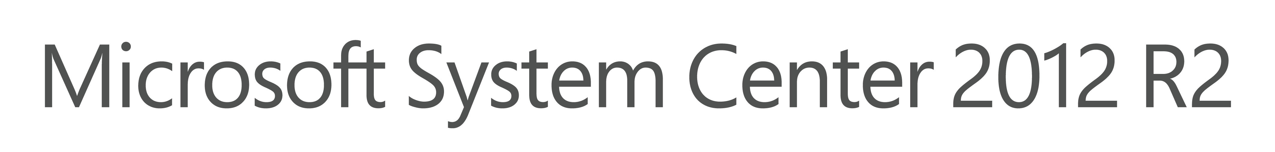
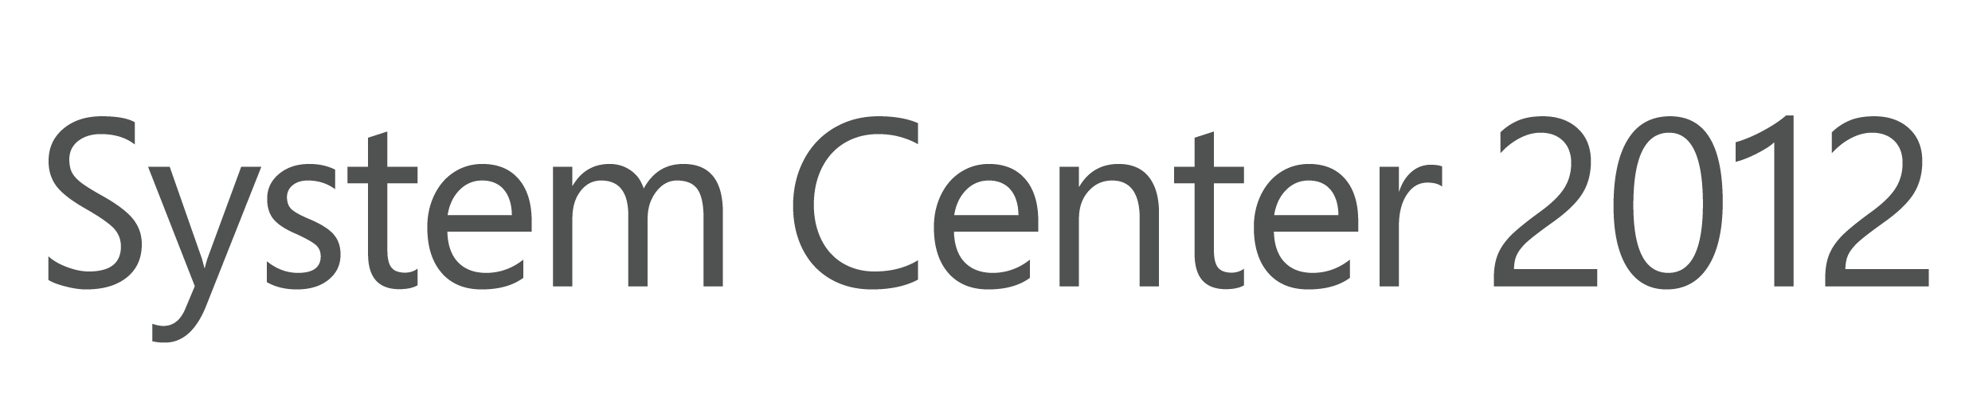
Simplified, orchestrated VM recovery
At-scale disaster recovery with Windows
Azure Hyper-V Recovery Manager
Process automation and orchestrated recovery
Ensure workload reliability with
policy-based SLA
Easy to manage and deploy across
several use-cases, such as dev-test
and compliance audits
Windows Azure
Hyper-V Recovery Manager
Communication channel
Communication channel
LOB cloud/Dev-test
LOB cloud/Dev-test
Failover
Replication Channel
Datacenter 1
Datacenter 2
Notes:
Windows Azure Hyper-V Recovery Manager will help customers to protect important services by coordinating the replication and recovery of System Center 2012 private clouds at a secondary location. System Center 2012 Virtual Machine Manager private clouds can be protected through automating the replication of the virtual machines that compose them at a secondary location. The ongoing asynchronous replication of each VM is provided by Windows Server 2012 Hyper-V Replica and is monitored and coordinated by Hyper-V Recovery Manager. The service helps automate the orderly recovery in the event of a site outage at the primary datacenter. VMs can be brought up in an orchestrated fashion to help restore service quickly. Since the service intelligence resides in the Windows Azure public cloud, customers will benefit from the high-scale automation on offer.
Windows Azure Hyper-V Recovery Manager helps simplify the task of delivering service availability. For organizations with two or more datacenters looking to protect vital workloads running in their private cloud, Windows Azure Hyper-V Recovery Manager enables them to combine Windows Azure, System Center and Hyper-V Replica to deliver business continuity of workloads. Note Currently, the Hyper-V Recovery Manager feature is being offered as a limited customer preview to customers selected via an application process.
Windows Azure Hyper-V Recovery Manager provides:
Automated Protection:
Private clouds can be protected by automating the replication of the virtual machines that compose them at a secondary location. The ongoing asynchronous replication of each VM is provided by Windows Server Hyper-V Replica. All communications with Windows Azure is encrypted and limited to the System Center Virtual Machine Manager server in each datacenter.
Continuous Health Monitoring:
Service availability at the primary datacenter is monitored by Windows Azure Hyper-V Recovery Manager on an ongoing basis. Workload data is not transferred to Windows Azure.
Orchestrated Recovery:
The service helps automate the orderly recovery of services in the event of a site outage at the primary datacenter. Virtual machines are started in an orchestrated fashion to help restore service quickly. This process can also be used for testing recovery without disruption to services, or temporarily transferring services to the secondary location.

Slide 26
Service delivery
Windows Server 2012 R2 and
System Center 2012 R2 together deliver
IT demands
Standardized services and reliable SLAs on top of shared
infrastructure
Efficient delivery and maintenance of infrastructure services
Flexibility to compose differentiated services and tenant offerings
Control over IT assets while increasing agility of application owners
Provisioning of multi-tenant compute, storage and network resources
Automated standards-based switch configuration
Service management automation
Tenant user services: Virtual machines, websites and service bus
Standardized VM gallery for consistent workload deployment
Flexible tenant offer administration
Standardized application provisioning with
service templates
(e.g., SharePoint farms)
Scalable, multi-VM tenant services with Windows Azure-consistent user experience (e.g. SQL cluster)
Simplified provisioning and servicing of shared resources
Consistent, cross-cloud management experiences and services
Self-service app provisioning for multi-tenant environments
Notes:
Windows Server 2012 R2 and System Center 2012 R2 offer simplified provisioning, service delivery and service operations, as well as robust automation for your multi-tenant cloud infrastructure. For example, using the Service Manager and Orchestrator components of System Center 2012 R2, you can automate core organizational process workflows like incident management, problem management, change management, and release management. You can also integrate and extend your existing toolsets and build flexible workflows (or runbooks) to automate processes across your IT assets and organizations.
Simplified provisioning and servicing of shared resources
Automated standards-based switch configuration:
Today’s datacenters are made up of different classes of devices – e.g. load balancers, power distribution units, baseboard management controllers (BMCs), top-of-rack (TOR) switches, routers, etc. - from a variety of device manufacturers. With the explosion of datacenters the need to automate management of such devices in a consistent way is more important than ever. Since most of these devices are managed via different protocols and schemas, and in some instances, proprietary solutions, customers are asking for a consistent developer abstraction layer for interacting with the wide array of devices & vendors, similar to the Hardware Abstraction Layer that Windows provides to application developers. System Center 2012 R2 offers a plugin for VMM to manage top-of-rack network switches that support OMI.
Service management automation:
Service management automation is extensible, including built-in PowerShell workflows & standardized APIs. Through this capability, service providers and enterprise IT are able to respond to tenant (and business) needs faster with higher efficiency and accuracy through automation of system tasks. Consistent with System Center 2012 SP1, these workflows and APIs are built into the Orchestrator component (and surfaced through the service administration portal) and enable automation of various IaaS and service administration tasks. This includes REST API coverage for VMM, orchestration, and monitoring tasks that also allow rich integration into external management systems as well as existing service provider systems. Enterprises can easily connect their on-premises infrastructure to service providers by using a self-service experience enabled through the new System Center Service Provider Foundation (SPF) which is a REST-based Odata API; for example, you can use this self-service experience to provision and manage connectivity and access, and to self-provision virtual networks. This self-service experience is delivered through the Windows Azure Pack for Windows Server, a free download for your Windows Server 2012 R2 and System Center 2012 R2 environment.
Consistent, cross-cloud management experiences and services
Tenant user services: Virtual machines, websites and service bus:
These are finished services with similar look and feel to services that we’ve designed for Windows Azure, but are designed to run on Windows Server and System Center. Virtual Machines will enable a high quality self-service experience to provision and manage VMs. Web Sites will enable high density, secure web hosting offerings for service providers and enterprise IT. Service Bus will enable reliable, persistent messaging between applications.
Standardized VM gallery for consistent workload deployment:
There is a consistent gallery of VM templates available for Windows Server and Windows Azure environments, both for single VMs and multi-tier VMs. This allows for uniform IaaS services across Windows Server and Windows Azure, including consistent VM lifecycle management from a provisioning and operations standpoint.
Flexible tenant offer administration and tenant-level usage metering for chargeback:
The Windows Azure Pack for Windows Server offers a flexible administrative portal to enterprises and service providers. This portal includes a service plan authoring capability, which enables service providers to create (and customize/add-on) service capabilities and quota for their tenant subscriptions. It also offers various reports, including allocation/utilization based views and price-sheets, for tenant-level usage metering and chargeback, which enables service providers to provision the right amount of capacity and incent tenants to use the capacity in a responsible manner.
Self-service app provisioning for multi-tenant environments
Standardized application provisioning with Service templates:
Self-service can empower app owners to provision their own application services. To this end, app owners and infrastructure admins work together to define standard application blueprints (or service templates) followed by controlled delegation. App owners can then deploy first party Microsoft workloads (like SharePoint farms) as well as LOB apps using the agreed upon service templates.
Scalable, multi-VM tenant services with Windows Azure consistent user experience:
For multitenant environments, System Center 2012 R2 and the Windows Azure Pack for Windows Server enable a Windows Azure-consistent user experience for tenant end users to provision multi-VM services (e.g. SQL cluster or SharePoint farms) based on defined parameters set by the infrastructure admin for each tenant.

Slide 27
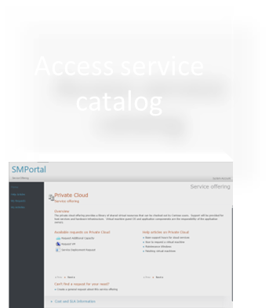
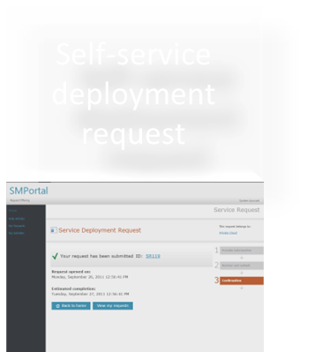
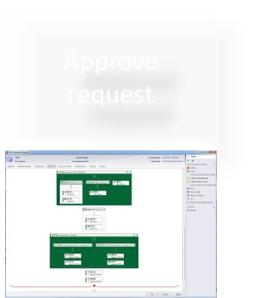
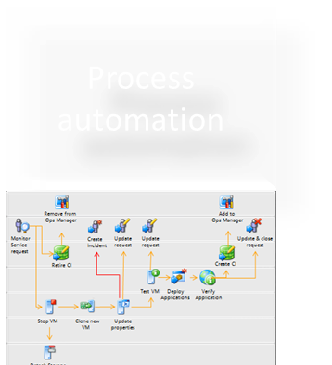
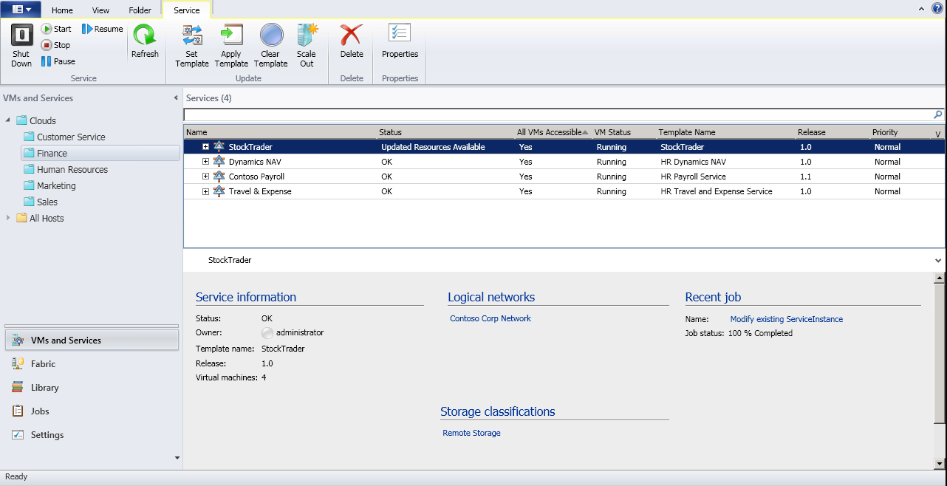
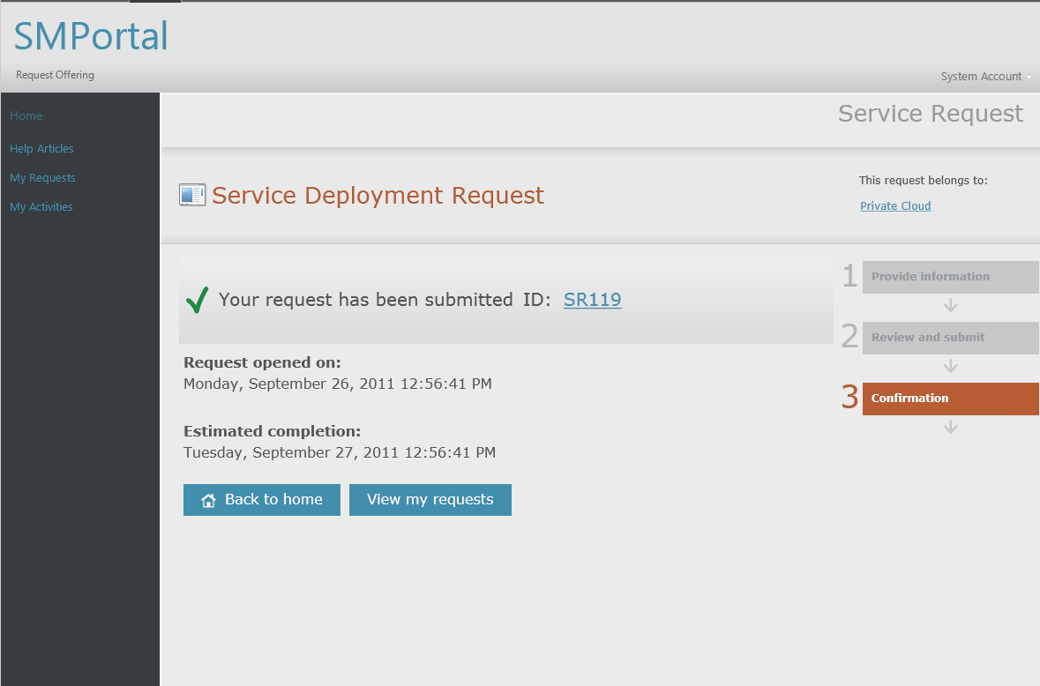
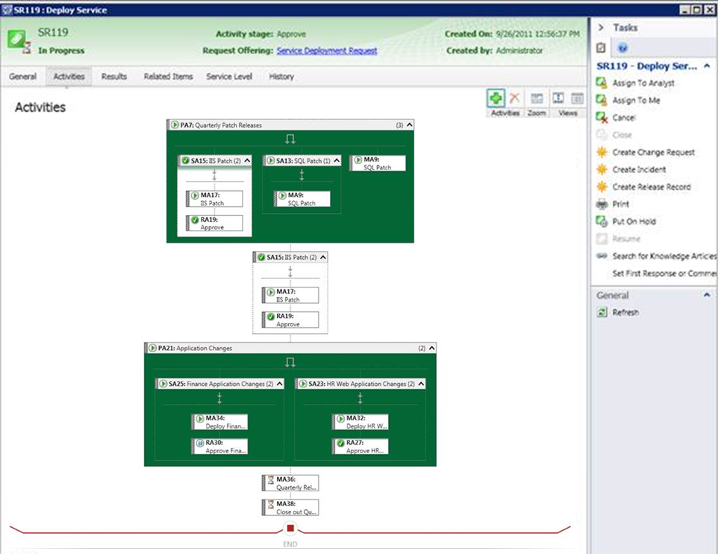
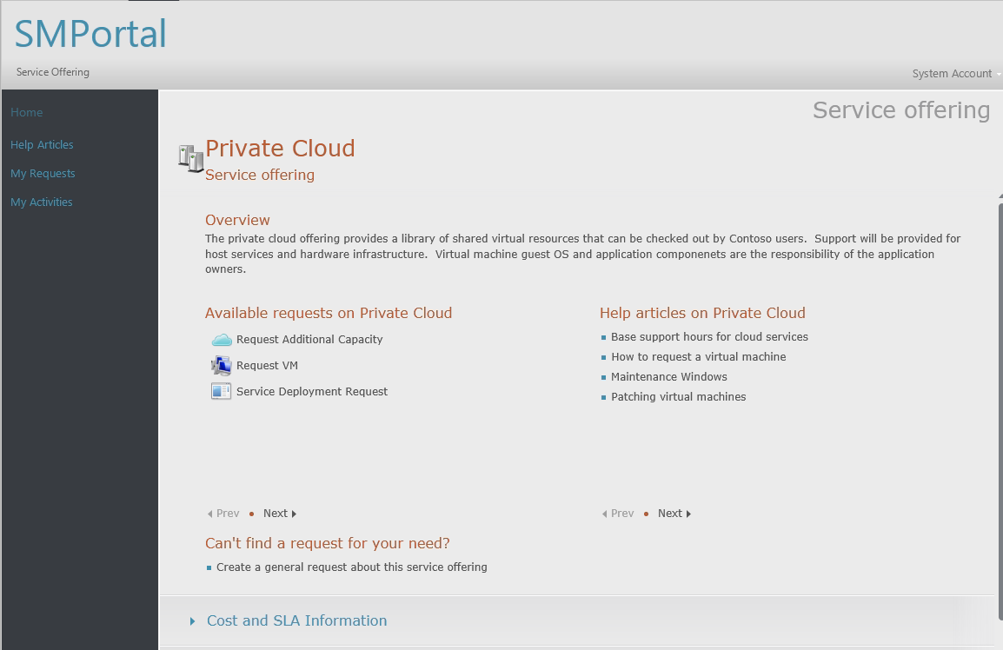
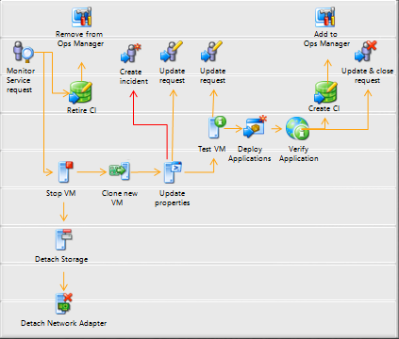
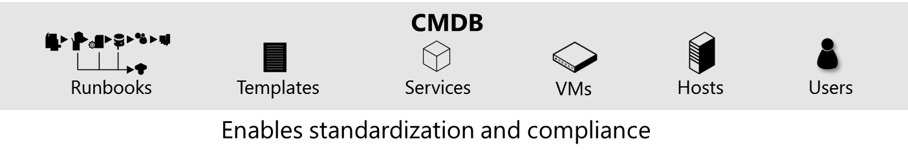



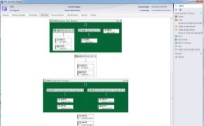
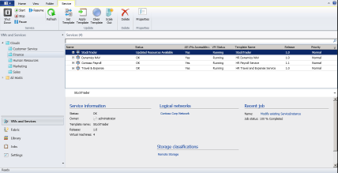
Efficient service delivery / Self Service
Approve request
Provision service
Self-service deployment request
Access service catalog
Process automation
Access service catalog
Self-service deployment request
Approve request
Process automation
Provision service
Notes:
Did you know that a majority of application or infrastructure outages can be traced back to poorly defined and executed change management?
What we’ll talk through now is an end-to-end scenario that enables you to deliver predictable datacenter services on-demand to your application owners (or end users). This scenario takes off at the point where IT publishes a list of standardized service offerings that can be consumed in a self-service mode.
It walks you through the process by which System Center 2012 R2 fulfills a service deployment request in a controlled manner. The service in question could be an application service or an infrastructure service.
<click> The Configuration Management Database (CMDB) in System Center 2012 R2 - Service Manager standardizes the capture of relationships across infrastructure and applications, thereby facilitating continued organizational compliance through any changes to these. If you are managing a private cloud, the CMDB can track various configuration items such as virtual machine templates, application service templates, virtual machines, hosts, and application services. The CMDB acts as the integration point across people, processes, and knowledge through this process.
<click> The application owner or end user accesses the published service catalog and requests deployment of a pre-defined service offering.
<click> The application owner requests the service offering in self-service mode, resulting in the creation of a service request. Additionally, the corresponding business process required to fulfill this request is triggered.
<click> Now, it turns out that this service deployment request is a “complex” request that impacts changes to multiple application and infrastructure configuration items. So Service Manager triggers change/release management approvals with the corresponding functional approvers before kicking off actual deployment. You can use the example of a real-life service request that impacts business mission-critical systems, and hence needs these approvals.
<click> Once all the required functional approvals are obtained, System Center 2012 R2 – Orchestrator triggers automated execution of a preconfigured runbook for this service deployment request.
<click> System Center 2012 R2 – Virtual Machine Manager provisions the service (including all the underlying configuration items like hosts and virtual machines) following the specifications in the service request. All these activities are tracked back to the service request in the form of an audit trail to ensure the right level of control at each step.

Slide 28
Consistent management experiences and services
Tenants / Customers
Enhance agility by delivering Windows Azure-consistent services to Windows Server
Extensible, enterprise-ready service
management portal
Tenant user services: Virtual
machines, websites and service bus
Standardized VM gallery format
for Windows Azure and for service providers
Consistency
Windows Server
& System Center
Windows Server
& System Center
Windows Azure
Service management portal & extensible API
Service management portal & extensible API
Service management portal & extensible API
Web
Sites
VM
Service
Bus
Web
Sites
VM
Service
Bus
Web
Sites
VM
Service
Bus
On-premises
Service provider
Microsoft
Notes:
Core to delivering on the Cloud OS promise is enabling parity of application owner experiences irrespective of where the underlying infrastructure may reside: on premises, in a hosted environment, or on Windows Azure. To do that, we need to ensure that tenant end-users have uniform self-service and management experiences to consume the infrastructure needed by their application services for both Windows Azure and Windows Server environments.
In Jan 2013, we made Windows Azure Services for Windows Server commercially available for service providers, where in service providers could deliver Windows-Azure like services and management experiences – specifically virtual machines and web sites - on top of their Windows Server and System Center infrastructure. These technologies enabled hosting service providers to easily provide a high quality, self-service offering to their customers while lowering the costs associated with delivering the service and managing customers. This was made possible by the fact that these services and technologies are inherently designed for easy self-service access in a multitenant public cloud environment like Windows Azure.
In this release cycle, as an evolution of (and successor to) Windows Azure services for Windows Server, we are introducing Windows Azure Pack for Windows Server, with the goal to make it even more valuable for service providers, but also to make it available to enterprises. We believe that this will enable the needed agility and consistency to delivering dynamic application services in both contexts. An example of where this will fit in well in an enterprise IT context would be agile, LOB developer-oriented scenarios like dev/test sandboxes.
Specific bullets
Extensible, enterprise-ready service management portal - The service management portal will bring the end-customer self-service experience from Windows Azure to Windows Server thereby delivering a consistent yet easy way to access and consume the infrastructure they need. The service management API is an extensible REST-based API that will enable enterprises and service providers to integrate their existing systems and tools (e.g. customer portals at service provider) with these new services. Key to enabling enterprise adoption will be portal/ API integration with Active Directory which we will be building in the upcoming release.
Tenant user services: Virtual Machines, Web Sites and Service Bus – These are finished services with similar look and feel to services that we’ve designed for Windows Azure, but are designed to run on Windows Server and System Center. Virtual Machines will enable a high quality self-service experience to provision and manage their VMs. Web Sites will enable high density, secure web hosting offerings for service providers and enterprise IT. Service Bus will enable reliable, persistent messaging between applications.
Standardized VM gallery for consistent workload deployment and hosting – We will be delivering a consistent gallery of VM templates - single VM and multi-VM tiers - for Windows Server and Windows Azure environments. The goal here is to enable uniform IaaS services across these contexts, including consistent VM lifecycle management from a provisioning and operations standpoint.

Slide 29
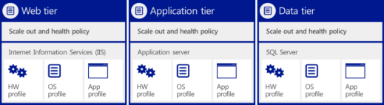





Standardized application provisioning
_{App owner}
Service template (multi-tier .NET applications)
Web tier
Application tier
Data tier
Web (IIS)
Server App-V
Data (SQL)
Scale out and health policy.
Scale out and health policy.
Scale out and health policy.
Internet Information Services (IIS)
Application Server
SQL Server
HW profile
OS profile
App profile
HW profile
OS profile
App profile
HW profile
OS
profile
App
profile
Compute
Storage
Network
DC admin
Notes:
<This capability was also delivered in System Center 2012 and SP1>
Goal of the slide
Represent how System Center 2012 R2 simplifies application provisioning for private clouds by enabling a standardized approach.
Drive CTA to identify a customer application(s) that might benefit from using capabilities like service templates
Talking points
<Click> Through service templates, System Center 2012 R2 Virtual Machine Manager offers you the ability to define standardized application blueprints, which can be used to automatically deploy application services to shared resource pools, thus simplifying application provisioning. Defining your application requirements with a repeatable construct like service templates makes provisioning faster and less error-prone.
Service templates provide the blueprint for the application service, including specifications for the hardware, operating system, and application packages. System Center 2012 R2 supports multiple package types for .NET applications, including MS Deploy for the web tier (IIS), SAV for the application tier, and SQL DAC for the data tier.
Operationalizing service templates across your service-consumer and service-provider organizations will likely require active collaboration between the App Owner and DC Admin roles to discuss and standardize the initial set of hardware, OS, and app profiles that new applications could adhere to. It might be beneficial to take an incremental approach to testing this capability before rolling out across a broader set of applications. This process will likely require broad sponsorship across the LOB application IT and infrastructure IT organizations.
<Click>
Once organizationally approved application blueprints are established and stored in the Virtual Machine Manager service template library, your application owners are ready to deploy applications on their own. They can go to the application owner self-service experience in System Center 2012 R2 App Controller, where they can access and select service templates that they’ve been authorized for. They can easily specify configuration requirements like application topology, scale-out rules, health thresholds, and upgrade rules into the service template and then kick-start a “one-click deployment.” Before the application owner hits deploy, App Controller provides a compelling visualization of the of the holistic application service, including all the requested service tiers, the underlying virtual instance templates, and storage, compute, and network resources. This enables application owners to “think services, not servers” by offering a “service-centric” approach to provisioning.
Virtual Machine Manager uses the service template specifications to build out the application tiers, including the various logical instances associated with each tier. In the real world, you are likely to encounter scaled-out (or multi-instance) web front ends and application tiers, but scaled-up (or single instance–based) database tiers.
Virtual Machine Manager uses the service template specifications to ensure that the application is deployed to the appropriate virtualized resource pools.

Slide 30
Application management
Windows Server 2012 R2 and
System Center 2012 R2 together deliver
IT demands
Broader reach for applications by reusing IT development skills
Great LOB application health and end user experiences
Rapid application lifecycles
Build, scale, and run apps with deep insight on-premises and in the cloud
Programming symmetry between Windows Server and Windows Azure
Hybrid applications
Support for multiple languages and for open source software
.NET and Java monitoring, including line-of-code
level traceability
Outside-in monitoring with Global Service Monitor
Best practice configuration with System Center Advisor
Faster issue tracking and remediation with System Center-Visual
Studio connector
Efficient app debugging with Microsoft Monitoring Agent
Flexible and open platform to build apps on-premises and in the cloud
Deep, cloud-integrated application insight
Integrated dev-ops tools that span people, processes and systems
Notes:
Windows Server 2012 R2 and System Center 2012 R2 offer unique application management capabilities for your Windows Server .NET applications that empower you to deliver agile, predictable application services to your business counterparts. For example, using the App Controller, Operations Manager, and Virtual Machine Manager components of System Center 2012 R2, you can easily deliver and manage "Applications as a Service“ (where a "Service" is a deployed instance of a cloud style application along with its associated configuration and virtual infrastructure).
Flexible and open platform to build apps on-premises and in the cloud
Programming symmetry between Windows Server and Windows Azure:
Windows Server is a proven application platform with thousands of applications already built and deployed and a community of millions of knowledgeable and skilled developers already in place. Windows Server 2012 R2 offers programming languages and tools, such as Microsoft Visual Studio and Microsoft .NET Framework, that span on-premises and cloud environments. With these tools, developers can work in a single, unified environment to build solutions for Windows Server and Windows Azure cloud platforms. Developers can use these programming tools across web, application, and datacenter tiers for locally deployed applications and for private and public cloud solutions. They provide the ability to use the same development model between Windows Server 2012 R2 and Windows Azure. This programming symmetry is complemented by the rich and comprehensive experience of working in Visual Studio. Whether developers work in house or as third-party solution providers, they can write code and use common workflows and rules to create on-premises, cloud-based, or hybrid applications from within a unified Windows development environment.
Hybrid applications:
Most organizations today are using—or are planning for—a combination of on-premises and off-premises IT resources and tools, resulting in “hybrid” environments that comprise on-premises and cloud environments. With Windows Server 2012 R2, your organization can protect its existing investment in on-premises applications as you begin to move to the cloud, and you can manage your applications in a unified way.
Support for multiple languages and for open source software:
Windows Server 2012 R2 enables business-critical applications and enhanced support for open frameworks, and open source applications, and various development languages. Windows Server 2012 R2 offers support for multiple languages:
Multilanguage support enables developers to choose from supported programming languages such as .NET, PHP, Node.js and Python
Enhanced support for PHP and MySQL is available through Internet Information Services extensions
Deep, cloud-integrated application insight
.NET and Java monitoring, including line-of-code level traceability:
System Center 2012 R2 Operations Manager offers deep application diagnostics and insight – including code level issue traceability - for .NET and Java applications to maximize application availability and performance, in turn leading to predictable SLAs. Easy-to-use reporting and dashboarding allows you to track and communicate SLAs more effectively.
Outside-in monitoring with Global Service Monitor:
System Center Global Service Monitor helps achieve a 360-degree view of the health of web applications. It uses Windows Azure points of presence across the globe, monitored alongside existing data found within the familiar System Center 2012 Operations Manager console. Global Service Monitor reports on availability, performance, and function of web applications by scheduling and executing synthetic transactions against the application from Windows Azure.
Best practice configuration with System Center Advisor:
System Center Advisor is a cloud service that enables you to assess your server configurations and proactively avoid problems, while helping support staff to resolve issues faster by accessing current and historical configuration data; all with the security features that meet your needs. Additionally, System Center Advisor helps reduce downtime by providing suggestions for improvement and notifying you of key updates specific to your configuration. System Center Advisor provides support for System Center, SQL Server, Windows Server, SharePoint Server, Exchange Server, and Lync Server.
Integrated dev-ops tools that span people, processes and systems
Faster issue tracking and remediation with System Center-Visual Studio connector:
SC Operations Manager integrates with Microsoft Visual Studio through a connector - also enabled with Intellitrace telemetry - to unlock development-to-operations collaboration, thereby helping you remediate application issues faster, which results in the delivery of predictable SLAs.
Efficient app debugging with Microsoft Monitoring Agent:
Microsoft Monitoring Agent unifies the Intellitrace agents across Visual Studio and System Center to further simplify issue debugging and collaboration.

Slide 31
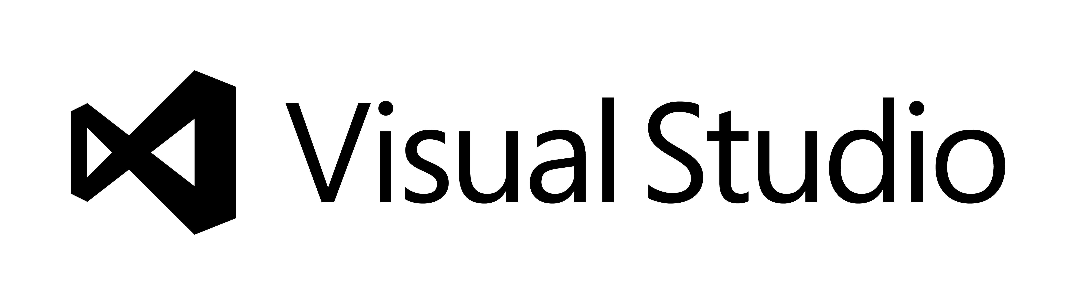
Programming symmetry
Windows Azure applications
  Create cloud-based or hybrid applications
  Same development tools between Windows Server and Windows Azure
  Common workflows and rules across
  web, application, and datacenter tiers
  Application-to-application contracts
  that support HTML5
  I/O operations that use isolated storage
Your code
Your code
Operating system
Operating system
Web role instance 1
Web role instance 2
Your code
Your code
Windows Server 2012
Windows Server 2012
Hyper-V or hardware
Hyper-V or hardware
On-premises applications
Notes:
Windows Server 2012 R2 offers programming languages and tools, such as Visual Studio and the .NET Framework, that span on-premises and cloud environments. With these tools, developers can work in a single, unified environment to build solutions for Windows Server and Windows Azure cloud platforms. Developers can use these programming tools across web, application, and datacenter tiers for locally deployed applications and for private and public cloud solutions.
This programming symmetry is complemented by the rich and comprehensive experience of working in Visual Studio. Whether developers work in house or as third-party solution providers, they can write code and use common workflows and rules to create on-premises, cloud-based, or hybrid applications from within a unified Windows development environment.
Windows Server 2012 R2 offers the following components and features:
Windows Azure SDK: Multiple updates to the Windows Azure Tools for Visual Studio 2010 that simplify development, deployment, and management on Windows Azure
Same development model: With programming symmetry, developers can work in a single, unified environment to build solutions that can be targeted to either Windows Server or the Windows Azure cloud platform
Common workflows and rules across web, application, and datacenter tiers
HTML5 or XAML-base for UI: New development platform
Application-to-application contracts that support HTML5 (Web 2.0)
I/O operations that use isolated storage: Developers can create and maintain a safe client-side virtual file system for partial-trust applications. (In Microsoft Silverlight®, all I/O operations are restricted to isolated storage and do not use the file system of the operating system.)
Applications cannot access operating system storage or another application’s space; access to system resources is brokered

Slide 32

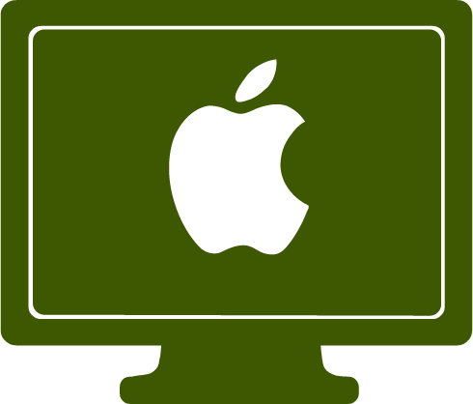


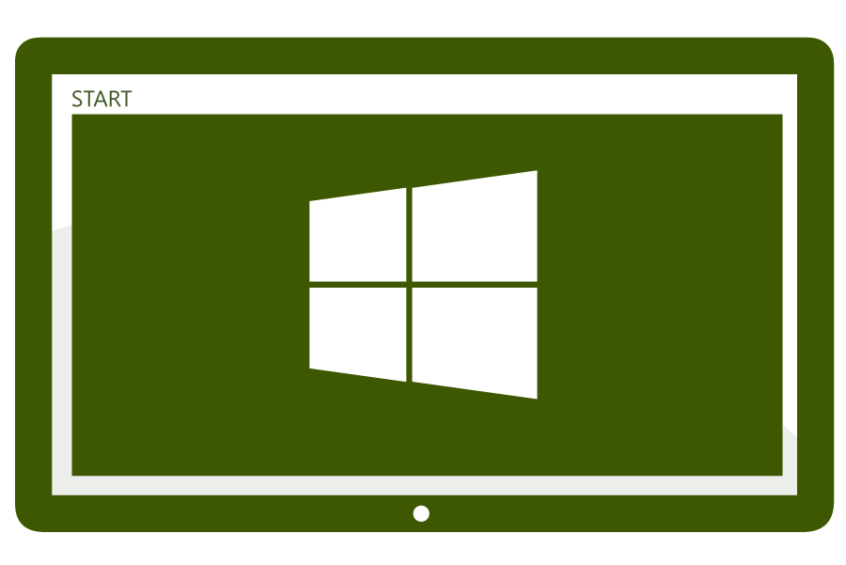
Device Management - Selecting the Management Platform
Unified Device Management
System Center 2012 R2 Configuration Manager with Windows Intune
  Build on existing Configuration Manager deployment
  Full PC management (OS Deployment, Endpoint Protection, application delivery control, rich reporting)
  Deep policy control requirements
  Scale to 100,000 devices
  Extensible administration tools (RBA, PowerShell, SQL Reporting Services)
Cloud-based Management
Standalone Windows Intune
No existing Configuration Manager deployment
Simplified policy control
Less than 7,000 devices and 4,000 users
Simple web-based administration console

Slide 33
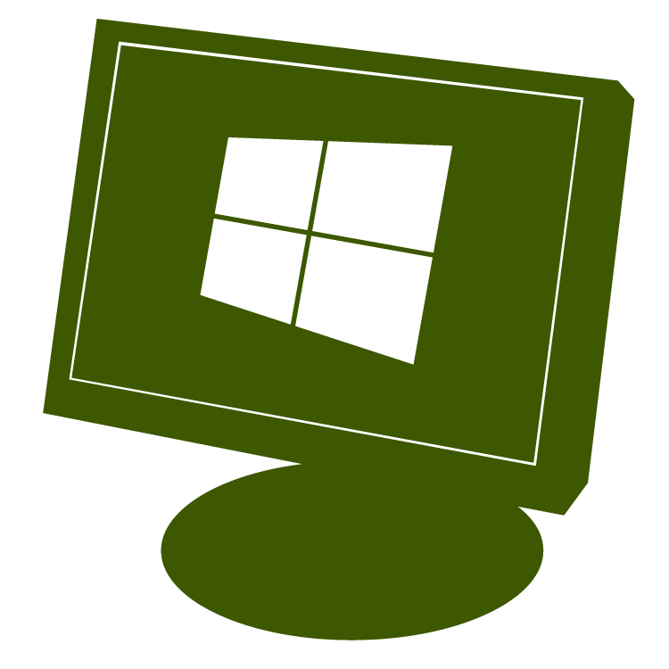
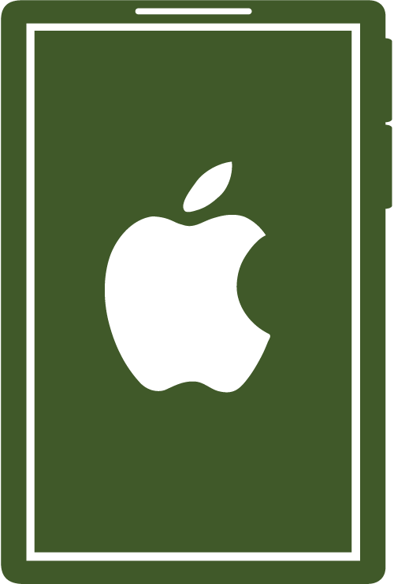
Unified Device Management
Windows PCs
(x86/64, Intel SoC),
Windows to Go
Windows Embedded
Mac OS X
IT
Single Admin
Console
Windows RT,
Windows Phone 8
iOS, Android

Slide 34
Why choose Windows Server 2012 R2 and
System Center 2012 R2 for your hybrid cloud
Enterprise-class
Simple and cost-effective
Application focused
Best-in-class performance, scale and management for Microsoft workloads
64 TB VHDX virtual disk with online resize for dynamically growing and shrinking the VHDX file
  Multi-hypervisor support, including Hyper-V, VMware, and Citrix
  Robust open source support: Dynamic Memory for Linux, Unix/ Linux monitoring and configuration
Hyper-V Network Virtualization and multi-tenant VPN gateway for inbox software-defined networking (SDN) solution
  Unified monitoring for on-premises and Windows Azure infrastructure
Storage Spaces with automatic tiering for inbox storage virtualization solution
Flexible guest clustering options for file and block storage with support for shared VHDX files
Inbox service templates and runbooks for System Center components
Standards-based top-of-rack network switch configuration
  Extensible service management automation and integration
Windows Azure Backup for reliable and cost-effective backup to the cloud
  Automated VM replication and orchestrated recovery with Windows Azure Hyper-V Recovery Manager
Easy VM portability between Windows Server and Windows Azure without the need for VM conversion
Standardized app provisioning with service templates
Deep .NET and Java application monitoring and diagnostics
  Integrated dev-ops with System Center-Visual Studio connector
  Cloud-integrated app and workload insight with Global Service Monitor and System Center Advisor
  Management Packs with extensive built-in knowledge for Microsoft Exchange, SQL, SharePoint
Notes:
Through this presentation, we hope you were able to get a sense of how Windows Server 2012 R2 and System Center 2012 R2 uniquely deliver against the promise of a hybrid cloud: Consistent with the notion of the Cloud OS, “hybrid” is built into Windows Server and System Center. System Center truly enables common management that spans Windows Server and Windows Azure environments., be it provisioning, self-service or monitoring.
Enterprise-class: Windows Server and System Center offer infrastructure and management capabilities that are enterprise grade and ready to use today. Not only is System Center best-of-breed for Windows environments and Microsoft workloads (like Exchange, SharePoint and SQL) but it also enables robust management of heterogeneous datacenters.
Simple and cost-effective: Windows Server 2012 R2 and System Center 2012 R2 take advantage of industry-standard hardware to lower your cost while enabling a high-performance, highly available datacenter environment. We’re constantly striving to reduce complexity in your datacenter by making it easy to provision, manage and operate hybrid infrastructure and application services.
Application focused: Applications are what your business cares most about, and Windows Server and System Center make it easy for you to develop, operate and monitor applications that can run in your datacenter, in the cloud or in a mixed (“hybrid”) environment. System Center has a relentless focus on optimizing your apps and workloads by arming you with rich insights to help you deliver predictable application SLA and a great end user experience.

Slide 35
Updated Azure Features
Windows Azure Automation
Windows Azure Automation allows you to automate the creation, monitoring, deployment, and maintenance of resources in your Windows Azure environment using a highly-available workflow execution engine.
Orchestrate time-consuming, error-prone, and frequently repeated tasks against Windows Azure and third party systems to decrease time to value for your cloud operations.
Azure RemoteApp
Microsoft Azure RemoteApp provides scalable Windows-based applications hosted in Azure.
Users can securely access their applications remotely from anywhere, on any device that appear to your users as if they are running on the end user's local computer.
Windows Azure Files
Windows Azure Files allows VMs in a Windows Azure Data Center to mount a shared file system using the SMB protocol.
These VMs will then be able to access the file system using standard Windows file APIs (CreateFile, ReadFile, WriteFile, etc).
Many VMs (or PaaS roles) can attach to these file systems concurrently, allowing you to share persistent data easily between various roles and instances.

Slide 36
SQL 2014 – Optimized for Virtualized Clouds
Memory-Optimized Tables
In-Memory OLTP is a memory-optimized database engine integrated into the SQL Server engine.
To use In-Memory OLTP, you define a heavily accessed table as memory optimized. Memory-optimized-tables are fully transactional, durable, and are accessed using Transact-SQL in the same way as disk-based tables
5-to-20 times performance improvements are common.
SQL Server Data Files in Windows Azure
SQL Server Data Files in Windows Azure enables native support for SQL Server database files stored as Windows Azure Blobs.
This feature allows you to create a database in SQL Server running in on-premises or in a virtual machine in Windows Azure with a dedicated storage location for your data in Windows Azure Blob Storage.
Host a SQL Server Database in a Windows Azure Virtual Machine
Use the Deploy a SQL Server Database from SQL Server Management Studio for SQL Server 2014 to a Windows Azure Virtual Machine Wizard to host a database from an instance of SQL Server in a Windows Azure Virtual Machine.

Slide 37
SQL 2014 – Optimized for Virtualized Clouds
AlwaysOn Enhancements
SQL Server 2014 contains the following enhancements for AlwaysOn Failover Cluster Instances and AlwaysOn Availability Groups:
An Add Azure Replica Wizard simplifies creating hybrid solutions for AlwaysOn availability groups. For more information, see Use the Add Azure Replica Wizard (SQL Server).
The maximum number of secondary replicas is increased from 4 to 8.
When disconnected from the primary replica or during cluster quorum loss, readable secondary replicas now remain available for read workloads.
Delayed Durability
SQL Server 2014 introduces the ability to reduce latency by designating some or all transactions as delayed durable.
A delayed durable transaction returns control to the client before the transaction log record is written to disk.

Slide 38
Use Building Blocks to facilitate deployments at all scales – from self-hosted, small organizations to Office 365
Server role evolution
Network layer improvements
Versioning and inter-op principles
Memory Caching and User Affinity
IOPS Reduced
Exchange 2013 Architecture Theme

Slide 39

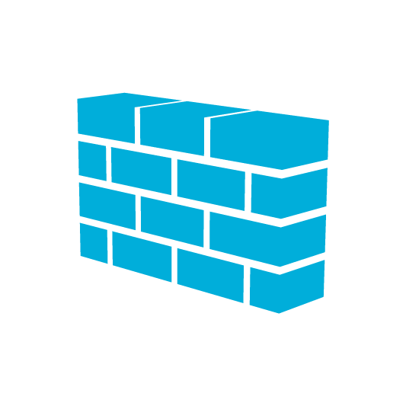

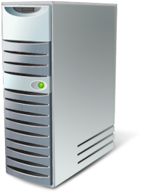

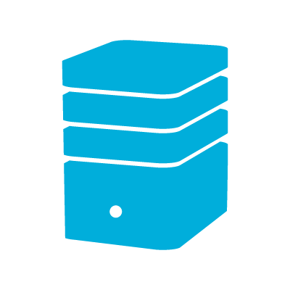




Exchange 2013 Server Role Architecture
  Building Blocks
Client Access server
CAS Array
Mailbox server
DAG
  Loosely-coupled
Functionality
Versioning
User partitioning
Geo-affinity
Multi-role Deployments:
Every server is an island
Exchange Online Protection
Internal Network
AD
CAS Array
DAG
External
SMTP
servers
Exchange 2010
Edge Transport
Layer 4 LB
Mobile
device
Web browser
Outlook
(remote user)
Outlook
(local user)
Line of business application
Phone system (PBX or VOIP)

Slide 40
Exchange 2013 – New Features
Simplified administration:
Single web-based interface with the Exchange Administration Center for all Exchange services, both on-premises and online.
Fully unified Hybrid Cloud Integration:
On-Premise / Office 365 / Azure / 3rd Party Hosting Provider
Managed High Availability (HA):
Integrated HA solution monitors and manages service availability end-to-end.
Outlook Web App:
Web-based, mobile device enabled webmail that is touch optimized.
SharePoint integration:
Integrated project information from SharePoint and Exchange, all from within Outlook.
Security:
Anti-Spam/Malware, Information Rights Management (Encryption), Archiving and Retention, Single Interface for eDiscovery for Exchange, SharePoint and Lync

Slide 41
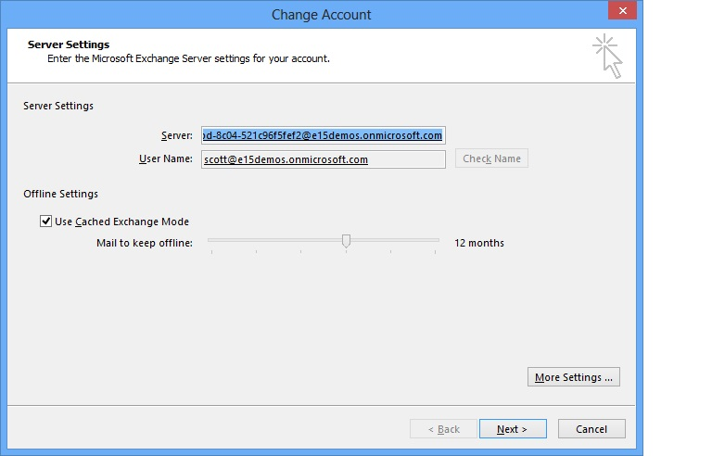
Exchange 2013 – Scalability and Control
Time | Items | Mailbox Size
1 Day | 150 | 11 MB
1 Month | 3300 | 242 MB
1 Year | 39000 | 2.8 GB
2 Years | 78000 | 5.6 GB
4 Years | 156000 | 11.2 GB
In the Exchange 2013 architecture, all workload processing for a given user occurs on the Mailbox server hosting the active copy of that user’s mailbox. Therefore, cache utilization is much more effective.
Large Mailbox Size is 100 GB+
  Aggregate Mailbox =
  Primary Mailbox + Archive Mailbox + Recoverable Items
  1-2 years of mail (minimum)
Increase IW productivity
Eliminate or reduce PST files
Eliminate or reduce third-party archive solutions
OST size control with Outlook 2013

Slide 42
Microsoft: Unmatched in the Cloud
15+
years in consumer and
business services
30k
engineers involved
in cloud-based activities
200+
$2.3B
invested in cloud
infrastructure
services, delivered 24x7
Certifications
Security
  FISMA certified
  EU Model Clauses
  SAS 70/SSAE 16
  ISO 27001 compliant
Highly secure,
compliant infrastructure
Notes:
Federated operations
centers 24x7
Highly secure, compliant infrastructure
FISMA certified, SAS 70/SSAE 16, and ISO 27001 compliant
Carbon footprint reduction
99.9% uptime, financially backed SLAs
>15 years in consumer and business services
9.9 billion messages a day via Windows Live Messenger
1 petabyte+ per month of updates via Windows Update
Windows Azure: used by customers in 41 countries
Office Web Apps: 50M users
$2.3B+ in cloud infrastructure
200+ services, delivered 24x7
Geo-distributed data centers
Rapid modular model
30,000+ engineers involved
in cloud-based activities
2,000+ people in cloud infrastructure engineering
and operations
Timing: 4 minutes
Presenter Guidance:
For each box, choose a few examples from the slide to illustrate the scale of our cloud services.
Key Points:
As a business cloud service provider, Microsoft is unmatched for the extent of our experience and our level of investment in the cloud.
We deliver services to millions of users and servers worldwide, we have made a substantial investment in data centers and people to support our cloud services, and we are fully committed to operational excellence.
Script:
No other company can match Microsoft in the business cloud today on the extent of our experience and investment in building and running cloud services:
We serve millions of users and our solutions run on millions of servers. We have more than 15 years of experience with cloud computing through both consumer and business services (starting with MSN in 1995).
We have spent over $2.3 billion dollars in building out our data center infrastructure to support our cloud platform. We deliver over 200 services 24 hours a day, seven days a week.
In terms of the physical infrastructure:
We have geo-distributed data centers, providing confidence that there is built-in redundancy if a data center is affected by a natural disaster. We consider over 35 weighted criteria including proximity to a stable power source and fiber optic networks, availability of affordable skilled labor, and affordable energy rates to determine the long-term viability of each site.
We also build our data centers using industry-leading modular designs, so they can be constructed more quickly for lower upfront and ongoing costs.
In terms of people resources, over 30,000 Microsoft engineers are involved in cloud-based activities, and we have more than 2,000 people in cloud infrastructure engineering and operations.
We’re committed to operational excellence for Microsoft Online Services.
Our federated Microsoft Operations Center has failover facilities in Redmond, India, and California to help ensure business continuity 24 hours a day, 7 days a week.
We obtain third-party audits and certifications so you can trust that our services are designed and operated with stringent safeguards.
Office 365 has International Organization for Standardization (ISO) 27001 certification and complies with European Union (EU) Safe Harbor principles.
The data centers and physical infrastructure that Office 365, Windows Azure, and other Microsoft online properties run on:
Have ISO 27001 certification.
Meet EU Safe Harbor principles.
Are audited annually against Statement on Auditing Standards No. 70 (SAS 70) (and will be audited against Statement on Standards for Attestation Engagements [SSAE] 16, which effectively replaces SAS 70, going forward).
Have Federal Information Security Management Act of 2002 (FISMA) certification.
We’re committed to operating efficient services and are continually improving our data center designs to save energy and lower their carbon footprint. Compared with data centers built just three years ago, our new data centers consume half the energy, and our goal is to construct data centers that average 1.125 in their power usage effectiveness (PUE) (where optimal energy use is 1 PUE), compared with an industry average of 2 PUE.
Our cloud services come with a financially backed 99.9 percent service level agreement (SLA)—if your applications and data aren’t available at least 99.9 percent of the time, we’ll compensate you.
Additional Information:
Online Services certification and security: http://www.microsoft.com/online/legal/v2/en-us/MOS_PTC_Security_Audit.htm

Slide 43
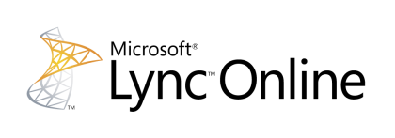


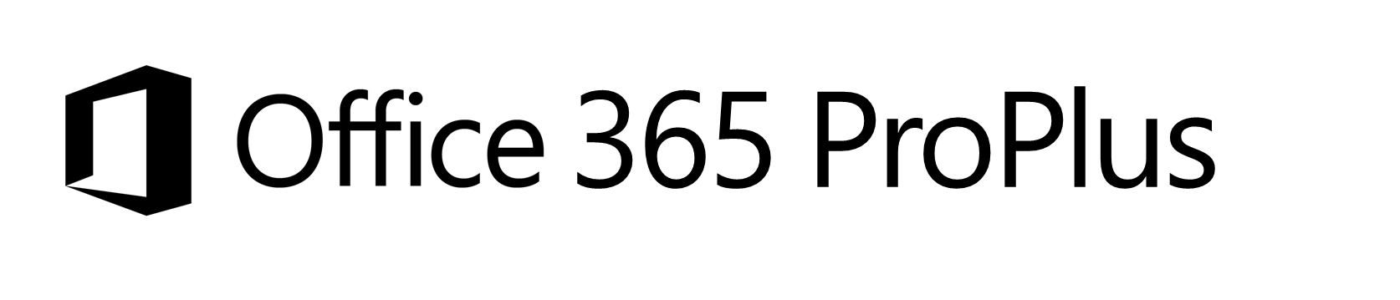




Office 365 At a Glance
Familiar and full Office user experience
Fast deployment and broad management controls
Works with your on premises email and storage
Per-user licensing
Online meeting with desktop sharing
IM & Presence across firewalls
GAL search with contact card
Windows Live federation
Access documents offline
Document-level permissions
My Sites to manage and share documents
Share documents securely with Extranet Sites
Free/busy coexistence
Integrated personal archiving
Retention policies and legal hold
25Gb mailbox with voicemail & unified messaging
Notes:
Speaker Notes (1 minute):
Office 365 offers the tools and technologies to deliver leading experiences messaging with Exchange Online, collaboration with SharePoint Online, unified communications with Lync Online and of course rich Office application experiences with Office 365 ProPlus. (click) Office 365 ProPlus is the full version of Office, you can use it without an Internet connection, and it works with the customizations you have made over the years. Deploy it how you normally would deploy Office and you can use Office with your existing in-house SharePoint or Exchange services and whether you want to allow cloud file storage is up to you.
We’ll focus the rest of our time talking about Office 365 ProPlus and the optimizations we have made to improve user and IT experiences for adopting the new Office.

Slide 44


Microsoft Office 365 - Cloud Principles
Services are highly configurable and scalable without customization.
Services are under the Microsoft Security Policy.
We provide transparency in data location and transfers.
We audit on your behalf and provide certification reports.
Microsoft’s liability is capped, consistent with industry standards.
Office 365 is an evergreen service. Customers need to stay current.
Our solution evolves rapidly with a documented roadmap.
We provide services offers to help you migrate to the cloud efficiently.

Slide 45




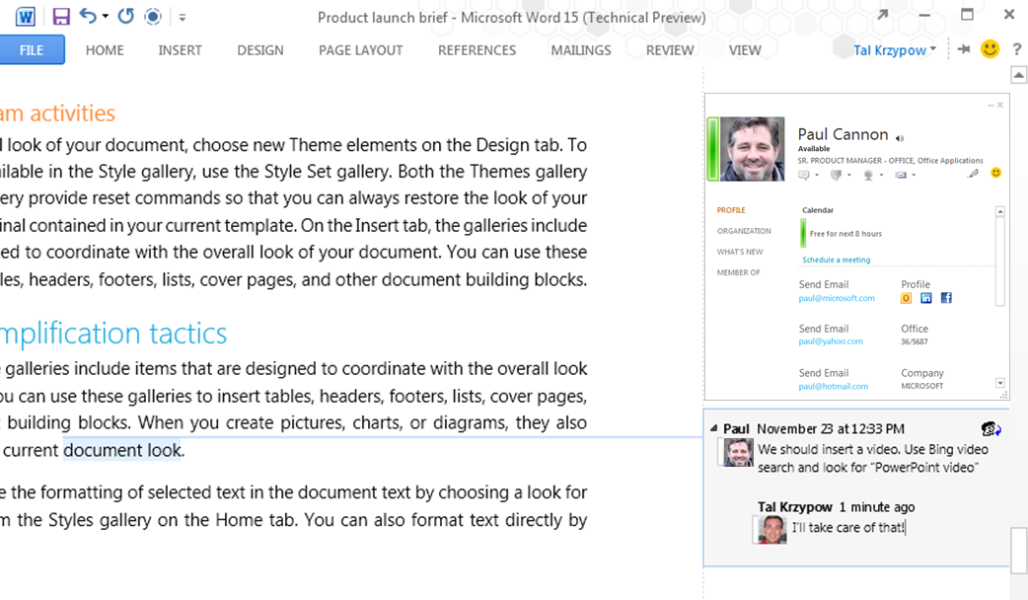
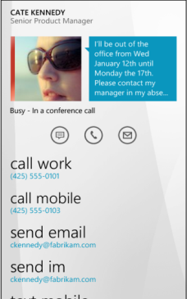

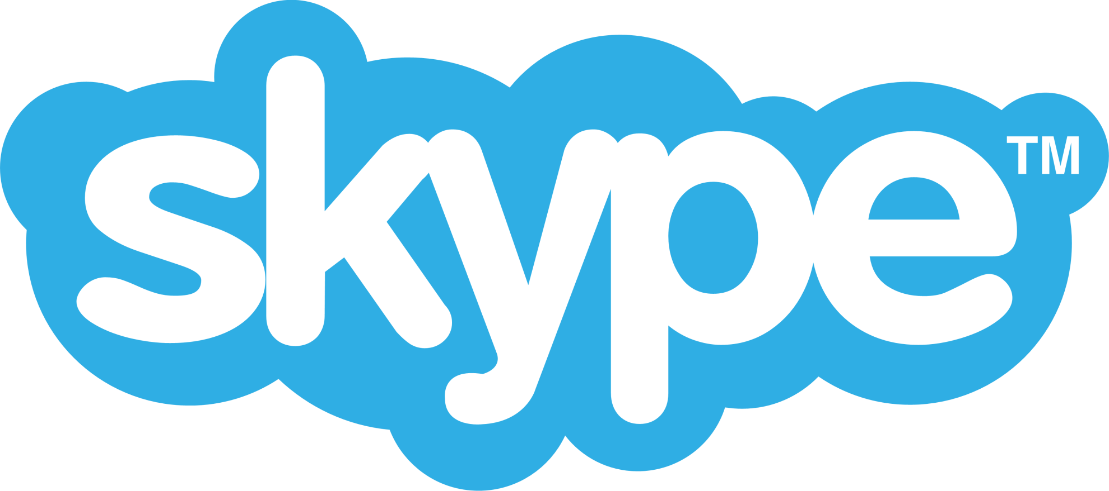
Lync 2013 Features
Multiparty HD video & content sharing
Modern, mobile and web clients
Integration across Office apps
Federation with Skype
Video gallery
HD video or high resolution photos of attendees
H.264 SVC support
Presenter controls to optimize for meeting type
Participant selected views
Single unified client experience across workloads
Lync Windows 8 immersive experience optimized for touch
Mobile client experiences designed for the device
Lync Web App for browser access to meetings
Communicate directly from within Office
Single identity
Shared contact card
OneNote Share
Communicate with anyone on Skype
Presence
Instant Messaging
Peer to peer voice
Notes:
Slide Objective:
Articulate the vision for Lync 2013 & Lync Online.
No Build - Use the pillars to articulate the investments and set-up the subsequent slides. Talking points:
The vision for the next release of Lync builds upon the strengths of Lync 2010 while taking a broader view of how communications, data and human interaction can blend in order to drive connections among a diverse and distributed workforce. When animation, clean design and touch are layered in, the scenarios and user experience is elevated in new and engaging ways.
The essence of Lync 2013 is captured in 4 pillars, or collections of investments:
The first is Multiparty HD video & content sharing. Lync 2013 and Lync Online showcase advances in video and visual communications. “I see what you mean” takes on an entirely different meaning when colleagues and customers from down the hall, across town or around the globe can see each other’s gestures while hearing their tone - when working together in a Lync Meeting.
The next release of Lync further delivers on the promise of “access anywhere”, ensuring that Lync is available anywhere a user has access to Windows 8 PC or tablet, mobile device or browser. Modern, mobile and web client investments allow Lync to be where the users are, putting people at the center of communications and collaboration. And yet, with the diversity of platform, form factor and device support – the experience is familiar and engaging.
Lync was built from the ground up to deliver identity-based communications– pivoting on a user’s identity rather than the old paradigm of using phone numbers as a proxy for a person. Lync Integration across Office apps enables “one-click” communications directly from within the productivity applications used by Information Workers everyday. Lync is integrated into Outlook, SharePoint, OneNote and other Microsoft applications, users do not have to leave their current application when they need to reach out to others. Lync breaks down solution silos and application boundaries making communication and collaboration natural and less complex.
Federation with Skype unlocks the potential to bring all of these investments mentioned, and the rich communication and collaborations scenarios they enable - to hundreds of millions of users worldwide.
Transition - Take a closer looks at each one of these investment areas

Slide 46

Enabling customer deployment choice
Lync Server
Lync Hybrid
Lync Online
Lync Server
Private cloud / dedicated
Single domain & directory
Users split – server / online
Office 365, Lync Online
Partner-hosted multi-tenant
Notes:
Lync today supports on-Premises and Cloud deployments, and supports interoperability between on-premises Lync deployments and Office 365. In Lync 2013, we will be updating the Server and the service will provide users with more choice in terms of how they deploy.
On premises: Lync can be deployed “on premises” configuration, just as it has in Lync 2010 This deployment approach supports customer premises deployments and Private Cloud deployments via license mobility
Cloud: Lync Online– standalone or as a part of an Office 365 suite– will continue to be available and will get the advantages of the feature and manageability improvements we deliver as part of Lync 15
Hybrid: New in the Lync 2013 timeframe, enterprises will be able to split users between Lync Server 2013 and Lync Online, while keeping the same single domain name for all the users easing migration scenarios, especially where customers are eager to take advantage of the value of cloud services but where a portion of their users cannot move from an on premise deployment to the cloud.

Slide 47
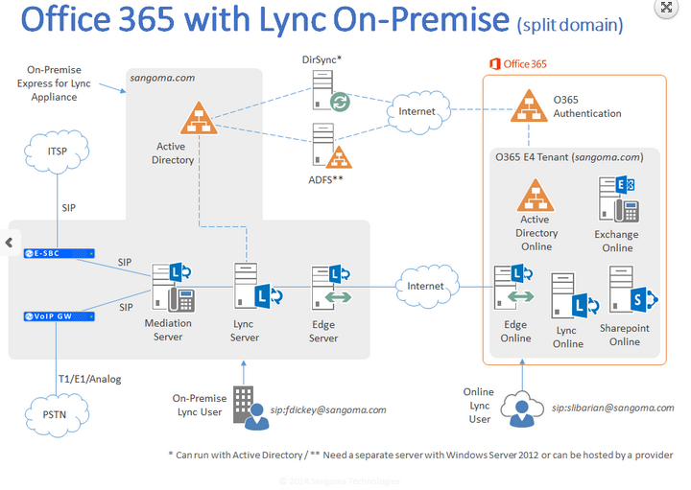

Slide 48
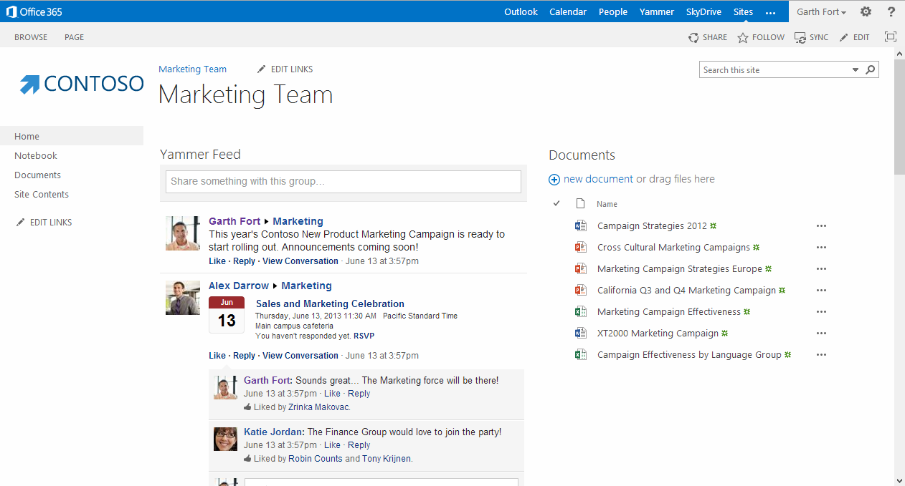
SharePoint 2013

Slide 49
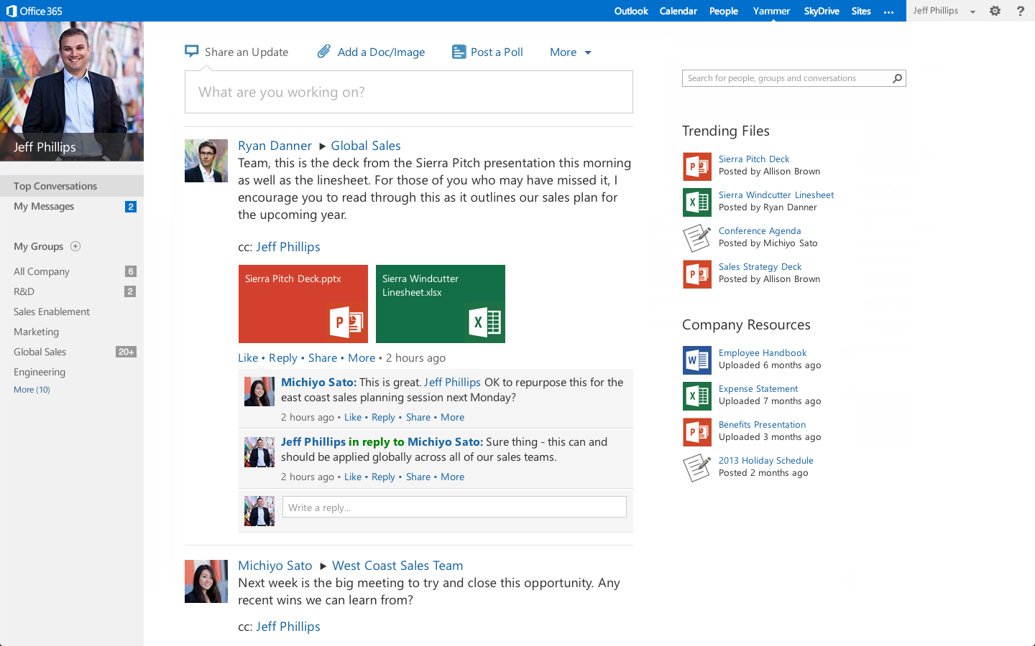

Slide 50
Yammer and Office 365
Summer
Fall
Winter
Today
Tomorrow
Coming Up
Connected Experiences
New experiences that combine social, collab, email, instant messaging, voice, and video
Option to replace SharePoint
Newsfeed with Yammer
New user experience
External Communication
Yammer app for SharePoint
Document Conversations
Email Integration
SharePoint 2013
on-premises guidance
Office 365 Single sign-on
Enhance Messaging

Slide 51
ENCORE TECHNOLOGY GROUP
Rethink Technology!
What is Unified Communications?
Unified communications (UC) is the integration of real-time, enterprise, communication services such as instant messaging (chat), presence information, voice (including IP telephony), mobility features (including extension mobility and single number reach), audio, web & video conferencing, unified messaging, etc.
UC is not necessarily a single product, but a set of products that provides a consistent unified user-interface and user-experience across multiple devices and media-types.
Wikipedia Paraphrase
2015 - Encore Technology Group, LLC. - All rights reserved.
http://www.encoretg.com

Slide 52
ENCORE TECHNOLOGY GROUP
Rethink Technology!
Unified Communications
Telecommunications (Voice)
Unified Messaging (Email)
Instant Messaging and Presence (IM&P)
Video (P2P and Multipoint)
Collaboration
2015 - Encore Technology Group, LLC. - All rights reserved.
http://www.encoretg.com

Slide 53
ENCORE TECHNOLOGY GROUP
Rethink Technology!
How should Unified Communications be Deployed?
From a Cloud
Private
Public
Hybrid
2015 - Encore Technology Group, LLC. - All rights reserved.
http://www.encoretg.com

Slide 54
Commoditization (“Utilitization”) of Communication
Email / IM&P / Voice (Telephony)
We all have accepted consumer communication resources from the cloud – Skype, Gmail, Facebook, iMessage
Businesses are now rapidly adopting “Industrial Clouds” for their business needs.
Notes:
1.2 Billion Smartphones, Tablets To Be Bought Worldwide In 2013; 821 Million This Year: 70% Of Total Device Sales
http://techcrunch.com/2012/11/06/gartner-1-2-billion-smartphones-tablets-to-be-bought-worldwide-in-2013-821-million-this-year-70-of-total-device-sales/

Slide 55




Office Productivity
Essential for business and consumers
Comprehensive tools to do your best work
Enterprise-grade cloud services

Slide 56





Introducing the new Office
Comprehensive tools to do your best work
Enterprise-grade cloud services
Devices
Social
Cloud
Control

Slide 57
Introducing the new Office
Devices
Social
Cloud
Control
Fast and fluid experience with touch, pen, mouse & keyboard
Immersive touch-optimized Windows 8 apps
Support for Windows Phone, iOS & Android phones
Newsfeeds & microblogging, extend with Yammer
Pervasive social capabilities across Office
Multiparty HD video & Skype federation
Office - on demand, roaming & up-to-date
New cloud app development model
Enterprise-grade reliability and standards
DLP, data retention & unified eDiscovery
Reimagined deployment model for Office apps
Common management experience across Office 365

Slide 58
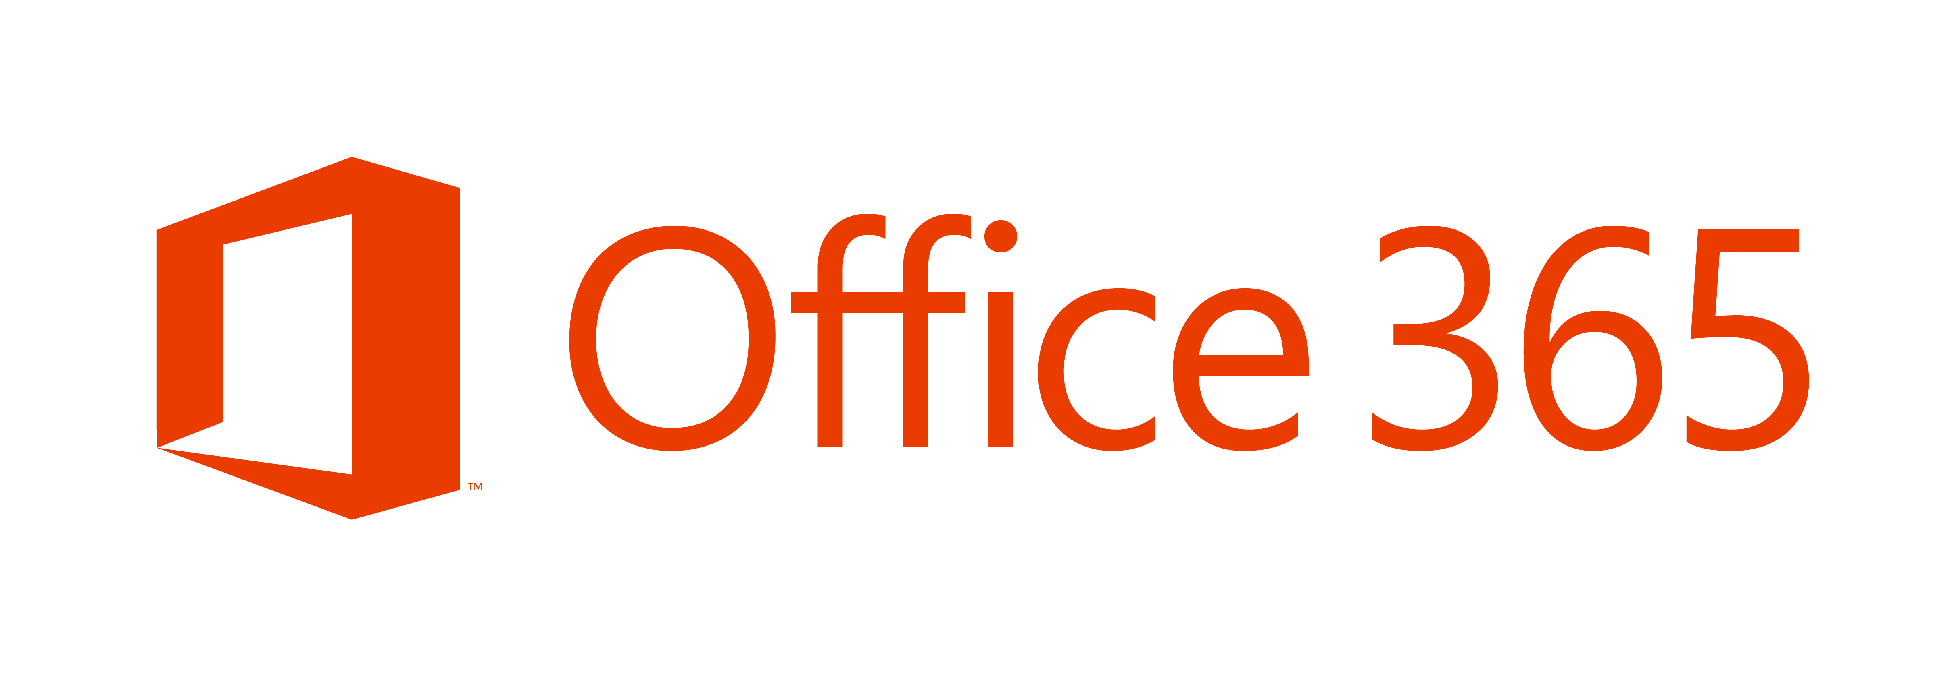

| Collaboration for Everyone
Enterprise Quality Support
Best SLA
in the Industry
Office
Exchange
SharePoint Lync
Familiar, Powerful
& Cross-platform
Service Plans for Everyone

Slide 59
Office 365 At a Glance
Familiar and full Office user experience
Fast deployment and broad management controls
Works with your on premises email and storage
Per-user licensing
Online meeting with desktop sharing
IM & Presence across firewalls
GAL search with contact card
Windows Live federation
Access documents offline
Document-level permissions
My Sites to manage and share documents
Share documents securely with Extranet Sites
Free/busy coexistence
Integrated personal archiving
Retention policies and legal hold
25Gb mailbox with voicemail & unified messaging
Notes:
Speaker Notes (1 minute):
Office 365 offers the tools and technologies to deliver leading experiences messaging with Exchange Online, collaboration with SharePoint Online, unified communications with Lync Online and of course rich Office application experiences with Office 365 ProPlus. (click) Office 365 ProPlus is the full version of Office, you can use it without an Internet connection, and it works with the customizations you have made over the years. Deploy it how you normally would deploy Office and you can use Office with your existing in-house SharePoint or Exchange services and whether you want to allow cloud file storage is up to you.
We’ll focus the rest of our time talking about Office 365 ProPlus and the optimizations we have made to improve user and IT experiences for adopting the new Office.

Slide 60




Office 365 works for everyone
Information Worker Offering
Task Worker Offering
Enable
Empower
Extend
Connect
Rich Productivity and Collaboration Solution to empower Information Workers
Cost effective offering for users with limited access to a Productivity solution today
Notes:
Today's companies need to support different types of users, including task workers who perform routine transactional work using a single application to collect structured data and knowledge workers who are responsible for more cognitive tasks requiring access to multiple information sources and applications. Both types of users need business applications that support industry-specific business processes that enable them to become productive quickly.
With a low cost Kiosk Worker Offering - our Plan K – many companies can finally reach all of the employees and stay connected. Kiosk plan gives everyone access a secure 1GB mailbox, Exchange ActiveSync & POP support, Messaging, calendar, contacts
Forefront antivirus and anti-spam, SharePoint Access; Site search capabilities; Office Web Apps
For example, Godiva Chocolatiers are finally able to connect all their store employees on one single secure messaging system with Office 365 that makes economic sense:
“User response has been overwhelmingly positive. Our employees are thrilled to have a modern, familiar email program, which makes them more efficient and productive.” Mike Strause, IT Architect, Global Shared Services, Godiva Chocolatier
Office 365 E-Plans offer a reach feature set that can enable your information workers to collaborate, access information from anywhere and empower them with:
User Segment Offers: Plan E Family
25 GB mailbox
500 MB SharePoint storage
Client connectivity
Mobility
Lync capabilities
Exchange and SharePoint capabilities
Office Professional Plus
On-premises access rights

Slide 61
Yammer and Office 365
Summer
Fall
Winter
Today
Tomorrow
Coming Up
Connected Experiences
New experiences that combine social, collab, email, instant messaging, voice, and video
Option to replace SharePoint
Newsfeed with Yammer
New user experience
External Communication
Yammer app for SharePoint
Document Conversations
Email Integration
SharePoint 2013
on-premises guidance
Office 365 Single sign-on
Enhance Messaging

Slide 62
SharePoint 2013

Slide 63

Share & Receive Information
  Businesses today are required to move fast to keep up with the ever changing needs of consumers. This can be a challenge if there’s lack of visibility into what’s happening across and outside of the organization.
Use Announcements for company-wide messaging
Spend 20 mins/week scanning your Feed to stay abreast of activity
Follow up on big news by sharing a Note with additional details
Share key updates with All Company to keep your employees “in the know”
Join Groups to follow the conversations and work taking place across teams
Notes:
As you go through the use cases, briefly demonstrate how easy it is to post an announcement or message, like or reply to a message, and scan through the Home feed.
From the slide:
Business today are required to move fast to keep up with the ever changing needs of consumers. This can be a challenge if there’s lack of visibility into what’s happening across and outside of the organization.
Use Announcements to efficiently distribute company-wide messaging.
Follow up on all-company meetings by sharing a Note with additional details and FAQs.
Share key updates from a conference or speaking engagement with the All Company to enable your employees to feel “in the know.”
Join Groups to follow the conversations and work taking place within a specific department or project team.
Spend 20 minutes/week scanning your Feed to stay abreast of:
Activities and updates in regards to project milestones
Employee satisfaction
Professional development

Slide 64
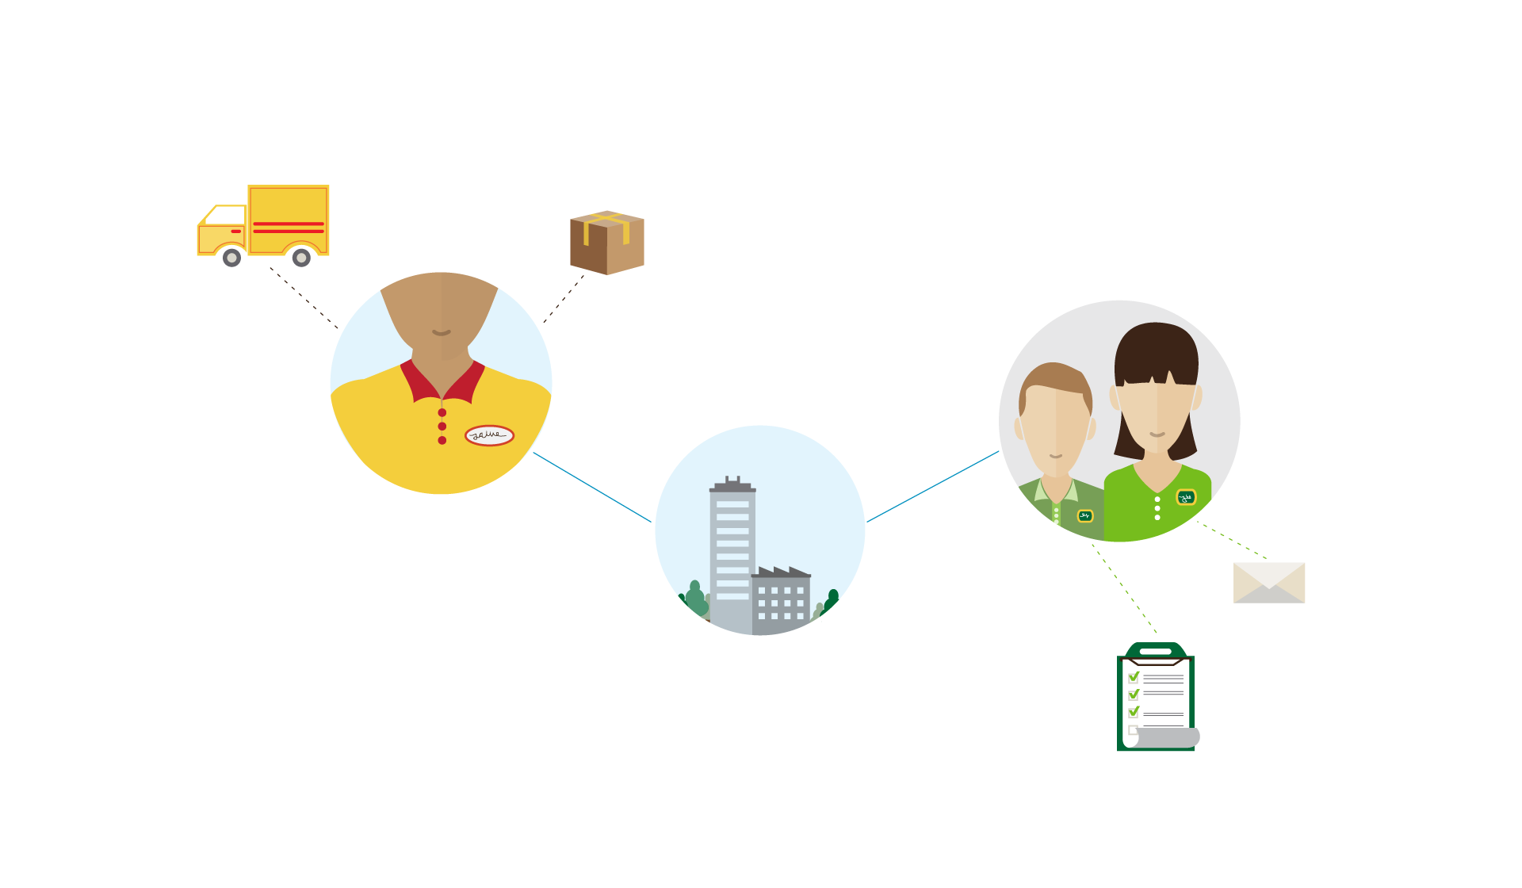
Encourage & Respond to Feedback
  The majority of employees are disengaged and feel as though their input doesn’t matter. It’s essential to enable your employees to have a voice and show that you are listening.
Ask an open-ended question
Take note of Likes and Replies to your posts
Encourage employees to Reply to your posts with questions and feedback
Host a YamJam
Notes:
As you go through the use cases, briefly demonstrate how easy it is to post an announcement or message, like or reply to a message, and scan through the Home feed.
Observe real-time reactions and responses to your posts by taking note of “Likes” and Replies.
Encourage employees to Reply to announcements with feedback and questions.
Ask an open-ended question or post a poll seeking feedback on an issue or possible initiative.
With the help of your network Community Managers, host periodic “YamJams” around a specific topic or hot-button issue to quickly capture employee insight.
A “YamJam” is a live, Q&A session that takes place directly within the Yammer network.

Slide 65
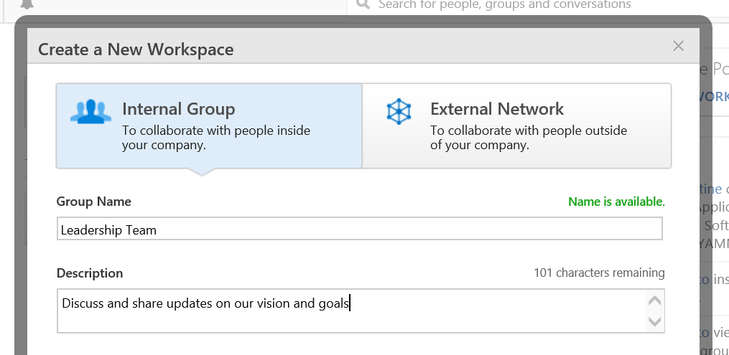
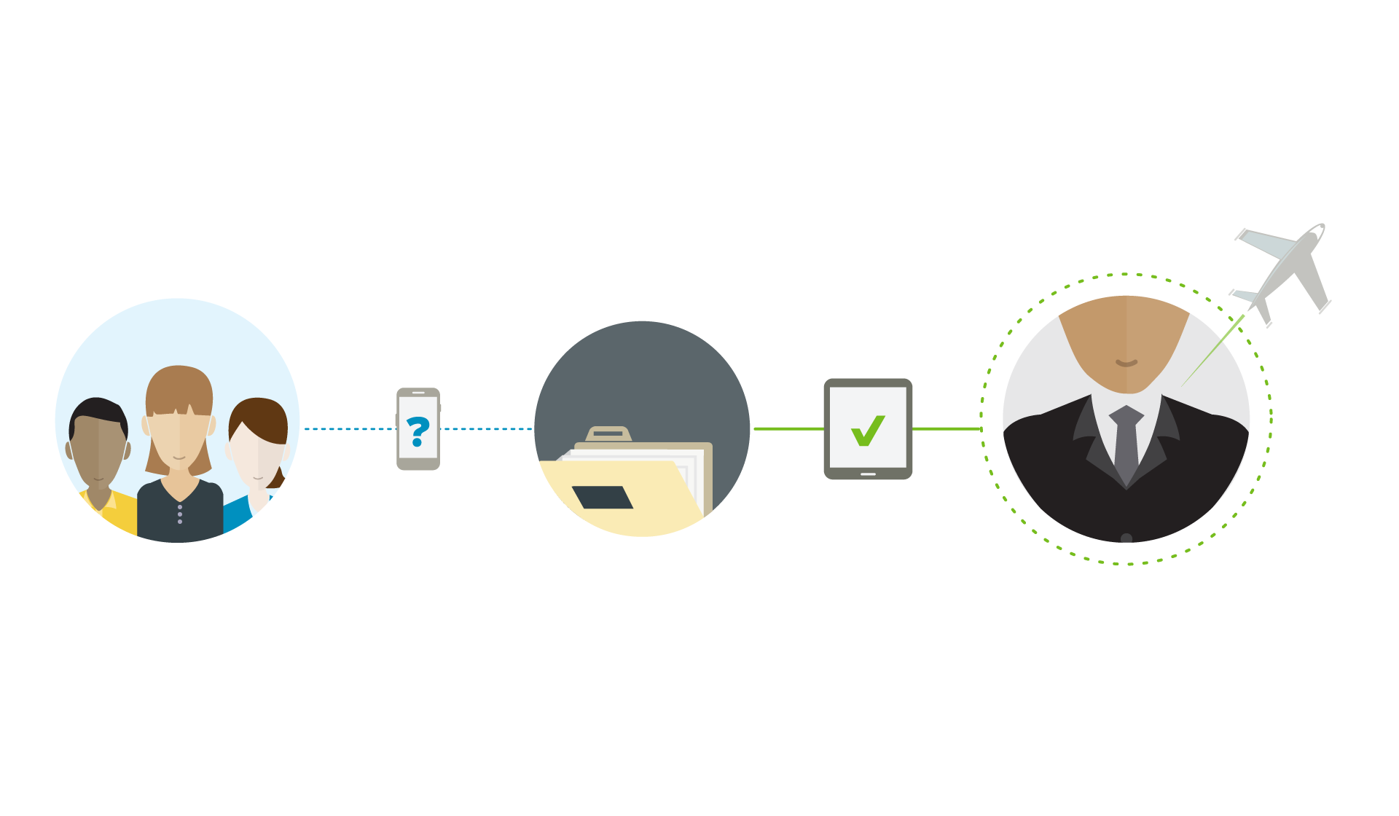
Bring Leaders & Teams Together
  Leaders and teams today are dispersed across geographies and departmental silos. It’s important to stay on top of what your fellow executives are doing and make sure leadership is in alignment.
Share regular reports and engage in discussion around these documents
Create a Leadership Group
Encourage other leaders to Post updates on strategies and goals
Notes:
As you go through the use cases, briefly demonstrate how easy it is to post an announcement or message, like or reply to a message, and scan through the Home feed.
Create a Leadership Group where fellow executives can come together to discuss and share updates around the organization’s vision and goals.
Share monthly/quarterly reports with Leadership and Board Members and engage in discussion around the documents that have been uploaded to the group.
Encourage other leaders to Post updates on team strategies and goals to provide greater visibility into where the organization is headed.

Slide 66

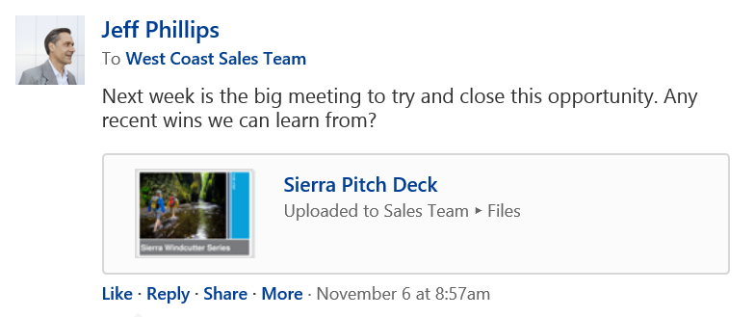
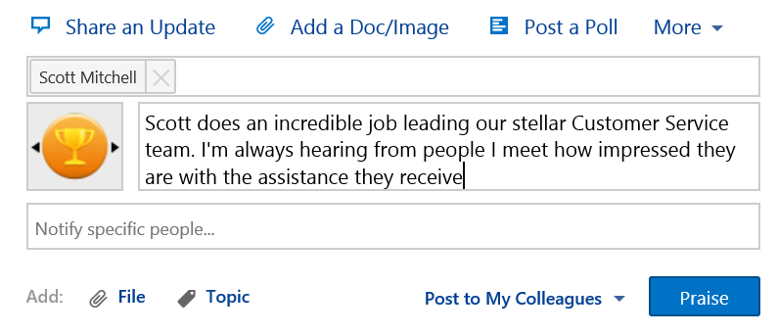
Recognize & Praise Hard Work
  Feedback is powerful. Employees are encouraged by the feedback and reinforcement they receive from others, especially managers and executives.
Post a Praise for a job well done
Like a post you find interesting or valuable
Notes:
As you go through the use cases, briefly demonstrate how easy it is to post an announcement or message, like or reply to a message, and scan through the Home feed.
Click the “Like” button under a post that you find to be interesting or valuable to others in the organization.
Post a “Praise” to one or several people for a job well done on a specific project or task. This could be anything from a new product launch, a key sales closing, a new marketing campaign, or a promotion.
These simple actions tell employees that you appreciate their work and reinforce positive behavior.

Slide 67
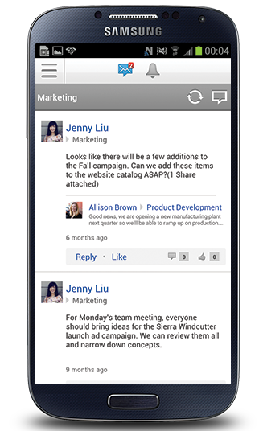
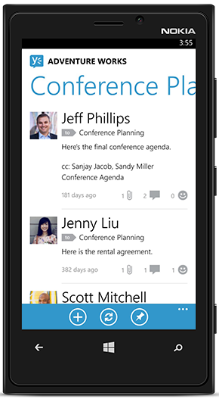
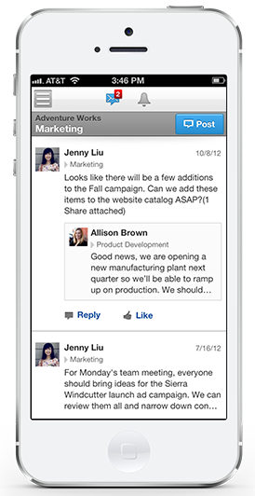
Accessing Yammer
Access Yammer from your mobile device when you’re on the go.
Notes:
You can add in screenshots of your own network here to make this more relevant.
Provide some assistance in setting up their mobile app if they’re not confident enough. The Yammer mobile applications are popular among leaders and executives who don’t spend a lot of time behind their desk. They can scan and access what’s happening while they’re on the move, which makes it much easier to stay abreast of what’s happening at their convenience.

Slide 68
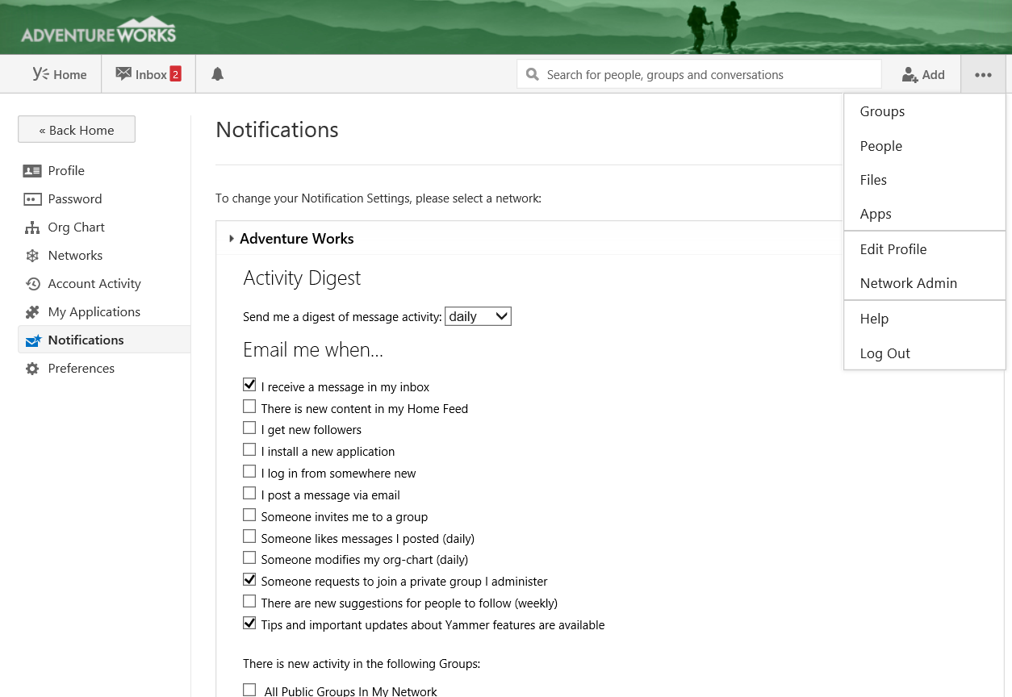
Adjust notifications
1. Select Edit Profile
2. Click Notifications
Messages where you are @mentioned
Optimum notification settings for new users
Notes:
You can add in screenshots of your own network here to make this more relevant.
Give your executives a hand in adjusting their notifications so that they get the right balance. You may even suggest setting up a email rule/filter so that all their Yammer notifications are sorted into a folder they can check at their convenience.

Slide 69
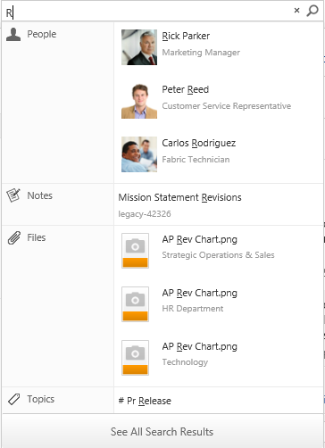
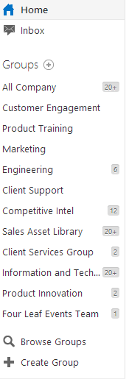
Make Yammer relevant to you
Follow Key People
  Search for your direct reports in the search bar
  You don't need to follow everyone
  Members will not receive a notification if you "un-follow" them
Join Groups
  Search and join groups that interest you so that they appear in your Following Feed
Notes:
You can add in screenshots of your own network here to make this more relevant.

Slide 70
Quick tips for engaging with colleagues
No need to be too formal! This is the opportunity for you to quickly engage with your teams and get a snapshot of what is happening on the front-line
Keep most posts shorter than traditional communications - the idea is to engage and start discussions
Ask questions!
Don't be afraid to show your personality.
Notes:
Coach your executives on hitting the right tone, and using their real voice when communicating on Yammer. Focus on the value of direct engagement with employees at all levels and across all areas of the business. Encourage them to Reply as well as only starting new discussions – this signals that they are engaging with what’s happening, not just using Yammer as yet another ‘broadcast’ channel.

Slide 71
InfoPath Details
InfoPath Forms Services is a server technology that makes it possible for people to fill out forms in a Web browser. By managing forms in a central location, you can streamline business processes and improve relations with customers, partners, and suppliers.
Forms are at the center of many business processes. By hosting browser-enabled form templates on a server running InfoPath Forms Services, you can integrate form data with existing business processes or applications.

Slide 72
InfoPath Uses
Submit data to existing business systems When you design a browser-compatible form template, you can create data connections to Web services or other external data sources. This allows you to submit data to existing business systems, enterprise applications, or corporate databases. For example, a sales department can design a form that can submit sales leads and customer information to an existing Customer Relationship Management (CRM) system.
Query data from existing business systems It is also possible to query data in existing business systems, enterprise applications, or corporate databases. For example, when users open a form based on your form template, you might want data from an external data source to appear in the name and address fields on the form. This enables you to take advantage of existing organizational data and simplifies the process of filling out a form.
Add workflow to forms You can add a workflow to the form template that is stored in a library. This enables you to consistently manage common business processes.

Slide 73


InfoPath Uses

Slide 74
InfoPath Roadmap
1. Will Microsoft be shipping another version of InfoPath?
No, there will not be another version of the InfoPath desktop client or InfoPath Forms Services. Microsoft is focusing all investments on new intelligent, integrated forms experiences across Office technology.
2. How long will InfoPath be supported?
The InfoPath 2013 client will be supported through April 2023.
InfoPath Forms Services for SharePoint Server 2013 will be supported until April 2023.
InfoPath Forms Services in Office 365 will be supported until further notice.
However, Infopath will only continue to be available in the Enterprise E3 and ProPlus plans.
Infopath will not be available in Business Premium or Business.
3. What should I use to build and complete forms?
You should continue to use InfoPath technology.

Slide 76









Each year customers of Microsoft’s cloud productivity services…
222
Fly
million
passengers
Build
6
million
automobiles
in the United States alone
Many of the world’s largest and most recognizable global brands run on Microsoft’s cloud productivity services.
27
Serve
billion
meals
41
16
of the
Interbrand Top 100
Sell
billion
cans of soda
4
Make
billion
cups of coffee
Notes:
Microsoft has been providing cloud productivity services for over three years, and we have had great success in the marketplace:
40 million+ paying customers of Microsoft Online Services
More than 9,000 business customers
More than 500 government entities
More than 50% of the Fortune 500
70% Exchanging from Notes
16,000 partners committed to BPOS
Global reach: Available in 40 countries and localized into 20 languages
Depending on your customer, you can pull specific customer references from this site and talk through in this slide: http://infoweb2007/onlineservices/evidence/Pages/CaseStudies.aspx.
Some approved customer quotes:
“The move to Microsoft Online Services will help cut operational costs by an estimated 30% and create a variable cost model that will provide increased flexibility in the future.” Ingo Elfering, VP, Information Technology Strategy, GlaxoSmithKline
“Our users consistently rave about the move to Microsoft Online Services, providing familiar, intuitive solutions that we could trust with our business communications.” Chris Millington, Global CTO, McDonald’s Corporation
“We looked at a variety of cloud-based offerings, and only Microsoft could meet our requirements for reliability. We have already started our rollout, and with Exchange Online, we will consolidate 42 e-mail systems into one, reducing our IT costs by at least 30%.” Olivier Baldassari, CIO, Rexel Group

Slide 77


Customer Examples
"Coca-Cola Enterprises needed to simplify its communication and collaboration technologies to provide better business value to our employees. Microsoft Online gave
us the technology to do so and exceeded our expectations."
John Key
Assistant Director of Communication
and Collaboration Technologies
Coca-Cola Enterprises
“With the successful rollout of Microsoft Online Services to our North American stores, we have demonstrated that we
can go into the ‘cloud’ with confidence.”
John Shepard
Director, Global IT Infrastructure Services Starbucks
“User response has been overwhelmingly positive. Our employees are thrilled to have a modern, familiar email program, which makes them more efficient
and productive.”
Mike Strause
IT Architect, Global Shared Services
Godiva Chocolatier
Notes:
Coca-Cola
Coca Cola Enterprises (CCE) opted for the cloud and implemented Microsoft-based hosted worldwide intranet with messaging and collaboration tools. Employees can access their data and information from any device, boost their productivity, and focus on their customers.
Story: With increasing competition in the marketplace, CCE needed a more effective way to collaborate with their employees, to increase their productivity, to enable better flow of information, and to create more time for sales persons to engage with customers. Their worldwide presence required employees and executives to spend numerous hours on the road every week, travelling to internal meetings. Microsoft Online Services technologies enable CCE to save travel expenses through online meeting tools and collaboration platforms that span time zones and geographies.
Case study: http://www.microsoft.com/casestudies/Case_Study_Detail.aspx?casestudyid=4000004584
Video: http://www.microsoft.com/showcase/en/US/details/470b9f4c-bac8-4be9-b22a-d1a6953ef6a7
QUOTE: "Coca-Cola Enterprises needed to simplify its communication and collaboration technologies to provide better business value to our employees. Microsoft Online gave us the technology to do so and exceeded our expectations." John Key, Assistant Director of Communication and Collaboration Technologies, Coca-Cola Enterprises
Starbucks
Starbucks continues to use Microsoft technology on-premises in its corporate headquarters, while rolling out 18,000 laptops using Exchange Online and SharePoint Online to store managers.
QUOTE: “With the successful rollout of Microsoft Online Services to our North American stores, we have demonstrated that we can go into the ‘cloud’ with confidence.” John Shepard, Director, Global IT Infrastructure Services, Starbucks
QUOTE: “It’s important to remember that we rolled out this entire project at a time when the company was under pressure to spend no money at all. Our ability to complete the project on time and under budget speaks to the efficiency of Microsoft Online Services and the ease of implementation.” John Shepard, Director, Global IT Infrastructure Services, Starbucks
QUOTE: “Web-based distribution of new-product materials enables Starbucks to be much more nimble in meeting customer needs,” Shepard adds. “Instead of taking six months to introduce a new product, we can do it in just a few weeks by communicating so quickly with partners.”
Godiva
Link to the case: http://www.microsoft.com/casestudies/Case_Study_Detail.aspx?CaseStudyID=4000008333

Slide 78

Relentless on Security
Deep Experience
Secure Development Lifecycle
5 Layers of Security
Proactive Monitoring
Access Restriction
Data replicated in geo-redundant datacenters to protect against datacenter wide failures
Backed by a 99.9% financially backed Service Level Agreement
"The robust security and reliability that Microsoft was providing with Office 365 was essential—we would not have agreed to a hosted solution without making sure that the State’s data would be secure.”
Tarek Tomes, Assistant Commissioner (OET),
State of Minnesota
Notes:
Relentless on security
As a pioneer in online data services, Microsoft builds on deep industry experience to incorporate cutting-edge security practices from development through to administration and maintenance.
Deep Experience. We have developed our practices and policies as a result of over 15 years of experience in providing security for online data.
Secure Development Lifecycle. Microsoft’s Secure Development Lifecycle ensures that security and privacy is incorporated into our products by design, from software development to service operations.
5 Layers of Security. Data is secured in 5 different layers – data, application, host, network and physical.
Proactive Monitoring. We proactively monitor Office 365 services to identify potential known and unknown threats by predicting malicious behavior, and also monitor for irregular events that may indicate threats.
Access Restriction. Microsoft restricts our production server access to a short list of critical operations personnel.

Slide 79


Trusting the service
Clear messaging
Details for security experts
Links videos, whitepapers
http://trust.office365.com
Notes:
ADD TRUST CENTER LINK
We don’t scan your email or documents for building analytics, data mining, advertising, or improving the service.
Microsoft strives to be a leader in industry privacy, security and compliance practices. By focusing on the following principles, Microsoft is consistently and proactively working towards earning your trust.
To learn more about privacy and security at Microsoft, you can review the documents here. These documents include Microsoft’s response to questions suggested by the Cloud Security Alliance for customers seeking a cloud provider. For a full list of the products covered by the Trust Center content, click here.

Slide 80
Microsoft: Unmatched in the Cloud
15+
years in consumer and
business services
30k
engineers involved
in cloud-based activities
200+
$2.3B
invested in cloud
infrastructure
services, delivered 24x7
Certifications
Security
  FISMA certified
  EU Model Clauses
  SAS 70/SSAE 16
  ISO 27001 compliant
Highly secure,
compliant infrastructure
Notes:
Federated operations
centers 24x7
Highly secure, compliant infrastructure
FISMA certified, SAS 70/SSAE 16, and ISO 27001 compliant
Carbon footprint reduction
99.9% uptime, financially backed SLAs
>15 years in consumer and business services
9.9 billion messages a day via Windows Live Messenger
1 petabyte+ per month of updates via Windows Update
Windows Azure: used by customers in 41 countries
Office Web Apps: 50M users
$2.3B+ in cloud infrastructure
200+ services, delivered 24x7
Geo-distributed data centers
Rapid modular model
30,000+ engineers involved
in cloud-based activities
2,000+ people in cloud infrastructure engineering
and operations
Timing: 4 minutes
Presenter Guidance:
For each box, choose a few examples from the slide to illustrate the scale of our cloud services.
Key Points:
As a business cloud service provider, Microsoft is unmatched for the extent of our experience and our level of investment in the cloud.
We deliver services to millions of users and servers worldwide, we have made a substantial investment in data centers and people to support our cloud services, and we are fully committed to operational excellence.
Script:
No other company can match Microsoft in the business cloud today on the extent of our experience and investment in building and running cloud services:
We serve millions of users and our solutions run on millions of servers. We have more than 15 years of experience with cloud computing through both consumer and business services (starting with MSN in 1995).
We have spent over $2.3 billion dollars in building out our data center infrastructure to support our cloud platform. We deliver over 200 services 24 hours a day, seven days a week.
In terms of the physical infrastructure:
We have geo-distributed data centers, providing confidence that there is built-in redundancy if a data center is affected by a natural disaster. We consider over 35 weighted criteria including proximity to a stable power source and fiber optic networks, availability of affordable skilled labor, and affordable energy rates to determine the long-term viability of each site.
We also build our data centers using industry-leading modular designs, so they can be constructed more quickly for lower upfront and ongoing costs.
In terms of people resources, over 30,000 Microsoft engineers are involved in cloud-based activities, and we have more than 2,000 people in cloud infrastructure engineering and operations.
We’re committed to operational excellence for Microsoft Online Services.
Our federated Microsoft Operations Center has failover facilities in Redmond, India, and California to help ensure business continuity 24 hours a day, 7 days a week.
We obtain third-party audits and certifications so you can trust that our services are designed and operated with stringent safeguards.
Office 365 has International Organization for Standardization (ISO) 27001 certification and complies with European Union (EU) Safe Harbor principles.
The data centers and physical infrastructure that Office 365, Windows Azure, and other Microsoft online properties run on:
Have ISO 27001 certification.
Meet EU Safe Harbor principles.
Are audited annually against Statement on Auditing Standards No. 70 (SAS 70) (and will be audited against Statement on Standards for Attestation Engagements [SSAE] 16, which effectively replaces SAS 70, going forward).
Have Federal Information Security Management Act of 2002 (FISMA) certification.
We’re committed to operating efficient services and are continually improving our data center designs to save energy and lower their carbon footprint. Compared with data centers built just three years ago, our new data centers consume half the energy, and our goal is to construct data centers that average 1.125 in their power usage effectiveness (PUE) (where optimal energy use is 1 PUE), compared with an industry average of 2 PUE.
Our cloud services come with a financially backed 99.9 percent service level agreement (SLA)—if your applications and data aren’t available at least 99.9 percent of the time, we’ll compensate you.
Additional Information:
Online Services certification and security: http://www.microsoft.com/online/legal/v2/en-us/MOS_PTC_Security_Audit.htm

Slide 81


Getting to the cloud
confidently!
Microsoft’s proven decision framework helps you move to the cloud confidently
1
Security?
Compliance?
“Formal Decision Frameworks Facilitate Cloud Investment Optimization
The cloud promises to deliver a range of benefits, …which need to be examined carefully and mapped against a number of challenges, including security, transparency, and integration needs. “
Source: Gartner; Five Cloud Computing Trends That Will Affect Cloud Strategy Through 2015; April 2, 2012
Support?
Deployment?
Evaluate
2
Deploy
Notes:
Microsoft has experience in getting more than 10 Million users to the cloud through a proven framework that enables a solution fit for your needs and a proper migration and change management plan.
The Customer Decision Framework outlines eight key decision points for enterprise customers. Not every customer needs to think about the same key points when moving to the cloud, but our experience has shown that typically all need to be addressed, before you can start benefitting from cloud solutions and experience a smooth transition and deployment experience.
This framework has been used by many of our customers, and even received great feedback from Gartner in a recent briefing.
Capability and Technology Fit
Business Value
Security, Privacy, Data Sovereignty
Legal & Compliance
Transaction
Governance
Services and Support
Partner
Internally this framework can help establish expectations with your key stakeholders and help in orchestrating a v-team by defining who does what, when, and to whom for each MSSP stage when driving the eight customer decisions.
[Note to sellers: The full details can be seen internally at http://office365onramp under the CDF Page. CDF will be executed by the SSP Office 365, but the top level introduction should be shared with customers at an early stage. It has proven to be a good differentiator for our solution.]

Slide 82
Microsoft Office 365 - Cloud Principles
Services are highly configurable and scalable without customization.
Services are under the Microsoft Security Policy.
We provide transparency in data location and transfers.
We audit on your behalf and provide certification reports.
Microsoft’s liability is capped, consistent with industry standards.
Office 365 is an evergreen service. Customers need to stay current.
Our solution evolves rapidly with a documented roadmap.
We provide services offers to help you migrate to the cloud efficiently.

Slide 83

Deployment options
1
Do it yourself
2
Microsoft partners
3
Microsoft Cloud Vantage Services
Notes:
Deploying Office 365 helps you realize business value from Office 365 and make the most out of your cloud investments.
Get started:
Begin planning with Microsoft Cloud Vantage Services or one of our Qualified Cloud Deployment partners and we will help fund the engagement.

Slide 84
Choice
Microsoft Office 365 Cloud Deployment Program
    Readying your enterprise partner of choice, through the Cloud Deployment Program, to deploy Office 365
Support
    Providing, for your benefit, deep domain Office 365 deployment support direct to your chosen Cloud Deployment Partner
Sustaining and cultivating your existing investment in high value strategic partnerships when deploying
Office 365
Advancement
    Ensuring continued ongoing investment in your strategic partner to allow you to persistently capitalize on the latest innovations in Office 365

Slide 85
Deep Expertise
    Single point of accountability for Office 365 across the lifecycle
    Global network of technical and operations experts
    Broad industry expertise
Cloud Vantage Services
Collaboration
    Partner for smooth program orchestration
    Increase IT agility through change management and roadmap planning
    Align on measurable business value results
Microsoft’s Cloud Vantage Services helps you realize business value from your Office 365 investments.
Full lifecycle
    Enable end-users and IT team for transition to cloud
    Prepare IT environment for Office 365 consumption
    Deliver on time deployment
    Provide enterprise grade support

Slide 86
For CAL Suite Customers
The Time is NOW
Office 365 Service Plan Offer
Promotional Offer +
Deployment Offer
 | Your EA License
Service Plan | Core CAL + Office
Office 365 E3 | $4.50 per user/month
Exchange Online Plan 1 | $1.50 per user/month
Add Office 365 to your EA.
Microsoft will help offset your deployment cost.
Deployment Investment
  Minimum 250 seats
  $40 per seat for first 3,000 seats
  $5 per seat for each additional seat
Notes:
There has never been a better time to move your company to the cloud. For a limited time, CAL Suite customers can add Office 365 to their EA with a small uplift, and we’ll help offset the cost of deployment. So you can enjoy all the benefits of our premium cloud services right away.
NOTE 1: Promotional SKUs will be lead status through local LSS and only available through amendment
NOTE 2: Customers can buy SKU quantities up to number of CAL Suite (and Office where applicable) licenses they own; does not apply to K2
NOTE 3: Please choose the right Promo slide based on your customer EA Licenses Position
Requires Office Professional Plus; Office Standard seats must step up to Professional Plus to leverage E3 promo SKUs
Hero Motion:
Add E2 for a $3 or $4 per user, per month uplift (to ECAL or Core CAL, respectively).
Comments:
Same uplift applies to equivalent GOV SKUs
EA Level A, USD prices shown, rounded to nearest $0.50
Exact uplift depends on customer price level
Office 365 E4 is included as part of the promo and will also qualify for deployment funding, but sales tools to support the promo on E4 will not be ready until January 1, so transactions for E4 will take place starting then. Pricing guidance will be provided to support proposals and selling ahead of the promo system availability.
Deployment funds up to U$ 250,000 per customer
Deployment Offset:
Partner Eligibility
MCS and external partners qualify
423 Cloud Deployment Partners⁽³⁾
Additional partners via Ignite training⁽⁴⁾
Requires minimum purchase of 250 seats
Only E2, E3, Exch P1, and Exch P2 eligible; requires respective deployment, however funds can be utilized on any O365 product deployment
Eligibility based on having Cloud Accelerate designation + Messaging competency
14 in person Ignite events in Q2 & Q3 + online Ignite training available December 2012 (target launch)
FTE or vendor must submit request

Slide 87

**Tablet Edition as well**

Slide 88


Slide 89

choose between Newsfeed and
Yammer

Slide 90


Slide 91

Standalone Email Plans
Features:
50GB Mailboxes and messages up to 25MB
Outlook Support
Web-based Access
Mobility (Mobile Device access)
Shared Calendar and Contacts
Apps for Outlook (3rd Party App Integration)
In-Place Archive
Includes E1 Features Plus:
Unlimited Email Archive Storage (Mailbox is still 50GB)
Hosted Voicemail
DLP

Slide 92
Isn’t Azure/O365 a Microsoft Public Cloud,
What can a Microsoft Technology Partner Provide?

Slide 93
Encore Cloud Unified Communication Migrations (Public, Private and Hybrid)
    Email (Exchange or Exchange Online)
    Instant Messaging and Presence (Lync or Lync Online)
    Unified Messaging (Exchange or Exchange Online)
    Collaboration (SharePoint / Yammer)
Encore Office 365 Enablement
Encore Cloud Services
    Provide Cloud-based Email Archiving and Off-Cloud Backup
    *Office 365 only provides 30 days of email recovery
    Provide Cloud-based HA for AD, ADFS, AASync
    **Office 365 requires a full-time AD and ADFS connection
Encore Office 365 Enhancements
Encore is a Managed Gold Partner

Slide 94


Slide 95


Slide 96

Other Cloud Offerings
Cloud-hosted VoIP
2013 - Encore Technology Group, LLC. - All rights reserved.
http://www.encoretg.com

Slide 97


Slide 98
Next steps
Speak with us about your Solution Needs
Request a technical briefing
Talk to a reference customer
1
2
3

Slide 99
Thank you.
Questions?
2015 - Encore Technology Group, LLC. - All rights reserved.

