Slide 1

Microsoft Cloud Services for Business
Michael J. Knight – Chief Technology Officer

Slide 2



Agenda
Why Office 365?
What Office 365 Can Do For You
Security and Privacy
Deploying Office 365
The Time is NOW: Promotional Offer

Slide 3
Encore Technology Group - Company Details
Originally founded in 1989 (25 Year History) / 100+ Employees
Focus on providing solutions and services for Public Sector
  Current customer size ranges from 1,000 to 2,000,000 Users
Technology Solutions:
Borderless Networks
Datacenter and Enterprise Systems
Unified Communications
Physical Security / Digital Signage / Interactive Technologies
Cloud and Consultancy:
Cloud Services (as a Service)
Consulting Services / Assessments
Managed/Support Services
Software Solutions: Identity Lifecycle Management and
Federated Security Suite (ILM/FSS)

Slide 4
Encore Professional Services
VAR Business:
Borderless Networks
Datacenter and Enterprise Systems
Unified Communications
Physical Security / Digital Signage
Interactive Technologies
Cloud and Consultancy:
Cloud Services (as a Service)
Consulting Services
Assessments
Managed/Support Services

Slide 5
ENCORE TECHNOLOGY GROUP
Rethink Technology!
What is Cloud?
Accessing a resource that is distributed and accessible both singularly and/or in a dispersed methodology from multiple, geographically diverse locations using a common connectivity medium
2013 - Encore Technology Group, LLC. - All rights reserved.
http://www.encoretg.com

Slide 6
ENCORE TECHNOLOGY GROUP
Rethink Technology!
What is Unified Communications?
Unified communications (UC) is the integration of real-time, enterprise, communication services such as instant messaging (chat), presence information, voice (including IP telephony), mobility features (including extension mobility and single number reach), audio, web & video conferencing, unified messaging, etc.
UC is not necessarily a single product, but a set of products that provides a consistent unified user-interface and user-experience across multiple devices and media-types.
Wikipedia Paraphrase
2013 - Encore Technology Group, LLC. - All rights reserved.
http://www.encoretg.com

Slide 7
ENCORE TECHNOLOGY GROUP
Rethink Technology!
Unified Communications
Telecommunications (Voice)
Unified Messaging (Email)
Instant Messaging and Presence (IM&P)
Video (P2P and Multipoint)
Collaboration
2013 - Encore Technology Group, LLC. - All rights reserved.
http://www.encoretg.com

Slide 8
ENCORE TECHNOLOGY GROUP
Rethink Technology!
How should Unified Communications be Deployed?
From a Cloud
Private
Public
Hybrid
2013 - Encore Technology Group, LLC. - All rights reserved.
http://www.encoretg.com

Slide 9




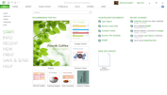
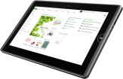
Trends impacting the way we work
Devices
People
Cloud
1 billion
For the first time in modern history, workplace demographics now span
50%
smartphones, 4 years ahead of predictions
3 generations
of enterprise customers
are “on the road” to cloud in some form
Notes:
1.2 Billion Smartphones, Tablets To Be Bought Worldwide In 2013; 821 Million This Year: 70% Of Total Device Sales
http://techcrunch.com/2012/11/06/gartner-1-2-billion-smartphones-tablets-to-be-bought-worldwide-in-2013-821-million-this-year-70-of-total-device-sales/

Slide 10
Commoditization (“Utilitization”) of Communication
Email / IM&P / Voice (Telephony)
We all have accepted consumer communication resources from the cloud – Skype, Gmail, Facebook, iMessage
Businesses are now rapidly adopting “Industrial Clouds” for their business needs.
Notes:
1.2 Billion Smartphones, Tablets To Be Bought Worldwide In 2013; 821 Million This Year: 70% Of Total Device Sales
http://techcrunch.com/2012/11/06/gartner-1-2-billion-smartphones-tablets-to-be-bought-worldwide-in-2013-821-million-this-year-70-of-total-device-sales/

Slide 11




Office Productivity
Essential for business and consumers
Comprehensive tools to do your best work
Enterprise-grade cloud services

Slide 12





Introducing the new Office
Comprehensive tools to do your best work
Enterprise-grade cloud services
Devices
Social
Cloud
Control

Slide 13
Introducing the new Office
Devices
Social
Cloud
Control
Fast and fluid experience with touch, pen, mouse & keyboard
Immersive touch-optimized Windows 8 apps
Support for Windows Phone, iOS & Android phones
Newsfeeds & microblogging, extend with Yammer
Pervasive social capabilities across Office
Multiparty HD video & Skype federation
Office - on demand, roaming & up-to-date
New cloud app development model
Enterprise-grade reliability and standards
DLP, data retention & unified eDiscovery
Reimagined deployment model for Office apps
Common management experience across Office 365

Slide 14


| Collaboration for Everyone
Enterprise Quality Support
Best SLA
in the Industry
Office
Exchange
SharePoint Lync
Familiar, Powerful
& Cross-platform
Service Plans for Everyone

Slide 15









Office 365 At a Glance
Familiar and full Office user experience
Fast deployment and broad management controls
Works with your on premises email and storage
Per-user licensing
Online meeting with desktop sharing
IM & Presence across firewalls
GAL search with contact card
Windows Live federation
Access documents offline
Document-level permissions
My Sites to manage and share documents
Share documents securely with Extranet Sites
Free/busy coexistence
Integrated personal archiving
Retention policies and legal hold
25Gb mailbox with voicemail & unified messaging
Notes:
Speaker Notes (1 minute):
Office 365 offers the tools and technologies to deliver leading experiences messaging with Exchange Online, collaboration with SharePoint Online, unified communications with Lync Online and of course rich Office application experiences with Office 365 ProPlus. (click) Office 365 ProPlus is the full version of Office, you can use it without an Internet connection, and it works with the customizations you have made over the years. Deploy it how you normally would deploy Office and you can use Office with your existing in-house SharePoint or Exchange services and whether you want to allow cloud file storage is up to you.
We’ll focus the rest of our time talking about Office 365 ProPlus and the optimizations we have made to improve user and IT experiences for adopting the new Office.

Slide 16




Office 365 works for everyone
Information Worker Offering
Task Worker Offering
Enable
Empower
Extend
Connect
Rich Productivity and Collaboration Solution to empower Information Workers
Cost effective offering for users with limited access to a Productivity solution today
Notes:
Today's companies need to support different types of users, including task workers who perform routine transactional work using a single application to collect structured data and knowledge workers who are responsible for more cognitive tasks requiring access to multiple information sources and applications. Both types of users need business applications that support industry-specific business processes that enable them to become productive quickly.
With a low cost Kiosk Worker Offering - our Plan K – many companies can finally reach all of the employees and stay connected. Kiosk plan gives everyone access a secure 1GB mailbox, Exchange ActiveSync & POP support, Messaging, calendar, contacts
Forefront antivirus and anti-spam, SharePoint Access; Site search capabilities; Office Web Apps
For example, Godiva Chocolatiers are finally able to connect all their store employees on one single secure messaging system with Office 365 that makes economic sense:
“User response has been overwhelmingly positive. Our employees are thrilled to have a modern, familiar email program, which makes them more efficient and productive.” Mike Strause, IT Architect, Global Shared Services, Godiva Chocolatier
Office 365 E-Plans offer a reach feature set that can enable your information workers to collaborate, access information from anywhere and empower them with:
User Segment Offers: Plan E Family
25 GB mailbox
500 MB SharePoint storage
Client connectivity
Mobility
Lync capabilities
Exchange and SharePoint capabilities
Office Professional Plus
On-premises access rights

Slide 17
Yammer and Office 365
Summer
Fall
Winter
Today
Tomorrow
Coming Up
Connected Experiences
New experiences that combine social, collab, email, instant messaging, voice, and video
Option to replace SharePoint
Newsfeed with Yammer
New user experience
External Communication
Yammer app for SharePoint
Document Conversations
Email Integration
SharePoint 2013
on-premises guidance
Office 365 Single sign-on
Enhance Messaging

Slide 18
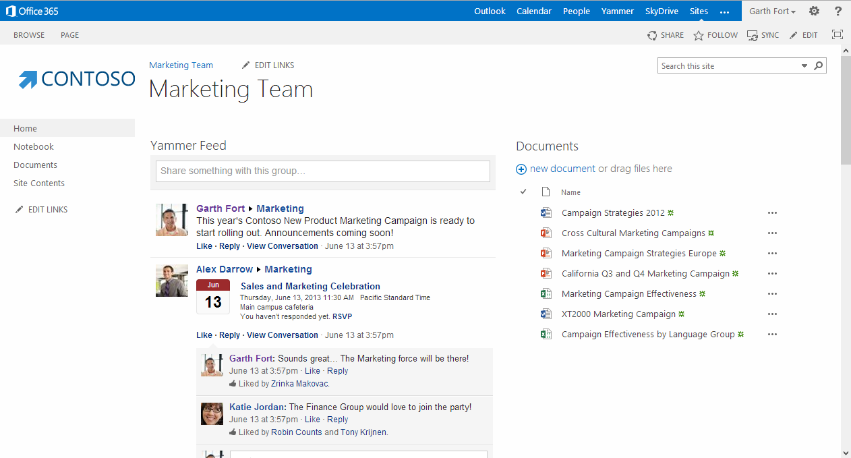
SharePoint 2013

Slide 19
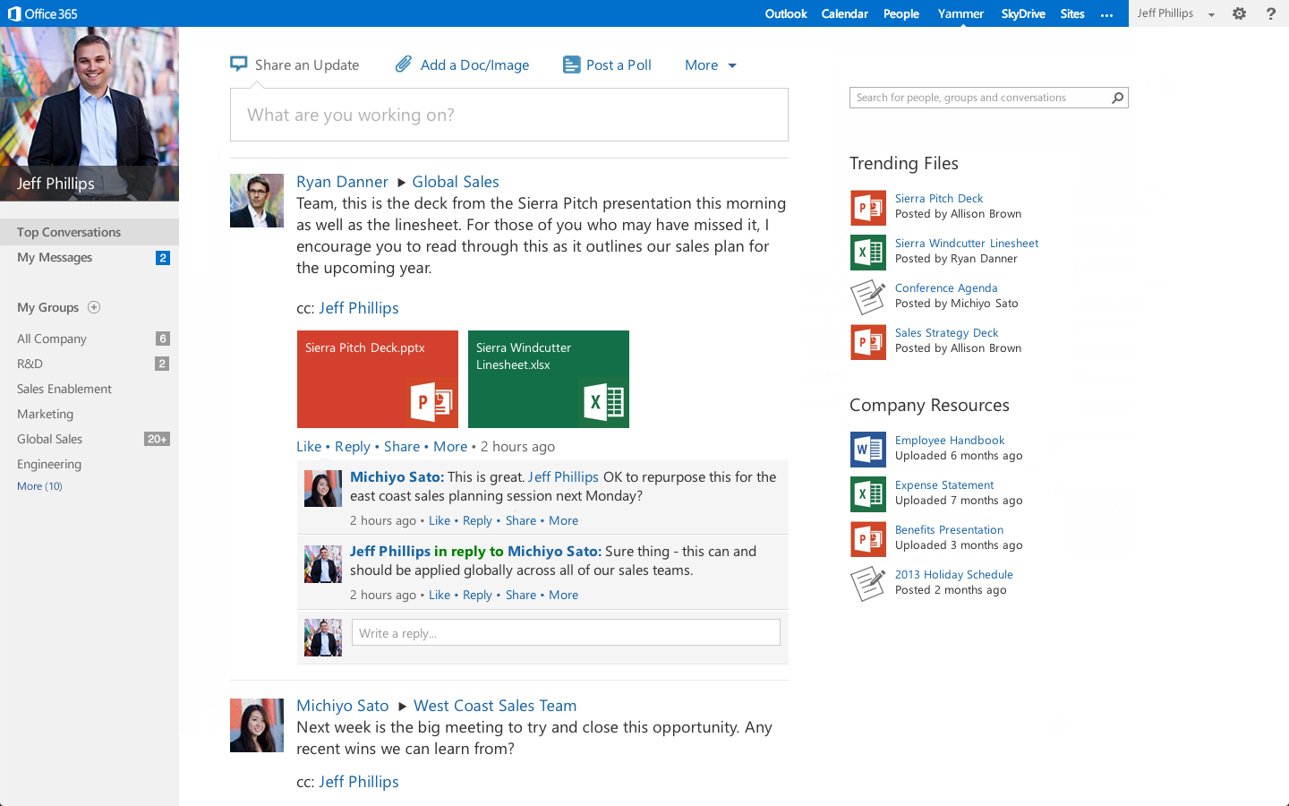

Slide 20









Each year customers of Microsoft’s cloud productivity services…
222
Fly
million
passengers
Build
6
million
automobiles
in the United States alone
Many of the world’s largest and most recognizable global brands run on Microsoft’s cloud productivity services.
27
Serve
billion
meals
41
16
of the
Interbrand Top 100
Sell
billion
cans of soda
4
Make
billion
cups of coffee
Notes:
Microsoft has been providing cloud productivity services for over three years, and we have had great success in the marketplace:
40 million+ paying customers of Microsoft Online Services
More than 9,000 business customers
More than 500 government entities
More than 50% of the Fortune 500
70% Exchanging from Notes
16,000 partners committed to BPOS
Global reach: Available in 40 countries and localized into 20 languages
Depending on your customer, you can pull specific customer references from this site and talk through in this slide: http://infoweb2007/onlineservices/evidence/Pages/CaseStudies.aspx.
Some approved customer quotes:
“The move to Microsoft Online Services will help cut operational costs by an estimated 30% and create a variable cost model that will provide increased flexibility in the future.” Ingo Elfering, VP, Information Technology Strategy, GlaxoSmithKline
“Our users consistently rave about the move to Microsoft Online Services, providing familiar, intuitive solutions that we could trust with our business communications.” Chris Millington, Global CTO, McDonald’s Corporation
“We looked at a variety of cloud-based offerings, and only Microsoft could meet our requirements for reliability. We have already started our rollout, and with Exchange Online, we will consolidate 42 e-mail systems into one, reducing our IT costs by at least 30%.” Olivier Baldassari, CIO, Rexel Group

Slide 21


Customer Examples
"Coca-Cola Enterprises needed to simplify its communication and collaboration technologies to provide better business value to our employees. Microsoft Online gave
us the technology to do so and exceeded our expectations."
John Key
Assistant Director of Communication
and Collaboration Technologies
Coca-Cola Enterprises
“With the successful rollout of Microsoft Online Services to our North American stores, we have demonstrated that we
can go into the ‘cloud’ with confidence.”
John Shepard
Director, Global IT Infrastructure Services Starbucks
“User response has been overwhelmingly positive. Our employees are thrilled to have a modern, familiar email program, which makes them more efficient
and productive.”
Mike Strause
IT Architect, Global Shared Services
Godiva Chocolatier
Notes:
Coca-Cola
Coca Cola Enterprises (CCE) opted for the cloud and implemented Microsoft-based hosted worldwide intranet with messaging and collaboration tools. Employees can access their data and information from any device, boost their productivity, and focus on their customers.
Story: With increasing competition in the marketplace, CCE needed a more effective way to collaborate with their employees, to increase their productivity, to enable better flow of information, and to create more time for sales persons to engage with customers. Their worldwide presence required employees and executives to spend numerous hours on the road every week, travelling to internal meetings. Microsoft Online Services technologies enable CCE to save travel expenses through online meeting tools and collaboration platforms that span time zones and geographies.
Case study: http://www.microsoft.com/casestudies/Case_Study_Detail.aspx?casestudyid=4000004584
Video: http://www.microsoft.com/showcase/en/US/details/470b9f4c-bac8-4be9-b22a-d1a6953ef6a7
QUOTE: "Coca-Cola Enterprises needed to simplify its communication and collaboration technologies to provide better business value to our employees. Microsoft Online gave us the technology to do so and exceeded our expectations." John Key, Assistant Director of Communication and Collaboration Technologies, Coca-Cola Enterprises
Starbucks
Starbucks continues to use Microsoft technology on-premises in its corporate headquarters, while rolling out 18,000 laptops using Exchange Online and SharePoint Online to store managers.
QUOTE: “With the successful rollout of Microsoft Online Services to our North American stores, we have demonstrated that we can go into the ‘cloud’ with confidence.” John Shepard, Director, Global IT Infrastructure Services, Starbucks
QUOTE: “It’s important to remember that we rolled out this entire project at a time when the company was under pressure to spend no money at all. Our ability to complete the project on time and under budget speaks to the efficiency of Microsoft Online Services and the ease of implementation.” John Shepard, Director, Global IT Infrastructure Services, Starbucks
QUOTE: “Web-based distribution of new-product materials enables Starbucks to be much more nimble in meeting customer needs,” Shepard adds. “Instead of taking six months to introduce a new product, we can do it in just a few weeks by communicating so quickly with partners.”
Godiva
Link to the case: http://www.microsoft.com/casestudies/Case_Study_Detail.aspx?CaseStudyID=4000008333

Slide 22

Relentless on Security
Deep Experience
Secure Development Lifecycle
5 Layers of Security
Proactive Monitoring
Access Restriction
Data replicated in geo-redundant datacenters to protect against datacenter wide failures
Backed by a 99.9% financially backed Service Level Agreement
"The robust security and reliability that Microsoft was providing with Office 365 was essential—we would not have agreed to a hosted solution without making sure that the State’s data would be secure.”
Tarek Tomes, Assistant Commissioner (OET),
State of Minnesota
Notes:
Relentless on security
As a pioneer in online data services, Microsoft builds on deep industry experience to incorporate cutting-edge security practices from development through to administration and maintenance.
Deep Experience. We have developed our practices and policies as a result of over 15 years of experience in providing security for online data.
Secure Development Lifecycle. Microsoft’s Secure Development Lifecycle ensures that security and privacy is incorporated into our products by design, from software development to service operations.
5 Layers of Security. Data is secured in 5 different layers – data, application, host, network and physical.
Proactive Monitoring. We proactively monitor Office 365 services to identify potential known and unknown threats by predicting malicious behavior, and also monitor for irregular events that may indicate threats.
Access Restriction. Microsoft restricts our production server access to a short list of critical operations personnel.

Slide 23

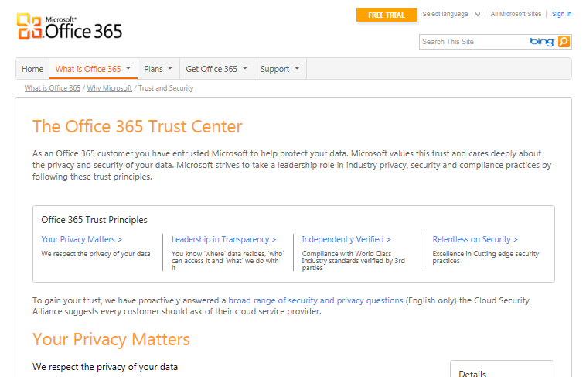
Trusting the service
Clear messaging with plain English
Details for security experts
Links videos, whitepapers
http://trust.office365.com
Notes:
ADD TRUST CENTER LINK
We don’t scan your email or documents for building analytics, data mining, advertising, or improving the service.
Microsoft strives to be a leader in industry privacy, security and compliance practices. By focusing on the following principles, Microsoft is consistently and proactively working towards earning your trust.
To learn more about privacy and security at Microsoft, you can review the documents here. These documents include Microsoft’s response to questions suggested by the Cloud Security Alliance for customers seeking a cloud provider. For a full list of the products covered by the Trust Center content, click here.

Slide 24
Microsoft: Unmatched in the Cloud
15+
years in consumer and
business services
30k
engineers involved
in cloud-based activities
200+
$2.3B
invested in cloud
infrastructure
services, delivered 24x7
Certifications
Security
  FISMA certified
  EU Model Clauses
  SAS 70/SSAE 16
  ISO 27001 compliant
Highly secure,
compliant infrastructure
Notes:
Federated operations
centers 24x7
Highly secure, compliant infrastructure
FISMA certified, SAS 70/SSAE 16, and ISO 27001 compliant
Carbon footprint reduction
99.9% uptime, financially backed SLAs
>15 years in consumer and business services
9.9 billion messages a day via Windows Live Messenger
1 petabyte+ per month of updates via Windows Update
Windows Azure: used by customers in 41 countries
Office Web Apps: 50M users
$2.3B+ in cloud infrastructure
200+ services, delivered 24x7
Geo-distributed data centers
Rapid modular model
30,000+ engineers involved
in cloud-based activities
2,000+ people in cloud infrastructure engineering
and operations
Timing: 4 minutes
Presenter Guidance:
For each box, choose a few examples from the slide to illustrate the scale of our cloud services.
Key Points:
As a business cloud service provider, Microsoft is unmatched for the extent of our experience and our level of investment in the cloud.
We deliver services to millions of users and servers worldwide, we have made a substantial investment in data centers and people to support our cloud services, and we are fully committed to operational excellence.
Script:
No other company can match Microsoft in the business cloud today on the extent of our experience and investment in building and running cloud services:
We serve millions of users and our solutions run on millions of servers. We have more than 15 years of experience with cloud computing through both consumer and business services (starting with MSN in 1995).
We have spent over $2.3 billion dollars in building out our data center infrastructure to support our cloud platform. We deliver over 200 services 24 hours a day, seven days a week.
In terms of the physical infrastructure:
We have geo-distributed data centers, providing confidence that there is built-in redundancy if a data center is affected by a natural disaster. We consider over 35 weighted criteria including proximity to a stable power source and fiber optic networks, availability of affordable skilled labor, and affordable energy rates to determine the long-term viability of each site.
We also build our data centers using industry-leading modular designs, so they can be constructed more quickly for lower upfront and ongoing costs.
In terms of people resources, over 30,000 Microsoft engineers are involved in cloud-based activities, and we have more than 2,000 people in cloud infrastructure engineering and operations.
We’re committed to operational excellence for Microsoft Online Services.
Our federated Microsoft Operations Center has failover facilities in Redmond, India, and California to help ensure business continuity 24 hours a day, 7 days a week.
We obtain third-party audits and certifications so you can trust that our services are designed and operated with stringent safeguards.
Office 365 has International Organization for Standardization (ISO) 27001 certification and complies with European Union (EU) Safe Harbor principles.
The data centers and physical infrastructure that Office 365, Windows Azure, and other Microsoft online properties run on:
Have ISO 27001 certification.
Meet EU Safe Harbor principles.
Are audited annually against Statement on Auditing Standards No. 70 (SAS 70) (and will be audited against Statement on Standards for Attestation Engagements [SSAE] 16, which effectively replaces SAS 70, going forward).
Have Federal Information Security Management Act of 2002 (FISMA) certification.
We’re committed to operating efficient services and are continually improving our data center designs to save energy and lower their carbon footprint. Compared with data centers built just three years ago, our new data centers consume half the energy, and our goal is to construct data centers that average 1.125 in their power usage effectiveness (PUE) (where optimal energy use is 1 PUE), compared with an industry average of 2 PUE.
Our cloud services come with a financially backed 99.9 percent service level agreement (SLA)—if your applications and data aren’t available at least 99.9 percent of the time, we’ll compensate you.
Additional Information:
Online Services certification and security: http://www.microsoft.com/online/legal/v2/en-us/MOS_PTC_Security_Audit.htm

Slide 25


Microsoft’s proven decision framework helps you move to the cloud confidently
Getting to the cloud
confidently!
1
Security?
Compliance?
“Formal Decision Frameworks Facilitate Cloud Investment Optimization
The cloud promises to deliver a range of benefits, …which need to be examined carefully and mapped against a number of challenges, including security, transparency, and integration needs. “
Source: Gartner; Five Cloud Computing Trends That Will Affect Cloud Strategy Through 2015; April 2, 2012
Support?
Deployment?
Evaluate
2
Deploy
Notes:
Microsoft has experience in getting more than 10 Million users to the cloud through a proven framework that enables a solution fit for your needs and a proper migration and change management plan.
The Customer Decision Framework outlines eight key decision points for enterprise customers. Not every customer needs to think about the same key points when moving to the cloud, but our experience has shown that typically all need to be addressed, before you can start benefitting from cloud solutions and experience a smooth transition and deployment experience.
This framework has been used by many of our customers, and even received great feedback from Gartner in a recent briefing.
Capability and Technology Fit
Business Value
Security, Privacy, Data Sovereignty
Legal & Compliance
Transaction
Governance
Services and Support
Partner
Internally this framework can help establish expectations with your key stakeholders and help in orchestrating a v-team by defining who does what, when, and to whom for each MSSP stage when driving the eight customer decisions.
[Note to sellers: The full details can be seen internally at http://office365onramp under the CDF Page. CDF will be executed by the SSP Office 365, but the top level introduction should be shared with customers at an early stage. It has proven to be a good differentiator for our solution.]

Slide 26

Microsoft Office 365 - Cloud Principles
Services are highly configurable and scalable without customization.
Services are under the Microsoft Security Policy.
We provide transparency in data location and transfers.
We audit on your behalf and provide certification reports.
Microsoft’s liability is capped, consistent with industry standards.
Office 365 is an evergreen service. Customers need to stay current.
Our solution evolves rapidly with a documented roadmap.
We provide services offers to help you migrate to the cloud efficiently.

Slide 27

Deployment options
1
Do it yourself
2
Microsoft partners
3
Microsoft Cloud Vantage Services
Notes:
Deploying Office 365 helps you realize business value from Office 365 and make the most out of your cloud investments.
Get started:
Begin planning with Microsoft Cloud Vantage Services or one of our Qualified Cloud Deployment partners and we will help fund the engagement.

Slide 28
Choice
Microsoft Office 365 Cloud Deployment Program
    Readying your enterprise partner of choice, through the Cloud Deployment Program, to deploy Office 365
Support
    Providing, for your benefit, deep domain Office 365 deployment support direct to your chosen Cloud Deployment Partner
Sustaining and cultivating your existing investment in high value strategic partnerships when deploying
Office 365
Advancement
    Ensuring continued ongoing investment in your strategic partner to allow you to persistently capitalize on the latest innovations in Office 365

Slide 29
Deep Expertise
    Single point of accountability for Office 365 across the lifecycle
    Global network of technical and operations experts
    Broad industry expertise
Cloud Vantage Services
Collaboration
    Partner for smooth program orchestration
    Increase IT agility through change management and roadmap planning
    Align on measurable business value results
Microsoft’s Cloud Vantage Services helps you realize business value from your Office 365 investments.
Full lifecycle
    Enable end-users and IT team for transition to cloud
    Prepare IT environment for Office 365 consumption
    Deliver on time deployment
    Provide enterprise grade support

Slide 30
For CAL Suite Customers
The Time is NOW
Office 365 Service Plan Offer
Promotional Offer +
Deployment Offer
 | Your EA License
Service Plan | Core CAL + Office
Office 365 E3 | $4.50 per user/month
Exchange Online Plan 1 | $1.50 per user/month
Add Office 365 to your EA.
Microsoft will help offset your deployment cost.
Deployment Investment
  Minimum 250 seats
  $40 per seat for first 3,000 seats
  $5 per seat for each additional seat
Notes:
There has never been a better time to move your company to the cloud. For a limited time, CAL Suite customers can add Office 365 to their EA with a small uplift, and we’ll help offset the cost of deployment. So you can enjoy all the benefits of our premium cloud services right away.
NOTE 1: Promotional SKUs will be lead status through local LSS and only available through amendment
NOTE 2: Customers can buy SKU quantities up to number of CAL Suite (and Office where applicable) licenses they own; does not apply to K2
NOTE 3: Please choose the right Promo slide based on your customer EA Licenses Position
Requires Office Professional Plus; Office Standard seats must step up to Professional Plus to leverage E3 promo SKUs
Hero Motion:
Add E2 for a $3 or $4 per user, per month uplift (to ECAL or Core CAL, respectively).
Comments:
Same uplift applies to equivalent GOV SKUs
EA Level A, USD prices shown, rounded to nearest $0.50
Exact uplift depends on customer price level
Office 365 E4 is included as part of the promo and will also qualify for deployment funding, but sales tools to support the promo on E4 will not be ready until January 1, so transactions for E4 will take place starting then. Pricing guidance will be provided to support proposals and selling ahead of the promo system availability.
Deployment funds up to U$ 250,000 per customer
Deployment Offset:
Partner Eligibility
MCS and external partners qualify
423 Cloud Deployment Partners⁽³⁾
Additional partners via Ignite training⁽⁴⁾
Requires minimum purchase of 250 seats
Only E2, E3, Exch P1, and Exch P2 eligible; requires respective deployment, however funds can be utilized on any O365 product deployment
Eligibility based on having Cloud Accelerate designation + Messaging competency
14 in person Ignite events in Q2 & Q3 + online Ignite training available December 2012 (target launch)
FTE or vendor must submit request

Slide 31
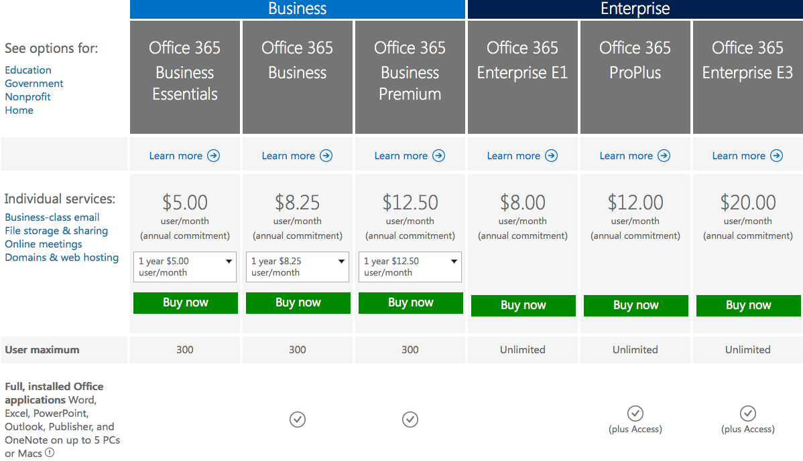
**Includes Yammer**
**Tablet Edition as well**

Slide 32
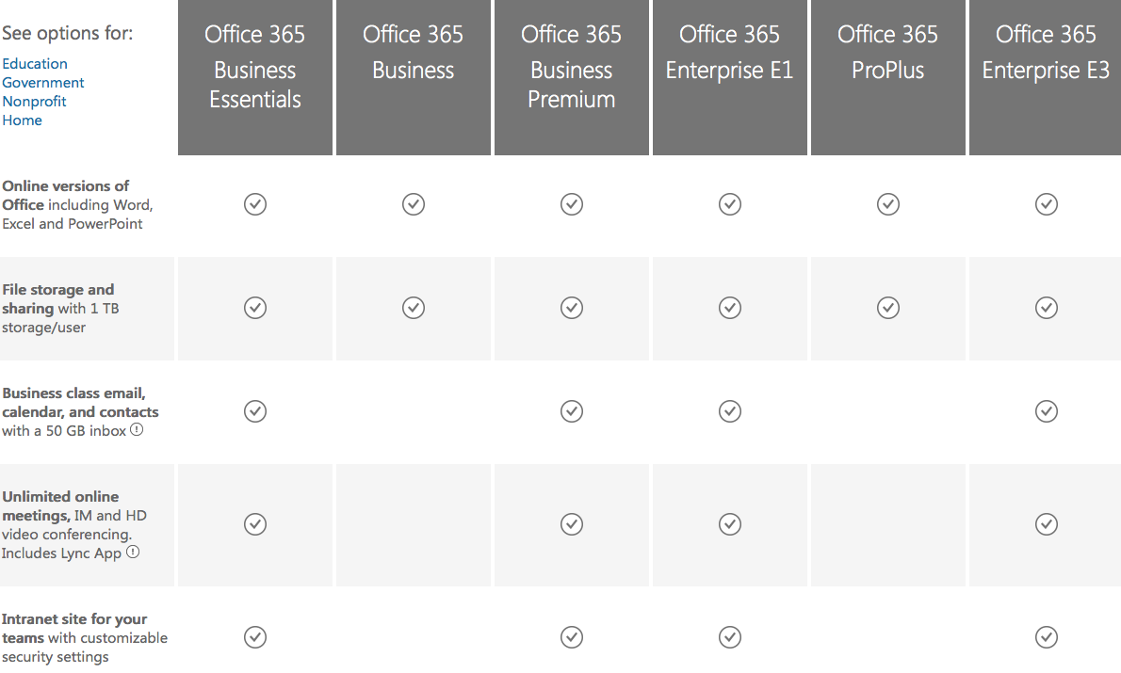

Slide 33
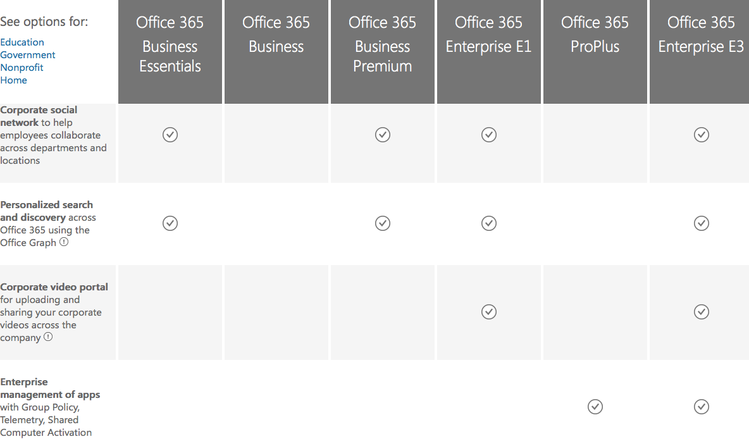

Slide 34
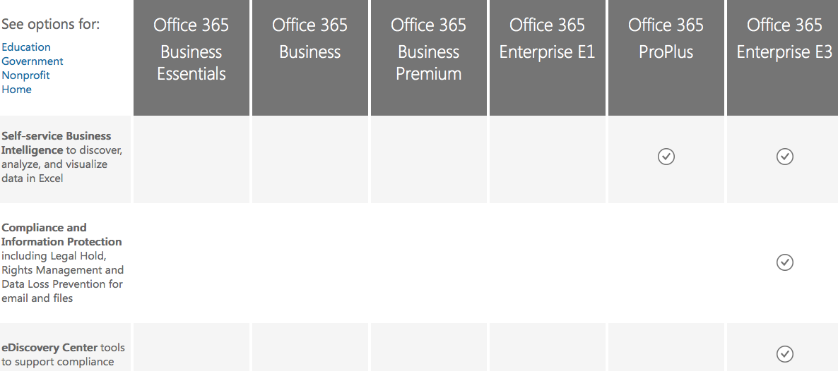

Slide 35
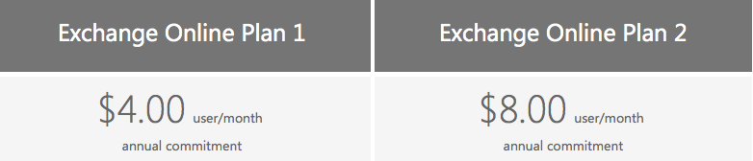
Standalone Email Plans
Features:
50GB Mailboxes and messages up to 25MB
Outlook Support
Web-based Access
Mobility (Mobile Device access)
Shared Calendar and Contacts
Apps for Outlook (3rd Party App Integration)
In-Place Archive
Includes E1 Features Plus:
Unlimited Email Archive Storage (Mailbox is still 50GB)
Hosted Voicemail
DLP

Slide 36
If this is all about Microsoft Public Cloud,
What can a Microsoft Technology Partner Provide?

Slide 37
Encore Cloud Unified Communication Migrations (Public, Private and Hybrid)
    Email (Exchange or Exchange Online)
    Instant Messaging and Presence (Lync or Lync Online)
    Unified Messaging (Exchange or Exchange Online)
    Collaboration (SharePoint / Yammer)
Encore Office 365 Enablement
Encore Cloud Services
    Provide Cloud-based Email Archiving and Off-Cloud Backup
    *Office 365 only provides 30 days of email recovery
    Provide Cloud-based HA for AD, ADFS, AASync
    **Office 365 requires a full-time AD and ADFS connection
Encore Office 365 Enhancements
Encore is a Managed Gold Partner

Slide 38
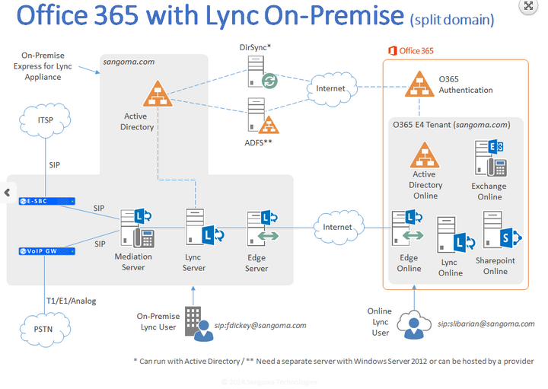

Slide 39
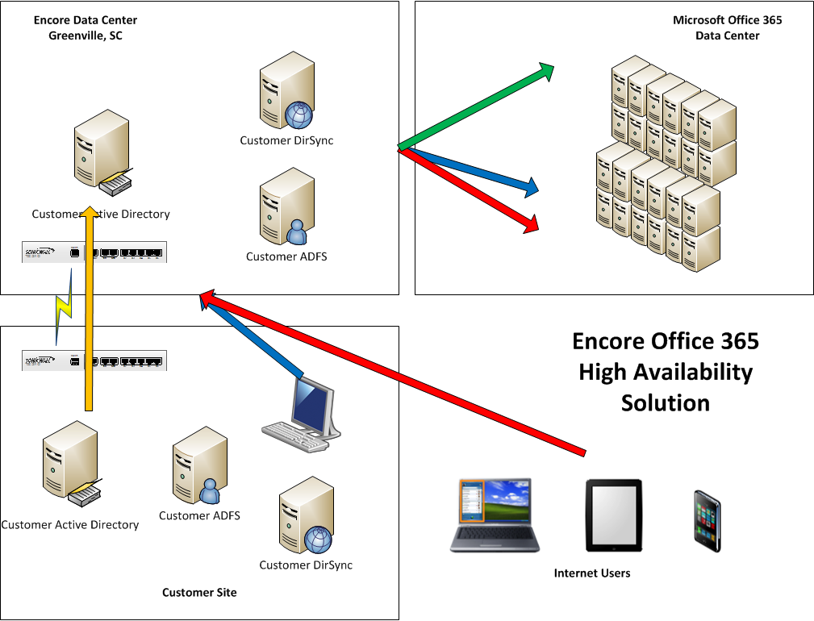

Slide 40
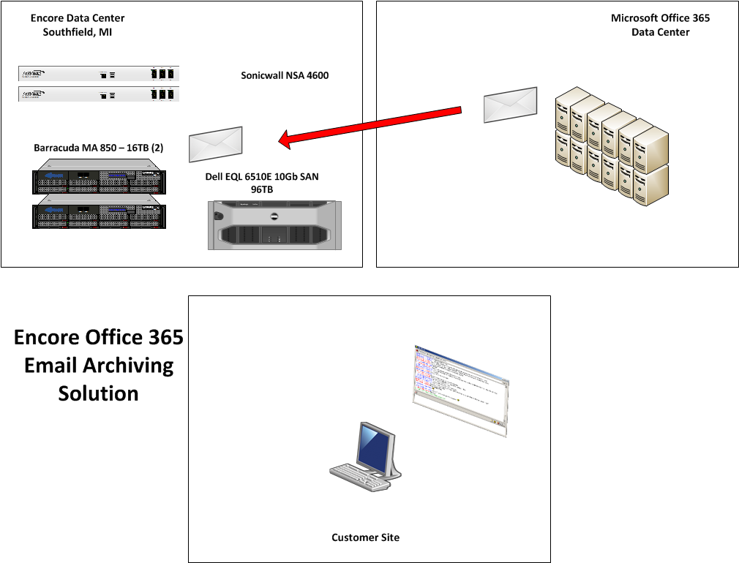

Slide 41
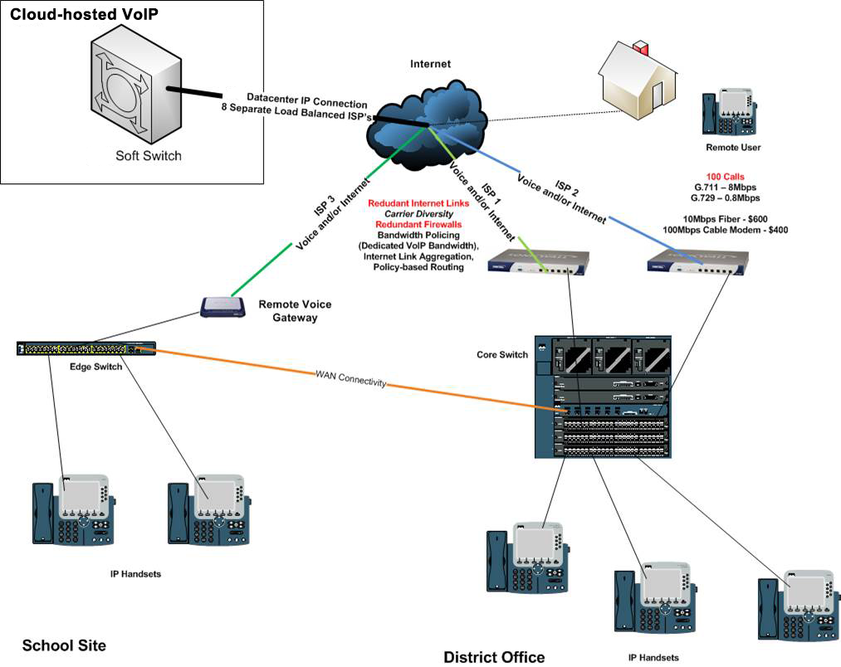
Other Cloud Offerings
Cloud-hosted VoIP
2013 - Encore Technology Group, LLC. - All rights reserved.
http://www.encoretg.com

Slide 42
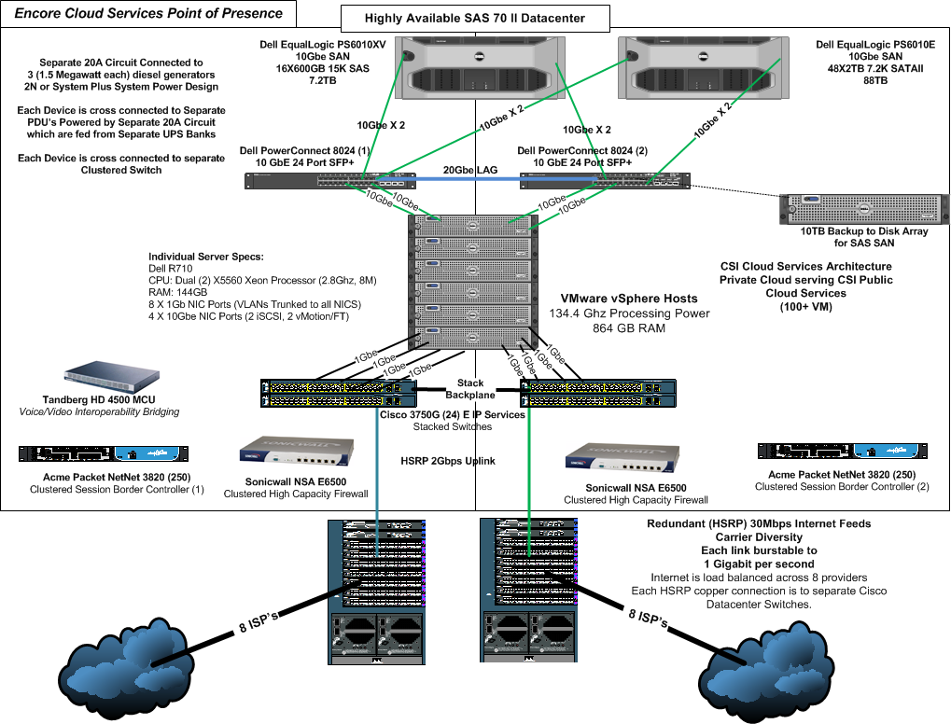

Slide 43
Next steps
Test drive the new Office in our Customer Immersion Experience Centers
Request a technical briefing
Talk to a reference customer
1
2
3

Slide 44
What are your questions?
Q A
&

Slide 45


Slide 46

© 2012 Microsoft Corporation. All rights reserved. Microsoft, Windows, and other product names are or may be registered trademarks and/or trademarks in the U.S. and/or other countries.
The information herein is for informational purposes only and represents the current view of Microsoft Corporation as of the date of this presentation. Because Microsoft must respond to changing market conditions, it should not be interpreted to be a commitment on the
part of Microsoft, and Microsoft cannot guarantee the accuracy of any information provided after the date of this presentation. MICROSOFT MAKES NO WARRANTIES, EXPRESS, IMPLIED OR STATUTORY, AS TO THE INFORMATION IN THIS PRESENTATION.

Slide 47
Why Customers are Moving to Office 365
Business strategy
Competitive migration
Shift IT personnel
from non-core to core
No server patching
and upgrades
Extend enterprise
1
2
3
4
5

